Slide 1
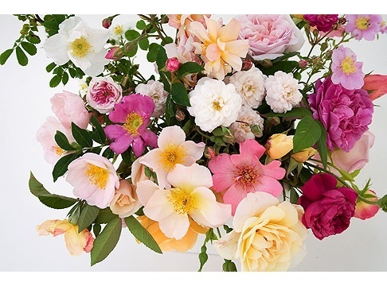
Variation and selection

Slide 2
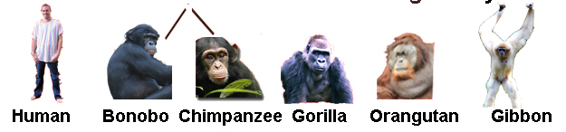
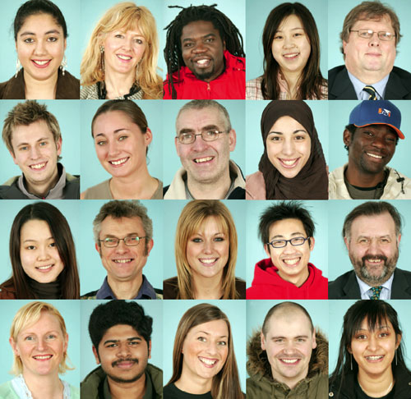
What do you mean by variation..?
Differences between species
Differences within a species

Slide 3
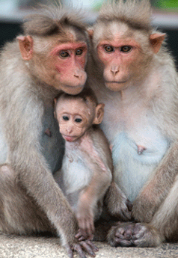
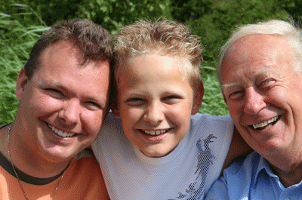
VARIATIONS:
SPECIES : A species is a group of organisms that are able to interbreed and produce fertile offspring.

Slide 4
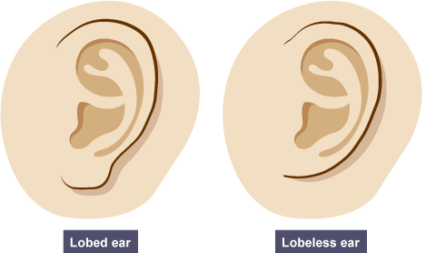
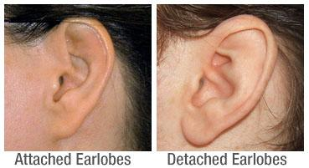
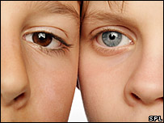
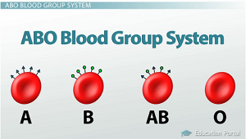
Causes of variation : Genetic causes

Slide 5
Causes of variation : Environmental causes
Climate,
Diet,
Accidents,
Culture and
Lifestyle.

Slide 6
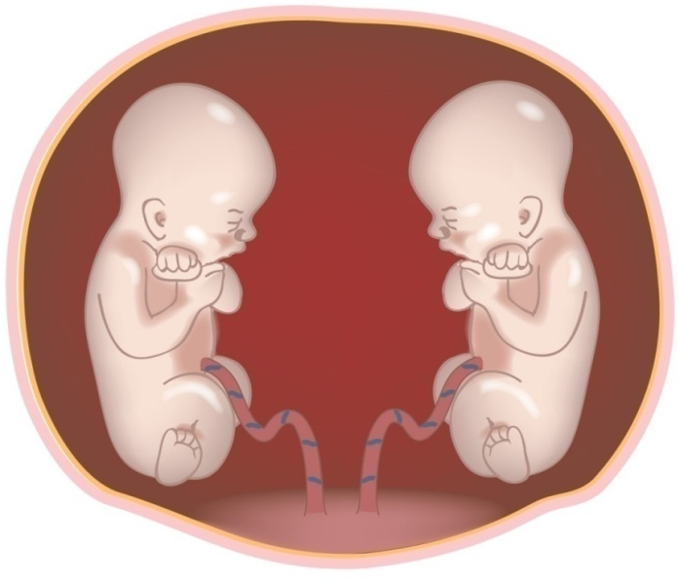
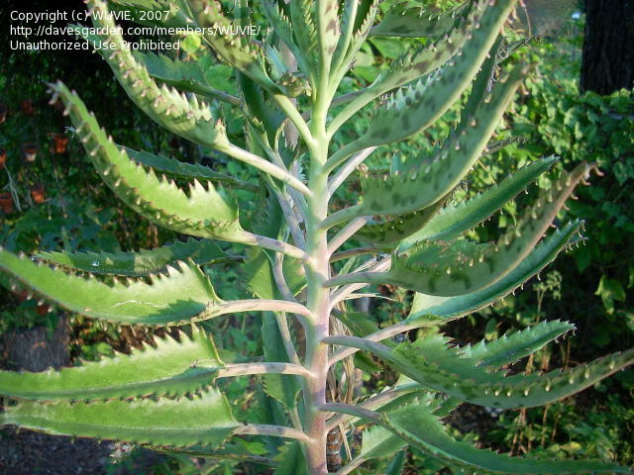
Causes of variation : Both genetic and environmental
a person might inherit a tendency to be tall, but a poor diet during childhood will cause poor growth
plants may have the potential for strong growth, but if they do not receive sufficient mineral resources from the soil, they may hardly grow at all

Slide 7
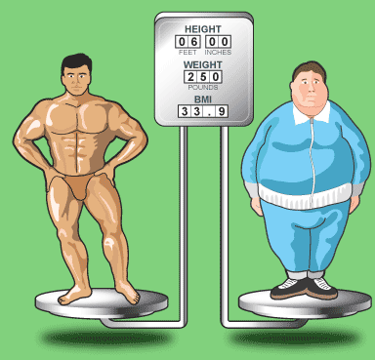
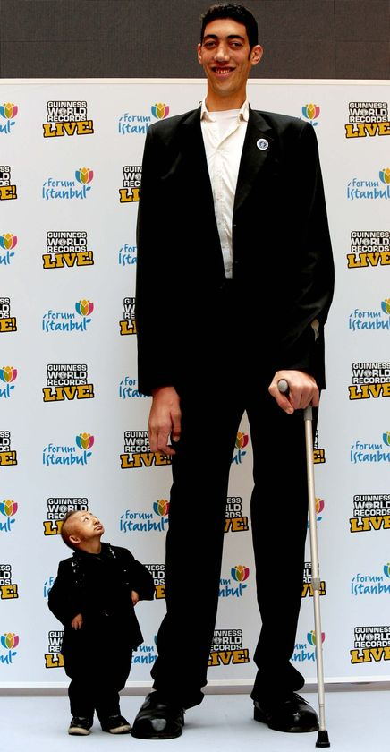
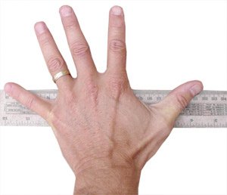
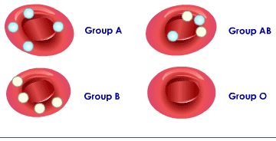
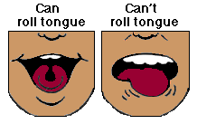
CONTINUOUS VS DISCONTINUOUS VARIATION
Variation, the small differences that exist between individuals, can be described as being either discontinuous or continuous.

Slide 8
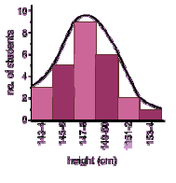
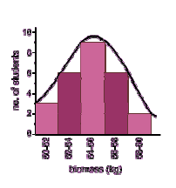
Continuous variation
Continuous variation shows a complete range of the characteristics within a population.
Example:
Height is an of continuous variation - individuals can have a complete range of heights, for example, 1.6, 1.61, 1.62, 1.625 etc meters high.
Weight;
Hand span
Shoe size
Continuous variation is the combined effect of many genes (known as polygenic inheritance) and is often significantly affected by environmental influences.

Slide 9
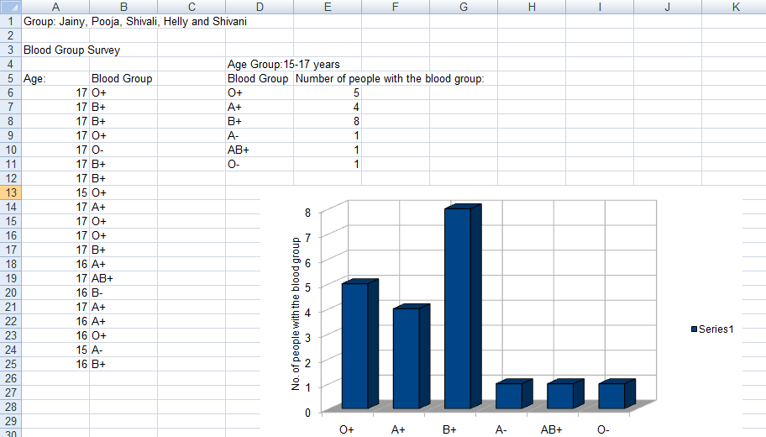
Discontinuous variation

Slide 10
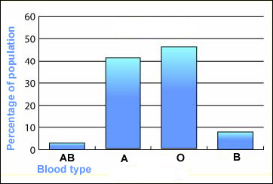
Discontinuous variation
This is where individuals fall into a number of distinct classes or categories, and is based on features that cannot be measured across a complete range.
There are no intermediates between categories.
You either have the characteristic or you don't.
Examples:
Blood groups are a good example: you are either one blood group or another - you can't be in between. Such data is called discrete (or categorical) data.
Discontinuous variation is controlled by alleles of a single gene or a small number of genes.
The environment has little effect on this type of variation.

Slide 11
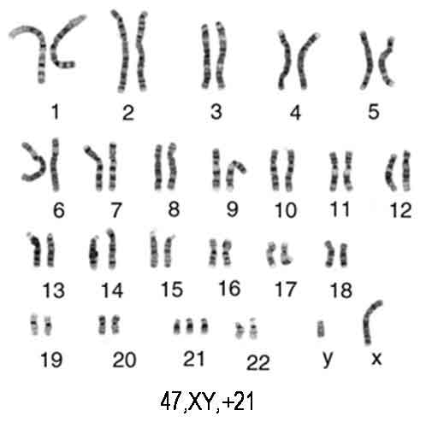
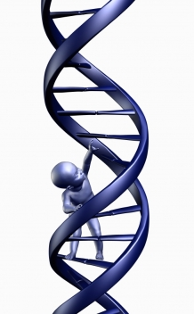
17.2 MUTATION

Slide 12
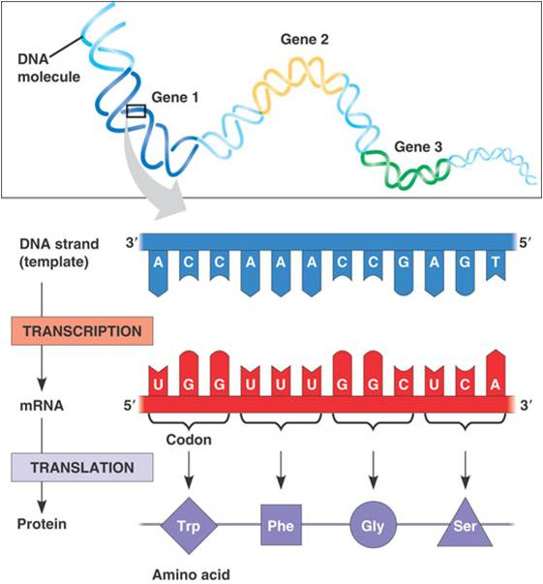
Protein synthesis

Slide 13
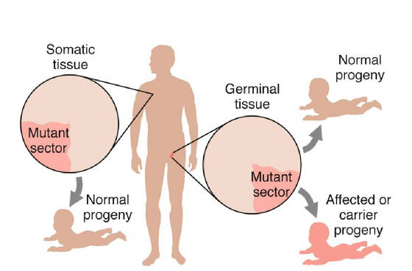
What Are Mutations?
A mutation is a spontaneous change in a gene or a chromosomes.

Slide 14
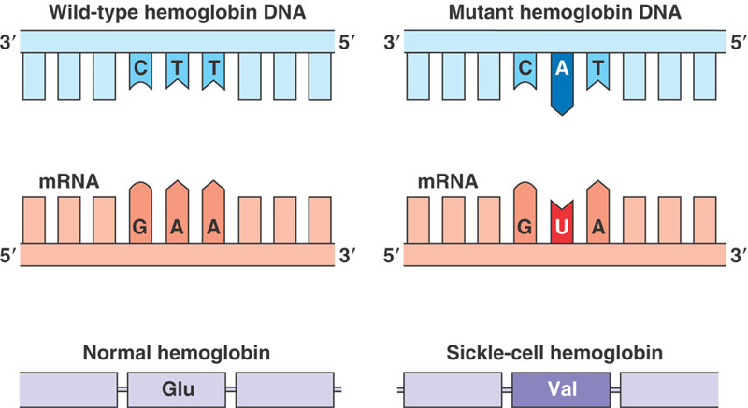
Types of mutation
1. Gene Mutation
Change in the nucleotide sequence of a gene
May only involve a single nucleotide.

Slide 15
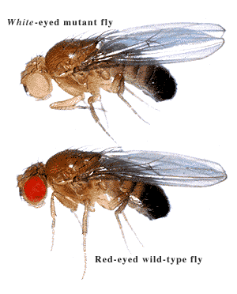
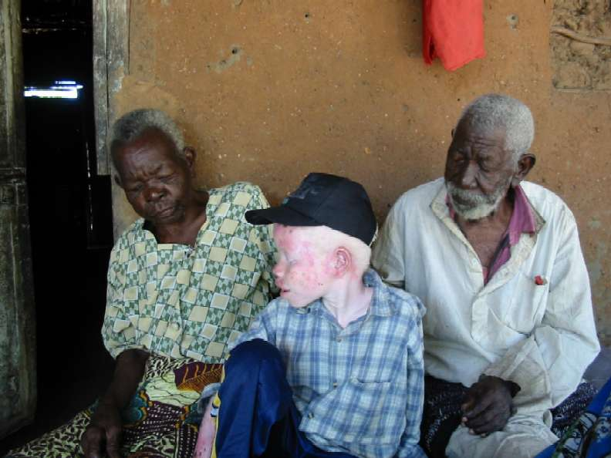
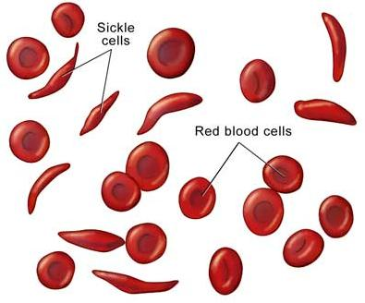
Gene Mutation Examples
Gene mutation in drosophila
Albino
Sickle cell anemia

Slide 16
Describe the features of sickle cell anaemia.
fewer red blood cells
less elastic / less flexible / sickle-shaped, red blood cells
haemoglobin is abnormal shape
haemoglobin / blood, less efficient at transporting oxygen
less respiration
less energy / fatigues / exhaustion / less active /
feeling faint / breathlessness
death of tissues linked to oxygen supply
capillaries are blocked
‘sickle cell crisis’
slow / poor, growth
susceptible to infections
reduced life span

Slide 17
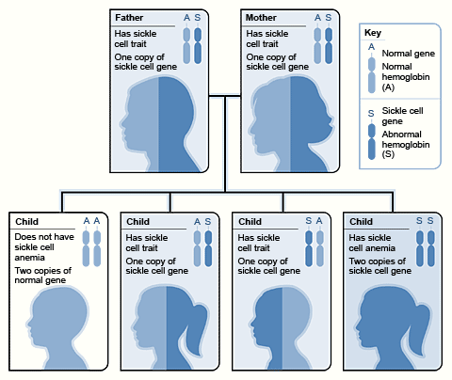
Example : Sickle cell anaemia
Sickle cell

Slide 18
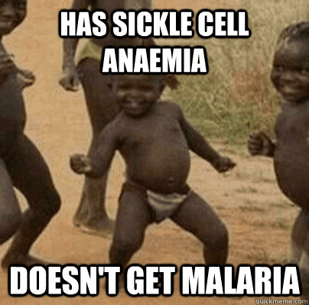
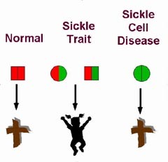
Sickle cell anaemia & its incidence in relation to that of malaria
Explain why Hb^{S} is more common in parts of tropical Africa

Slide 19
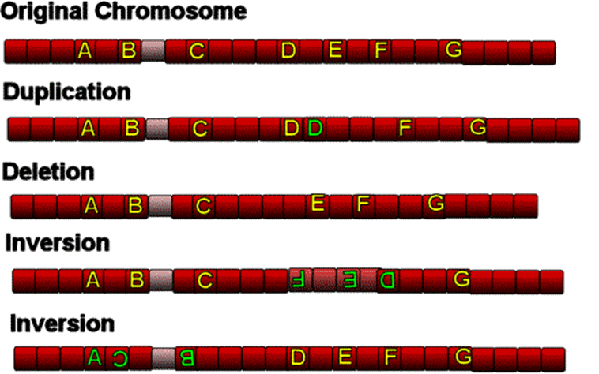
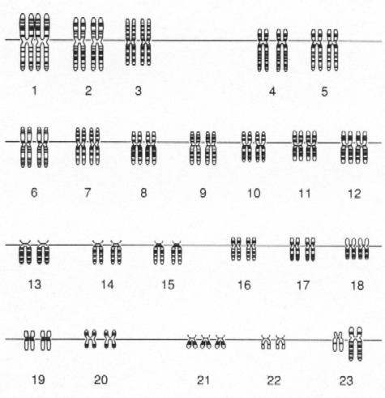
Chromosome Mutation : Structure
Types of mutation
2. Chromosome Mutation :
Structural and numerical
The loss or gain of part of a chromosome
  Changing the structure or number of a chromosome

Slide 20
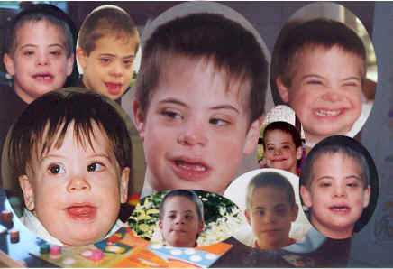
2. Chromosome Mutation : Number

Slide 21
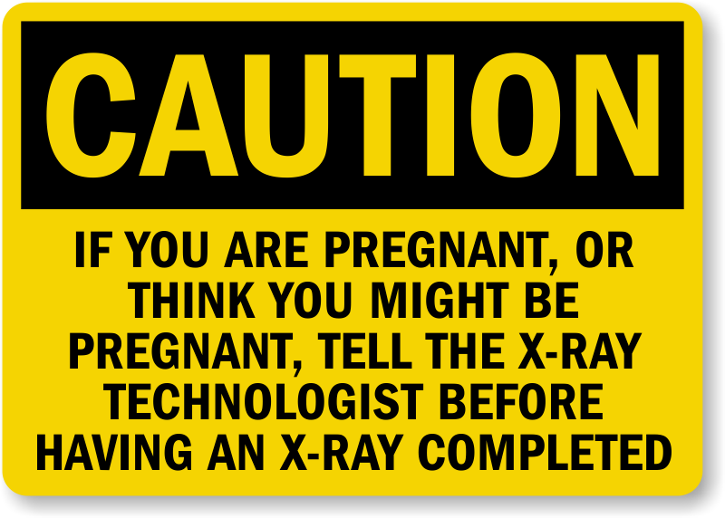
Causes of mutation
Mutagens such as:
Naturally: DNA replication error
X-rays
UV rays
Chemicals (tobacco smoke)

Slide 22
Are Mutations Helpful or Harmful?
Often mutation can be harmful.
Some mutation are beneficial .
Some mutation have no effect at all.

