Slide 1
Variation and selection

Slide 2
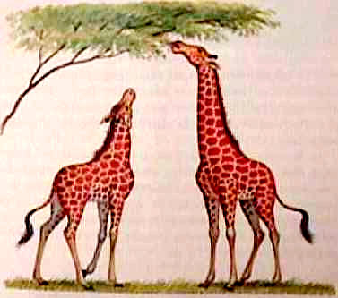
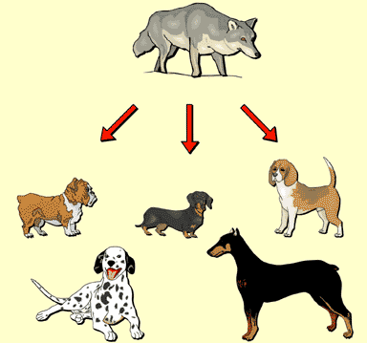
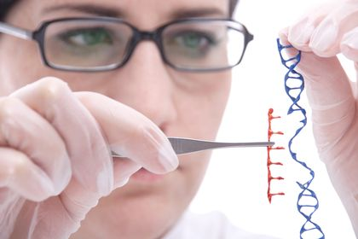
The characteristics of a species can be changed by:
Natural selection
Artificial selection
Genetic engineering

Slide 3
Natural selection
Natural selection is the process by which organisms that are well adapted to their environment have greater chance to breed and pass on their genes to the next generation than those are less adapted.
It can be summarised as follows:
A) Variation
B) Overproduction
C) Competition
D) Adaptation
E) Evolution

Slide 4
Natural selection

Slide 5
Evolution

Slide 6
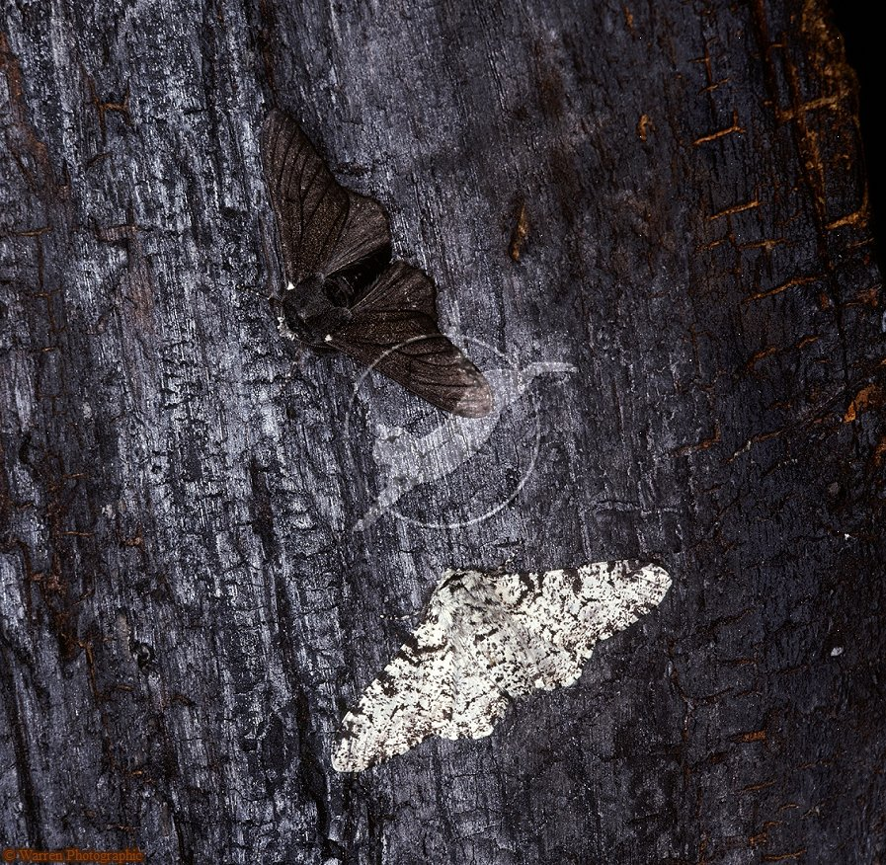
Example of natural selection: In peppered moth
In 1850
Common form : speckled
Rare form : Black
In 1859
In the Manchester area the black variety increased up to 98% in peppered moth population.
Explanation can be given by Natural selection

Slide 7
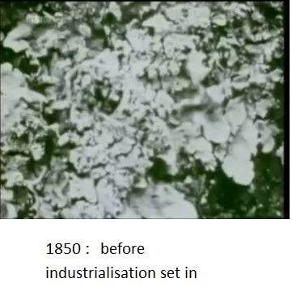
Example of natural selection: In peppered moth
Predators will spot a moth against a contrasting background.

Slide 8
Example of natural selection : Sickle cell anaemia
Reduced survival;
Selected against by malaria
Positive selection due to malaria resistance
Reduced survival;

Slide 9
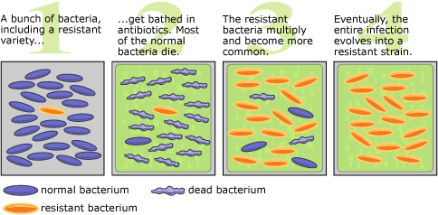
Describe the development of strains of antibiotic resistant bacteria as an example of natural selection

Slide 10
Artificial selection
Artificial selection is the process of changing the characteristics of animals or crops by artificial means

Slide 11
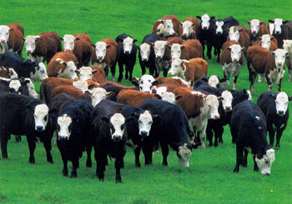
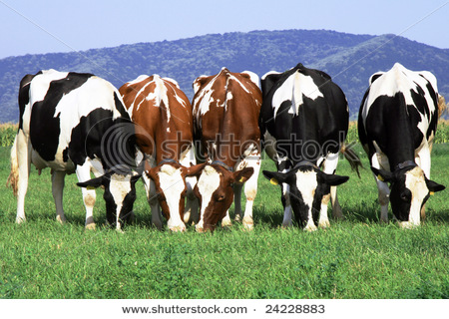
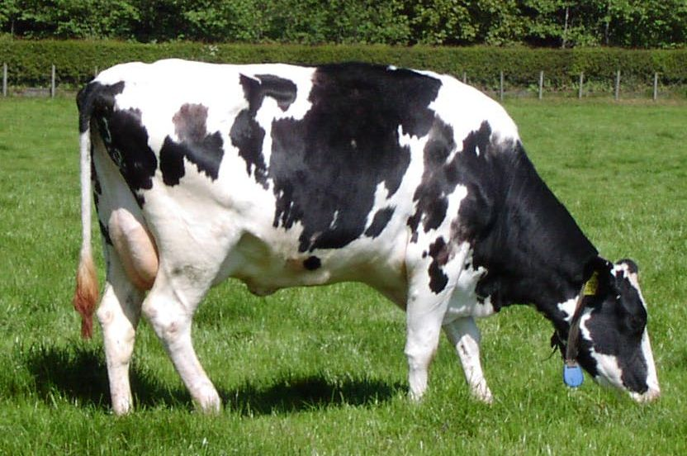
Suppose you want a variety of cow that produced a lot of milk. This is what you could do:
choose or select the cows in your herd that produce the most milk
only let these cows reproduce
select the offspring that produce the most milk
only let these offspring reproduce
keep repeating the process of selection and breeding until you achieve your goal

Slide 12
Artificial selection: For what……?
Fast growth
Short stem
High yield
Disease resistance
Resistance to drought

Slide 13
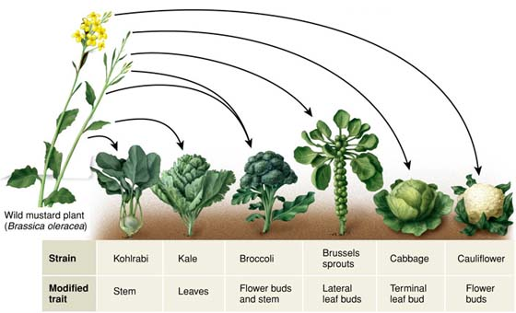
Examples: Artificial selection

