Slide 1
Enzymes
Biological catalysts
IGCSE Biology

Slide 2
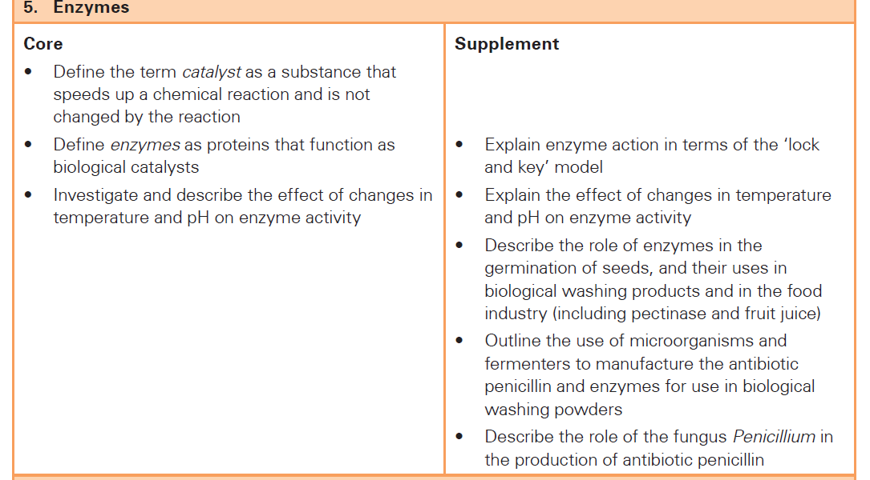
Scope of syllabus

Slide 3
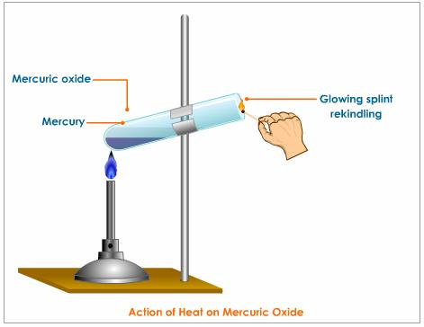
Chemical reactions

Slide 4
Catalyst and Biocatalyst.
Catalyst
Catalysts are substances that increase the rate of chemical reactions without being used up.
Inorganic in nature
Biocatalyst
Enzymes are biological catalysts that increase the rate of chemical reactions without being used up in living cell.
Organic in nature.

Slide 5
KEY TERMS
Chemical reaction: A process in which reactants converts into new substances called products.
Chemical equation: A chemical equation uses chemical symbols for reactants and products to describe a chemical change.
Substrate: The material or substance on which an enzyme acts.
Product: Products are the materials formed in a chemical reaction
Rate of reaction: The rate is like speed of the reaction measured in quantity of product or substrate per unit time.
The part of an enzyme where the catalytic activity on the substrate takes place is called active site.
Optimum is a useful word which means "the best". We call the temperature or pH which makes an enzyme work at its very fastest the optimum for that enzyme.

Slide 6
Example:
Hydrogen peroxide breaks down to water and oxygen
hydrogen peroxide
manganese oxide
water + oxygen
2H₂O₂
2H₂O
+
O₂
The escaping oxygen causes the foaming

Slide 7
Enzymes act as biological catalysts
They occur inside cells or are secreted by the cells.
Catalase is the enzyme that catalyses the break down of hydrogen peroxide.
Catalase
Substrate = Hydrogen peroxide
Enzyme = Catalase
Product = Water and oxygen

Slide 8
Types of reactions can be catalyzed by enzymes
Breaking large molecule into small ones(Catabolic reaction)
Building up large molecules from small ones(Anabolic reactions)
Converting one small molecule into another (Transformation)

Slide 9
Breaking large molecule into small ones(Catabolic reaction)
Starch Maltose
amylase
2. Building up large molecules from small ones(Anabolic reactions)
Glucose + Glucose Maltose + Water

Slide 10
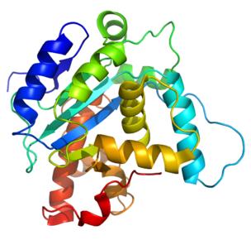
ENZYMES
Enzymes are proteins, produced by organisms, greatly increase the rate of reaction without themselves being changed at the end of the reaction.

Slide 11
Enzymes are proteins
Proteins are long molecules that are folded into a specific shape.
catalase
amylase
pepsin
trypsin

Slide 12
Structure of an enzyme
Enzymes are globular proteins.
A small portion of enzyme molecule make a cleft or depression where substrate molecules can bind are known as active site.
The place where these substrate molecules fit is called the active site.

Slide 13
Active site:
Enzyme

Slide 14
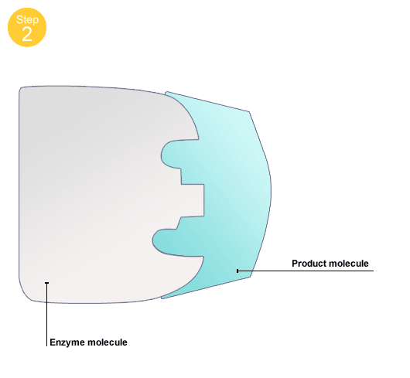
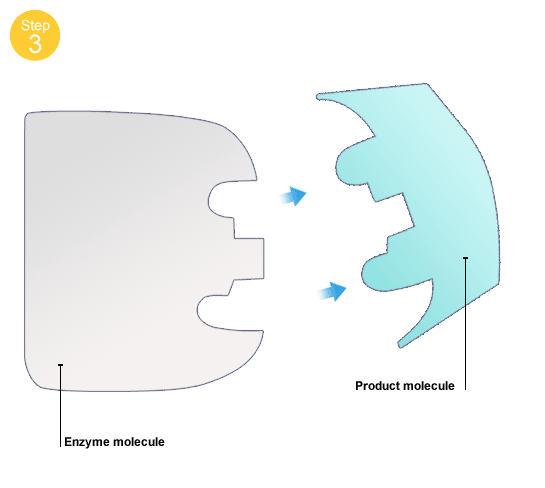
How an enzyme works..?
Play
Play

Slide 15
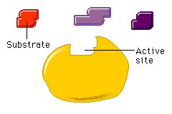
Mechanism of enzyme action
Lock and Key hypothesis (Fischer)
The substrate (key) must have a shape that fits exactly into the
active site (key hole) of the enzyme(lock).

Slide 16
Properties of enzymes
Each enzyme can catalyze one reaction (Specificity)
Powerful than inorganic catalyst.
Initiate and accelerate reactions.
They can be influenced by temperature (Act actively at optimum temperature)
They can be influenced by pH.
They can be used again and again.
Although enzymes are made by living things, they are proteins, and not alive.

Slide 17
Factors affecting enzyme action
Temperature
pH
Substrate concentration
Enzyme concentration

Slide 18
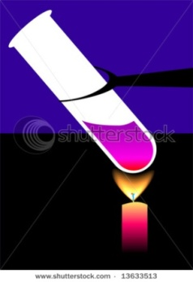
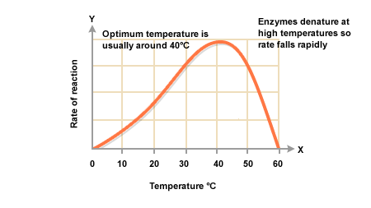
Factors affecting enzyme action :Temperature
The rate of enzyme activity increases with as temperature increases until the optimum temperature, then falls to zero as the enzyme is denatured.
This means that the protein changes shape and the active site is no longer complementary to the substrate molecule.

Slide 19
When temperature increases the reaction also increases as the molecules have more kinetic energy
But this only occurs up to the optimum temperature (usually about 40ºC)
The temperature at which the rate of reaction is
fastest is known as the optimum temperature

Slide 20
After the optimum temperature the heat causes the enzyme to denature
The enzyme changes shape and the active site no longer matches the shape of the substrate molecule

Slide 21
The rate of reaction increases in the beginning and decrease beyond the optimum temperature. Why…..?
Reasons:
Kinetic energy
Denatured
Optimum temperature
Molecules gain kinetic energy
Enzyme
is denaturing
Rate
Of
Reaction
Note:
In many cases a rise of 10⁰C will double the rate of reaction
0 10 20 30 40 50 60 70
Temperature/ºC

Slide 22
Factors affecting enzyme action: Temperature
Optimum temperature:
The temperature at which the maximum rate of reaction occur is called optimum temperature.
Examples of optimum temperature:
Fungal and plant enzyme : Appx. 20⁰C.
Human enzyme: 37 ⁰C
Some bacterial enzymes : 90⁰C

Slide 23
Factors affecting enzyme action : pH
Each enzyme has its own range of pH in which it will work best(Optimum pH)
Many enzymes work best in neutral conditions.
Some enzymes prefer acidic or alkaline conditions.
Changing in the condition alter the structure of active site of the enzyme.
Optimum pH
pepsin
amylase
Rate
Of
Reaction
1 2 3 4 5 6 7 8 9 10 11 12
pH

Slide 24
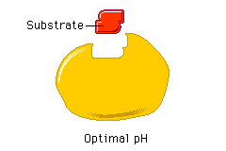
Factors affecting enzyme action : pH
How change in pH can affect the rate of enzyme catalyzed reactions?
Reasons:
The bonds that hold the enzyme molecule in the shape are broken by changes in pH.
Change the structure of active sites.
Note:
The changes due to alter in pH are usually reversible.
Extremes of pH may denature some enzymes irreversibly.

Slide 25
Factors affecting enzyme action : pH
Examples:
Enzyme | Optimum pH | Source | Role
Amylase | 9 (Alkaline) | In saliva (oral cavity) | Breakdown of starch into maltose
Protease | 2 (Acidic) | In gastric juice (Stomach) | Breakdown of proteins
Catalase | pH 7 - pH 11 | Fruits, liver | Breakdown of hydrogen peroxide

Slide 26
Increase Substrate Concentration
0
1
2
3
4
5
6
7
8
S
+
E
↓
P
80
60
40
20
0
Product
(in a fixed period of time)
0 2 4 6 8
Substrate (mmole)

Slide 27
Name of enzymes
End in –ase
Identifies a reacting substance
sucrase – reacts sucrose
lipase - acts on lipid,
Protease- acts on proteins,
Ending in –lytic
Proteolytic- splitting proteins
Amylolytic- splitting starch
Describes function of enzyme
Oxidase – catalyzes oxidation
Hydrolase – catalyzes hydrolysis
Dehydrogenase- removes hydrogen from a substance
Common names of digestion enzymes still use –in pepsin, trypsin

Slide 28
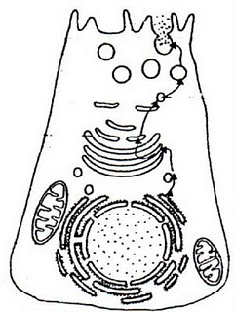
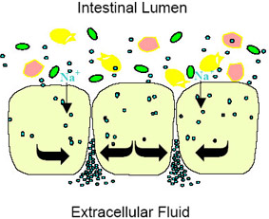
Types of enzymes
All enzymes are made inside cells.
On the basis of site of action, there are two groups of enzymes .
A. Intra cellular- Endozymes
Work inside the cell in which they produced.
B. Extra cellular- Exozymes
Work outside to the cells in which they produced.
Eg. Bacteria and fungus release enzymes in order to digest their food.

Slide 29
Enzymes in industry
Of about 2000 enzymes known, about 50 are used commercially in large quantities.
The reasons(advantages) of using enzymes are
They work at low temperature, so saving energy.
They are not corrosive.
They are specific so the process can be controlled,
Can be used over and over.
Required in small quantities

Slide 30
Application of enzymes
Brewing industry.
Baking industry
Cheese making industry
Extracting fruit juice
Production of antibiotics (industrial fermentor)
Biological washing powder

Slide 31
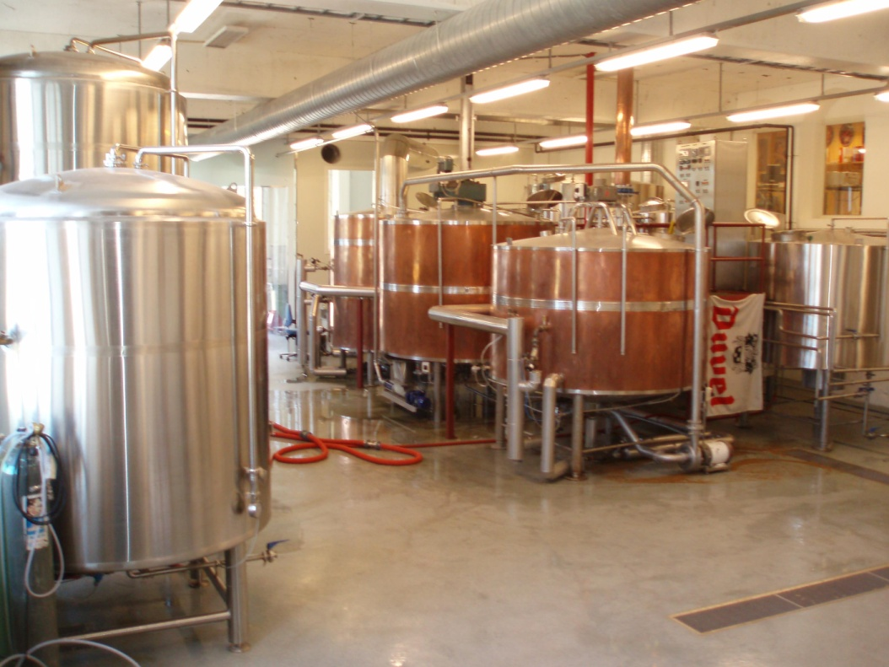
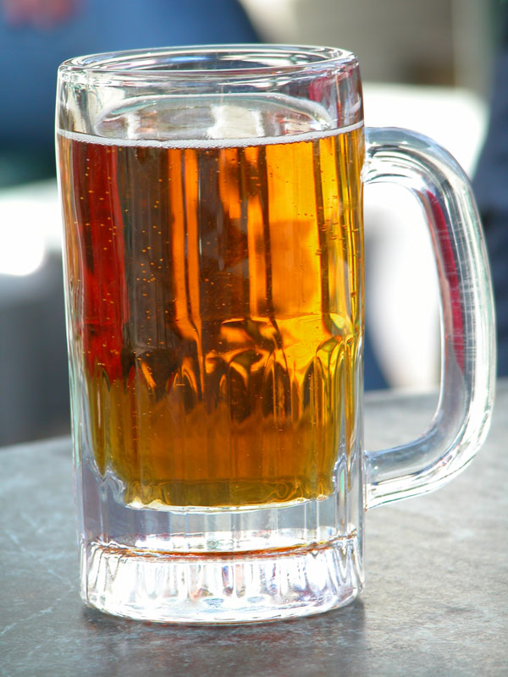
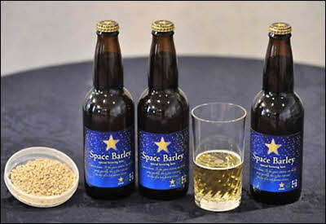
Brewing industry.

Slide 32
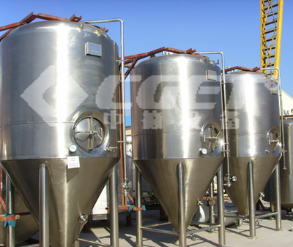
2.Baking industry

Slide 33
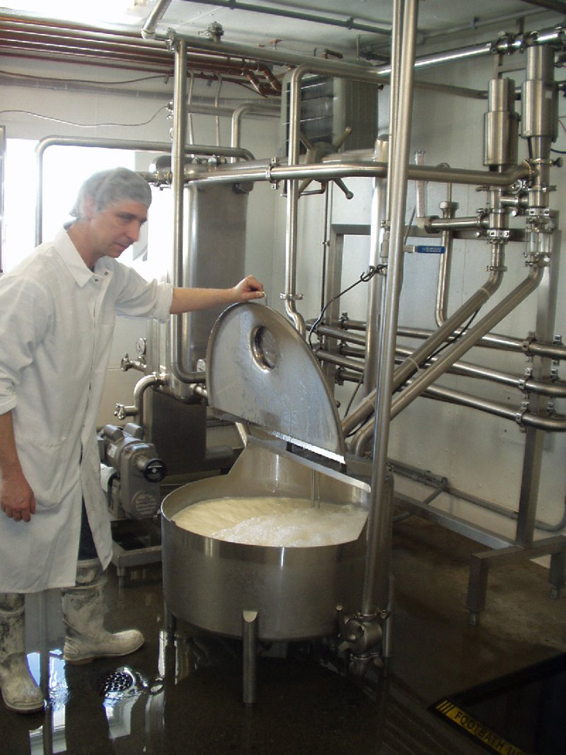
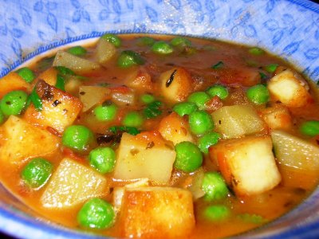
2. Cheese making industry
Cheese is made by adding an enzyme called rennet after bacteria have produced lactic acid in milk. Rennet makes milk proteins turn solid and this is the basis for cheese.

Slide 34
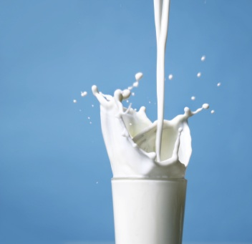
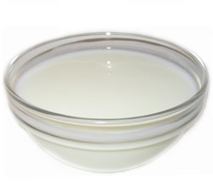
3. Yoghurt production
Bacteria can be added to milk to make yoghurt. An enzyme in the bacteria reacts with sugar in the milk (called lactose) and converts it into lactic acid. Lactic acid changes milk proteins and forms the thicker yoghurt.
yoghurt

Slide 35
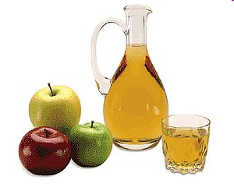
4. Extracting fruit juice
Pectinase are enzymes that breakdown pectins, which are molecule that act like a ‘glue’ in plant cell walls.
Pectinase are used for extracting fruit juices and for softening vegetables.

Slide 36
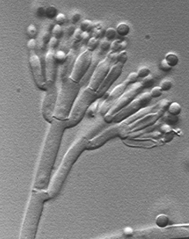
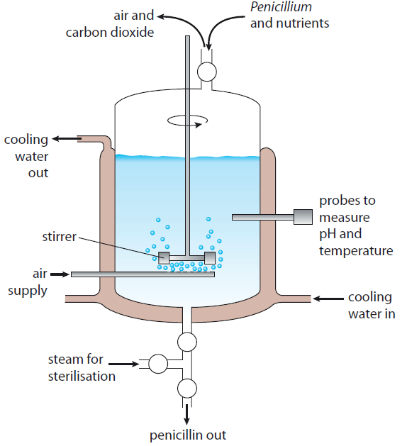
Role of fungus in penicillin production
Production of antibiotics (industrial fermentor)

Slide 37
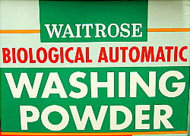
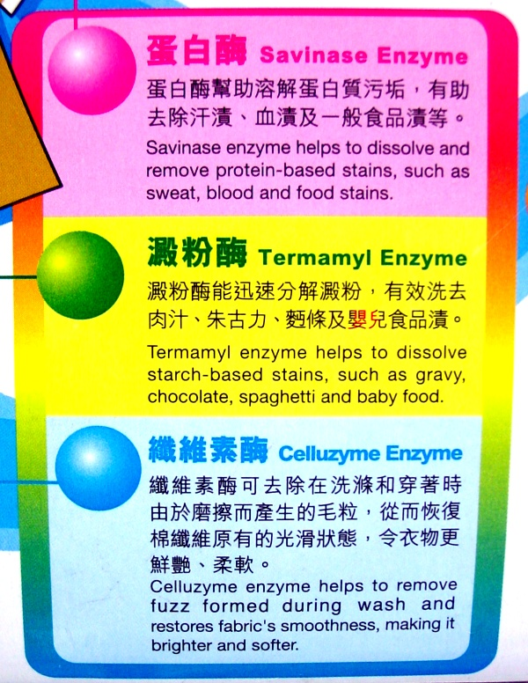
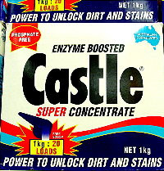
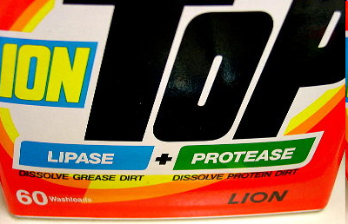
6. Biological washing powder
Biological washing powder may contain one or more of the following type of enzyme.
Proteases break down protein.
Amylase: break down starch ,
e.g. Food containing starch.
Cellulase: break down cellulose fibres .
Advantages:
Can wash at lower temperatures.
Do not harm the environment.

Slide 38
Enzymes are used in seed germination
starch
amylase
secreted
embryo plant
absorbed
maltose

Slide 39
Important links
http://www.bbc.co.uk/schools/gcsebitesize/science/add_aqa/enzymes/enzymes1.shtml
http://gcsebiologyblog.blogspot.com/
http://lgfl.skoool.co.uk/content/keystage4/biology/pc/lessons/uk_ks4_ecology/h-frame-ie.htm

