Slide 1
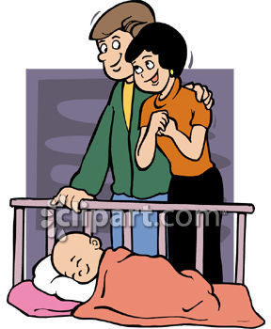
Reproduction in humans

Slide 2
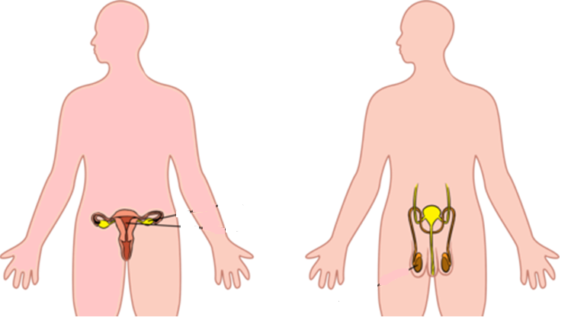
Human reproduction
Male reproductive system
Female reproductive system
Testis
Ovaries
Produces sperms and testosterone
Produces egg cell, estrogen and progesterone

Slide 3
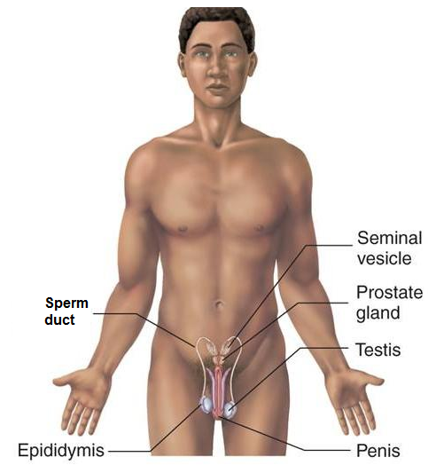
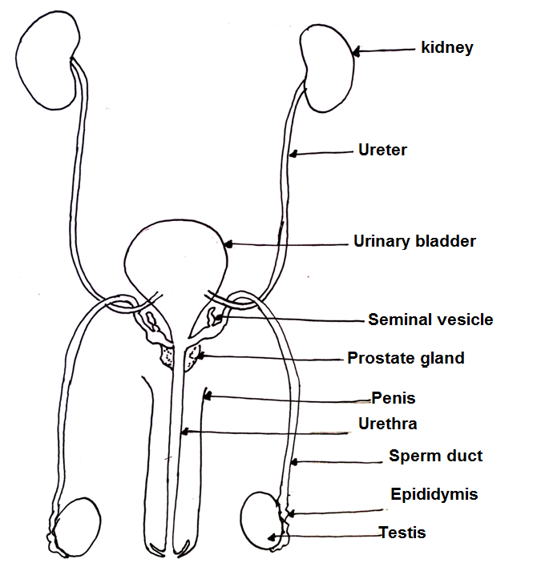
Male reproductive system : front view

Slide 4
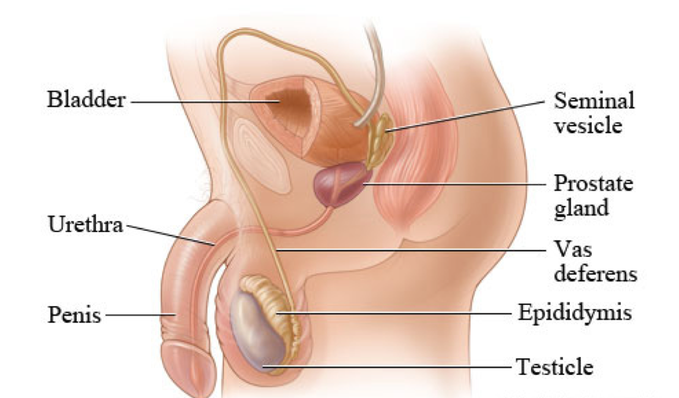
Male reproductive system (Side view)
Testis are located inside a sac called scrotum.
These are placed outside the abdominal cavity as sperms need temperature cooler than 37⁰C, for proper development

Slide 5
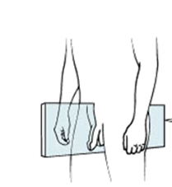
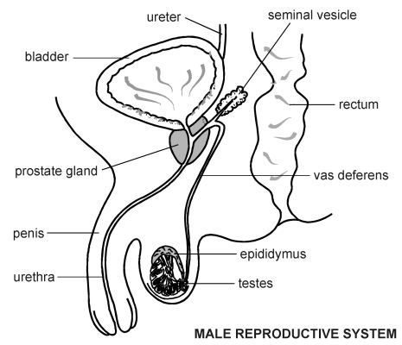
Male reproductive system (Side view)
Adds nutrients to sperm to form semen
Adds fluid and nutrients for the sperm to swim
To transfer sperm into the vagina during sexual intercourse
Sperm duct- tube that links testes to the urethra for sperm passage
Mass of tubes where sperms are stored
Pass semen containing sperms and urine from the bladder
Produces sperms and the male hormone testosterone

Slide 6
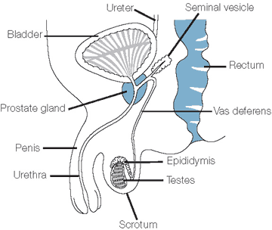
What is urinogenital system?
The urethra forms a common passage for both the sperms and urine.
http://lgfl.skoool.co.uk/content/keystage3/biology/pc/learningsteps/MRSLC/launch.html

Slide 7
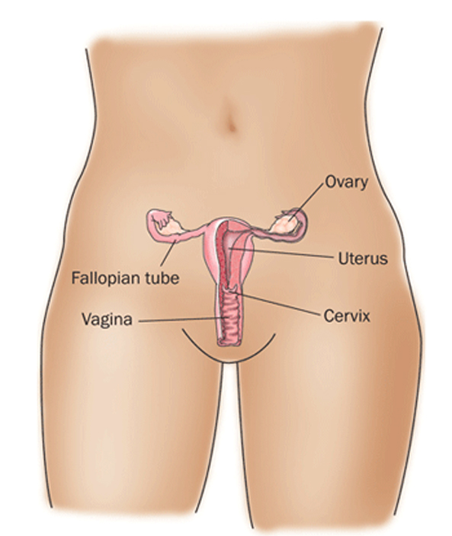
Female reproductive system

Slide 8
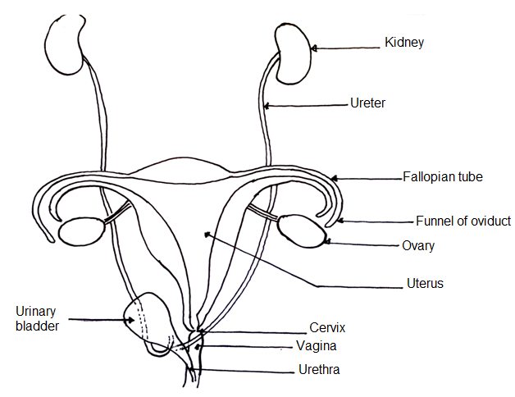
Female reproductive system

Slide 9
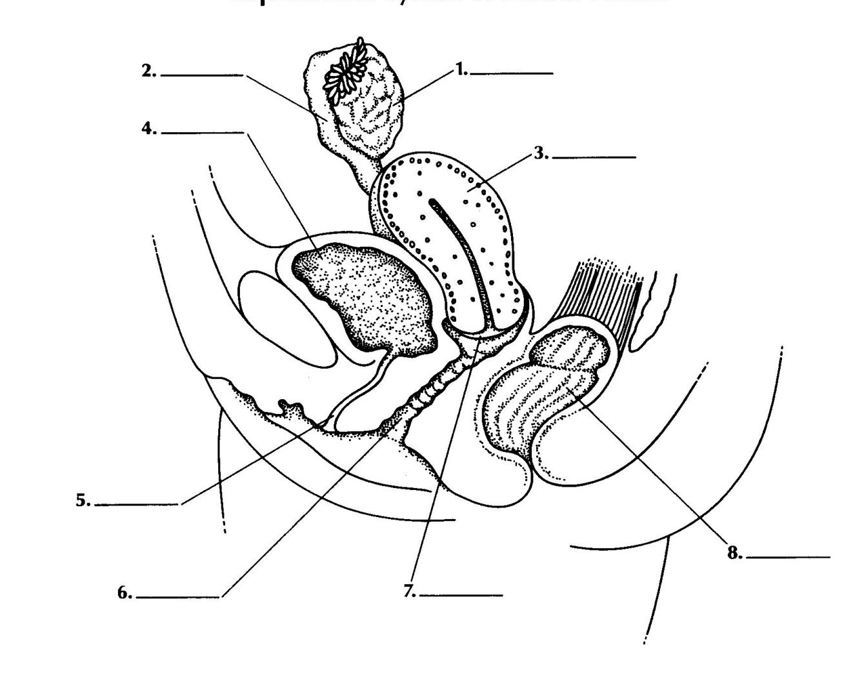
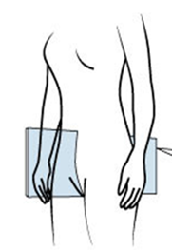
Female reproductive system (side view)
Carries ovum to the uterus and is also the site of fertilization
Contains follicle in which egg is produced
Oviduct
Ovary
Urinary bladder
Place where the fetus develops
Uterus
Vulva- the opening of the vagina to the outside
Carries urine from the bladder
Urethra
Receives the penis during sexual intercourse and sperms are deposited here
Rectum
Vagina
Cervix
A ring of muscles that separates the vagina from the uterus

Slide 10
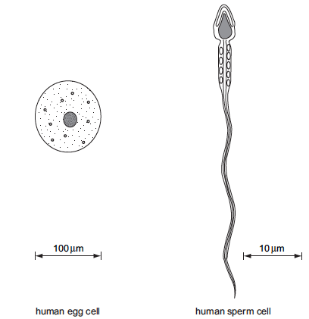
The male and the female gamete
Acrosome
Head
Cell membrane
Middle piece
Nucleus
Nucleus
Membrane
Cytoplasm
Jelly coat
Tail

Slide 11
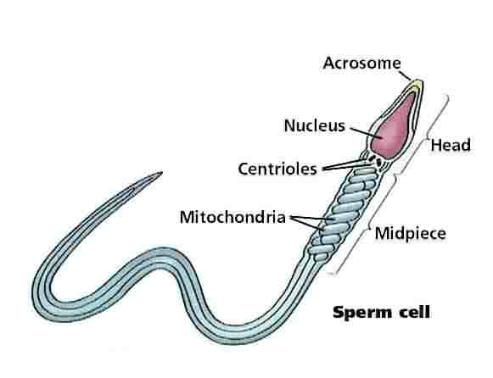
Semen and path of sperm
Semen is the mixture of sperms and secretions from glands.
Protects and activates the sperm; facilitates their movement
Provides energy for sperm movement
High pH neutralizes the urethra and vagina
Contains between 500 million sperm in 2-5 cm³.
Digest the jelly coat of the egg
Provides energy for swimming

Slide 12
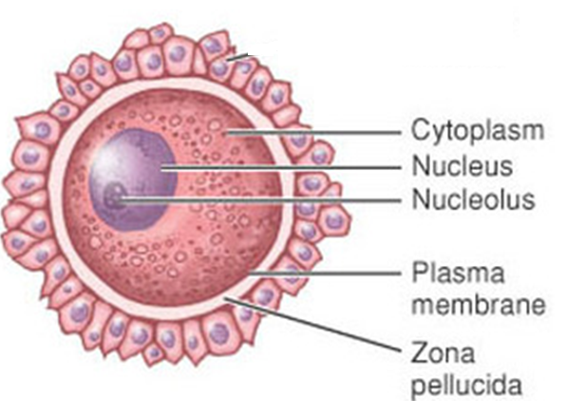
Structure of egg cell

Slide 13
Comparing male and female gametes
Feature | Sperm cell | Egg cell
Size | Small | Much larger than sperm cell
Mobility | Swims using the tail | Does not move- it is moved along the oviduct by cilia.
Number produced | Millions constantly produced after puberty, throughout life | One in a month after puberty till menopause
Number of chromosomes | 23 (haploid) | 23 (haploid)
Food store | Uses sugar in the seminal fluid | Protein and fat present in the cytoplasm

Slide 14
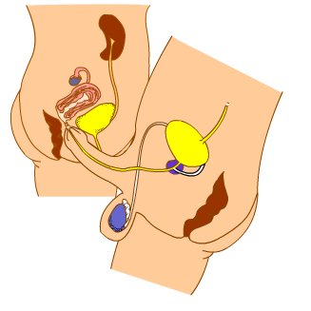
SEXUAL INTERCOURSE
Ejaculation : the action of ejecting semen from the body.

Slide 15
Release of the ovum and fertilization
Fertilization
For fertilization to occur-
1. Ovum has to be released from the ovary
2. Sperms need to be present in the oviduct.
release of the ovum

Slide 16
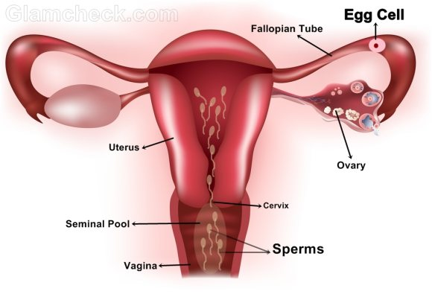
Why sperms are produced in large numbers.?
Sperms have to swim through the mucus in the cervix to the uterus and then oviduct.
After sexual intercourse
Thus sperms are produced in large numbers to increase the chance of some reaching the oviduct.

Slide 17
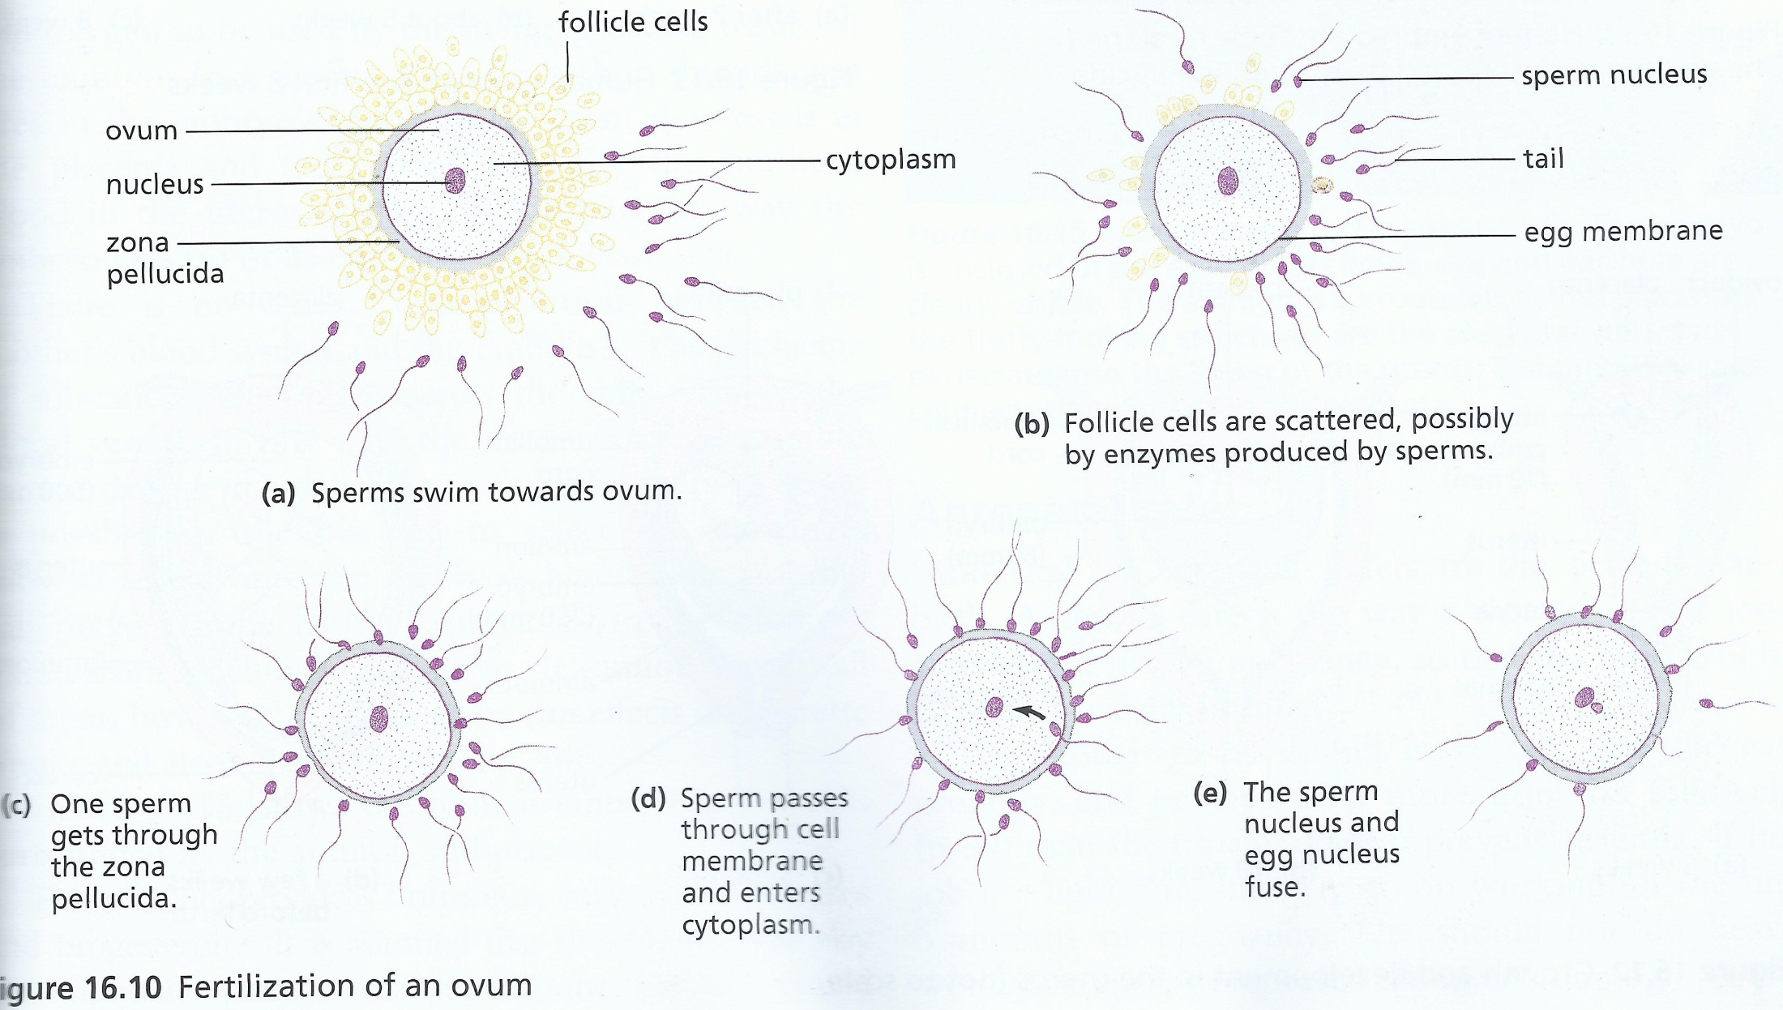
Process of fertilization
http://inteleducationresources.intel.co.uk/content/keystage3/biology/pc/learningsteps/human_fert/launch.html

Slide 18
Process of fertilization
Enzymes from the acrosome
Digest the jelly coat of the egg
Sperm membrane fuses with the egg membrane
Sperm nucleus enters the cytoplasm of the egg
Sperm nucleus fuses with the egg nucleus forms the zygote nucleus
Fusion results in the formation of diploid zygote
A membrane develops around the egg
This prevents other sperms from entering the egg

Slide 19
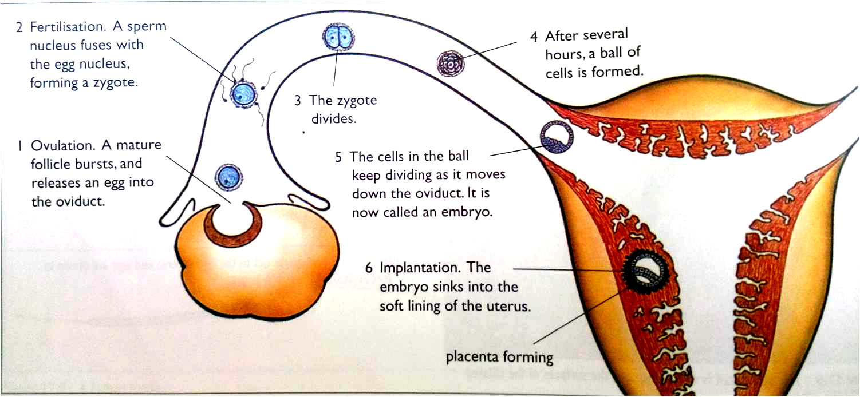
What happens after fertilization?

Slide 20
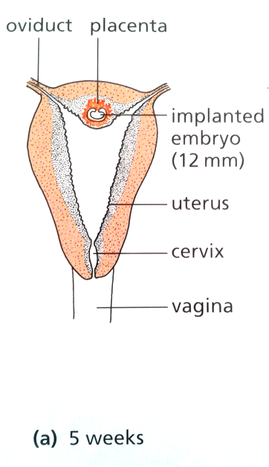
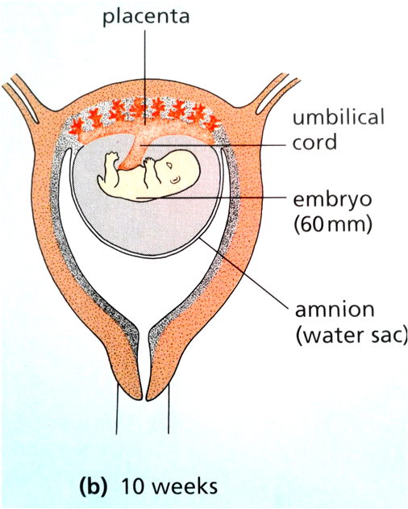
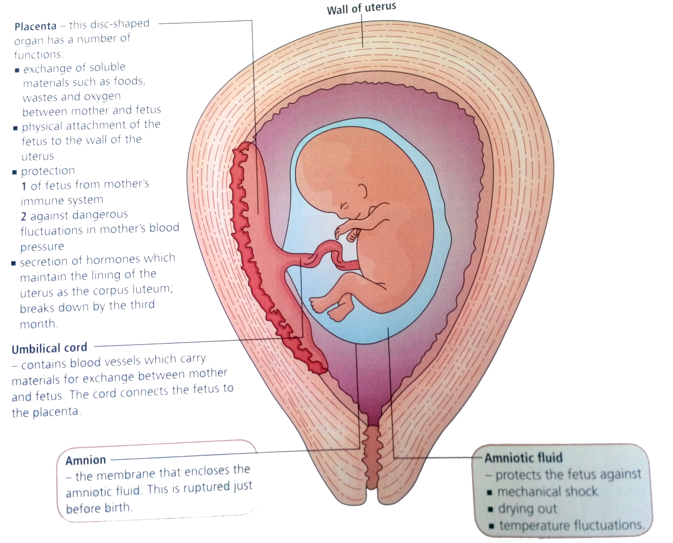
Pregnancy and placenta
http://inteleducationresources.intel.co.uk/content/keystage3/biology/pc/learningsteps/pregnancy/launch.html

Slide 21
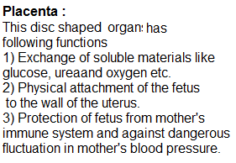
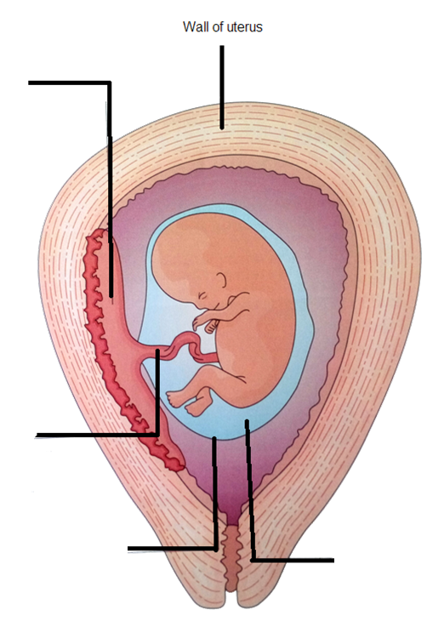
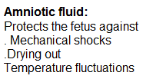

Slide 22
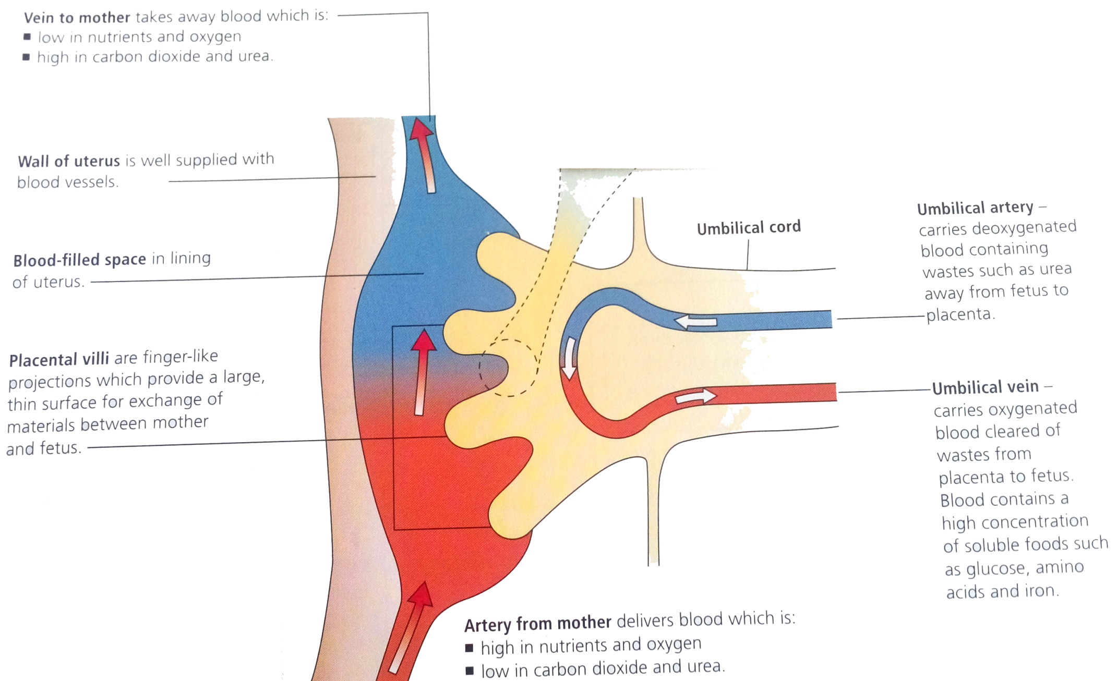
Placenta
The placenta brings the blood supply of the fetus close to that of the mother but prevent mixing. What is the advantage?

Slide 23
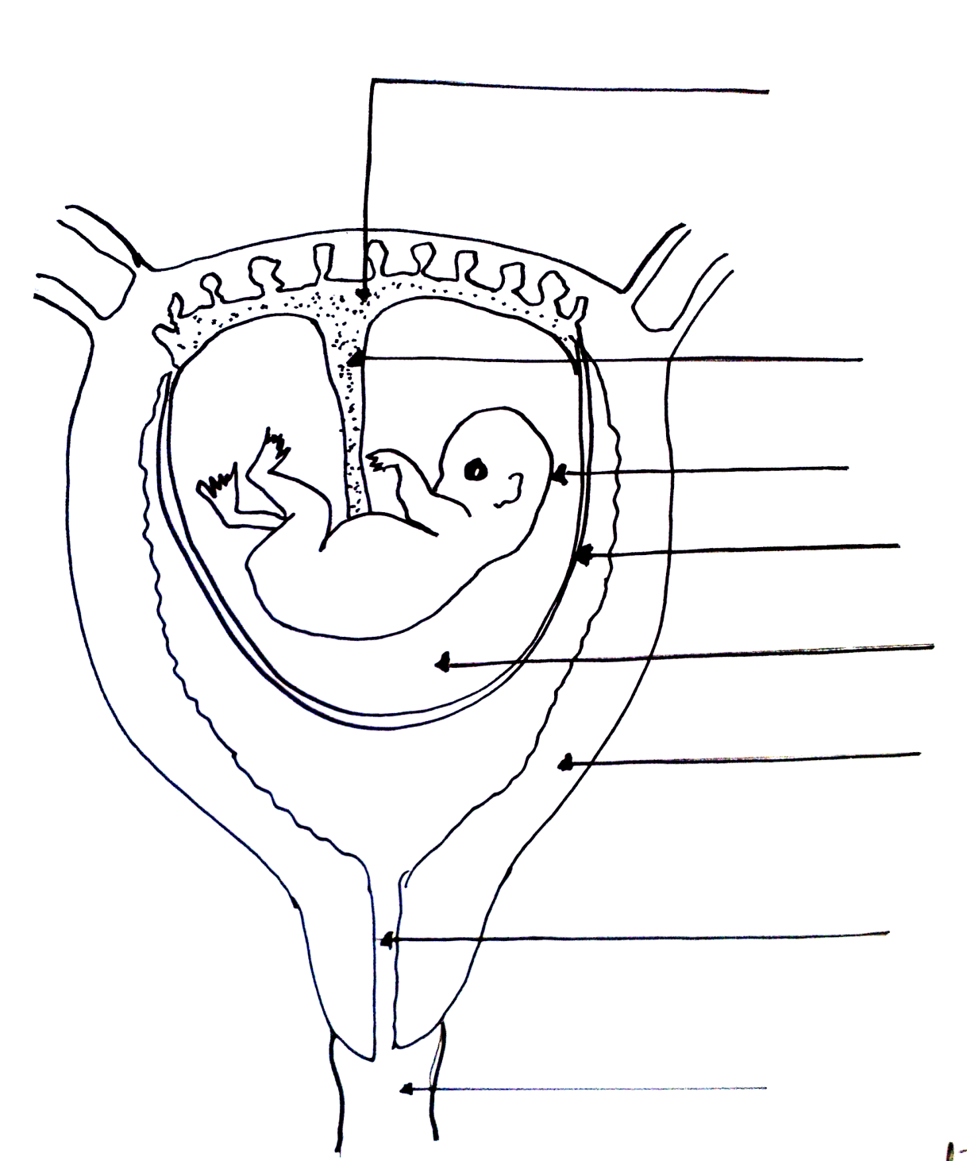
Label the following diagram
1
Placenta
2
Umbilical cord
3
Embryo
4
Amniotic sac
5
Amniotic fluid
6
Uterus
7
Cervix
8
Vagina

Slide 24
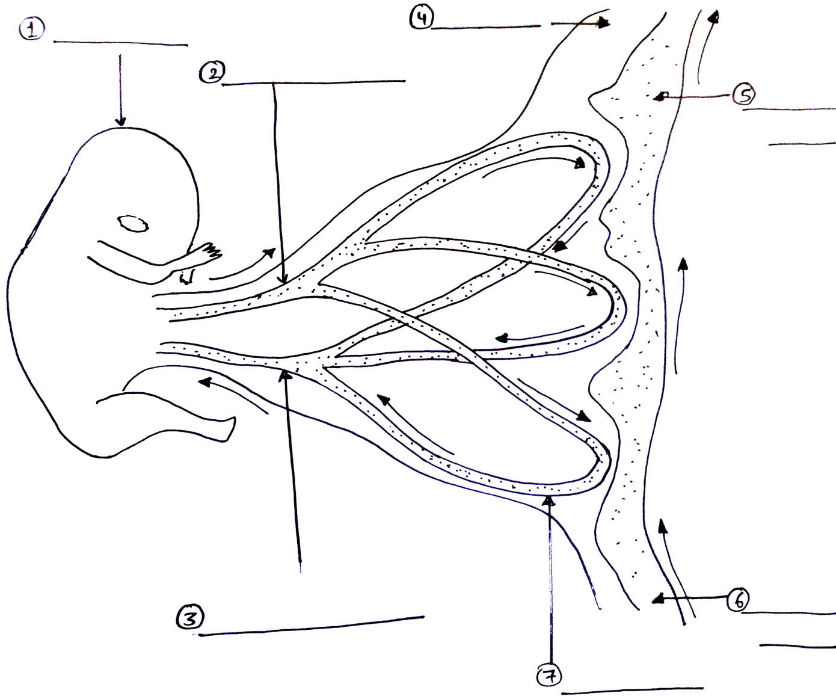
Umbilical artery carries deoxygenated blood containing such as urea away from fetus to placenta
Uterine lining
Fetus
Deoxygenated blood
Umbilical vein carries oxygenated blood containing nutrients from placenta to fetus
Oxygenated blood
Capillary network

Slide 25
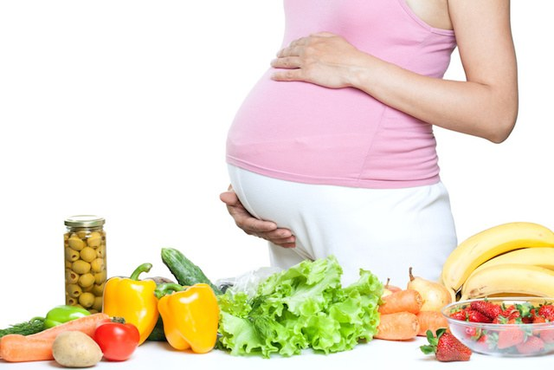
Antenatal care
Antenatal : Period before birth
Proper diet
Calcium- for the bones of the growing fetus.
Iron- more haemoglobin is made hence more iron is required (fetus and mother)
Carbohydrate- energy for the pregnant mother.
Protein- amino acids to make new tissues
No smoking
No alcohol
No drugs like heroin etc.

Slide 26
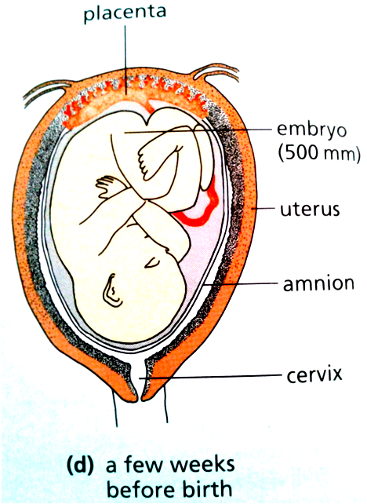
Birth : Few weeks before birth
Fetus turns upside down
Head is placed above the cervix
Fetus releases hormones
Pressure in the uterus stimulates release of oxytocin.
Oxytocin stimulates the contraction of the muscle of the uterus.
Mother feels small contractions of the wall of uterus.
This is the beginning of LABOUR
http://inteleducationresources.intel.co.uk/content/keystage3/biology/pc/learningsteps/birth/launch.html

Slide 27
LABOUR
The muscles of the uterus starts to contract strongly.
The pressure breaks the amniotic sac, releasing amniotic fluid
This pushes the baby to the cervix.
The cervix dilates and the baby’s head is pushed through the vagina.

Slide 28
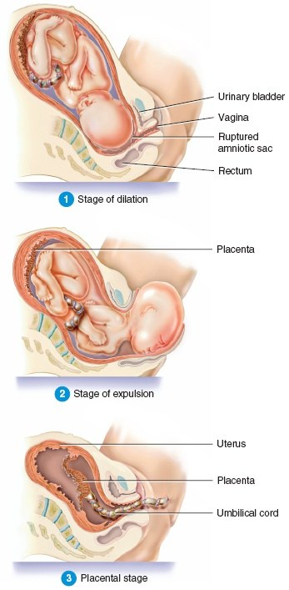
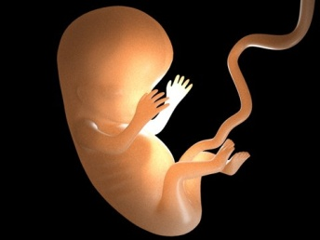
Parturition or birth
The act of expelling the fetus after a complete term of pregnancy or gestation.
It involves forceful muscular contractions called labor.
Oxytocin- causes contractions
Relaxin- relaxes the cervix and pelvic ligaments for easy birth.

Slide 29
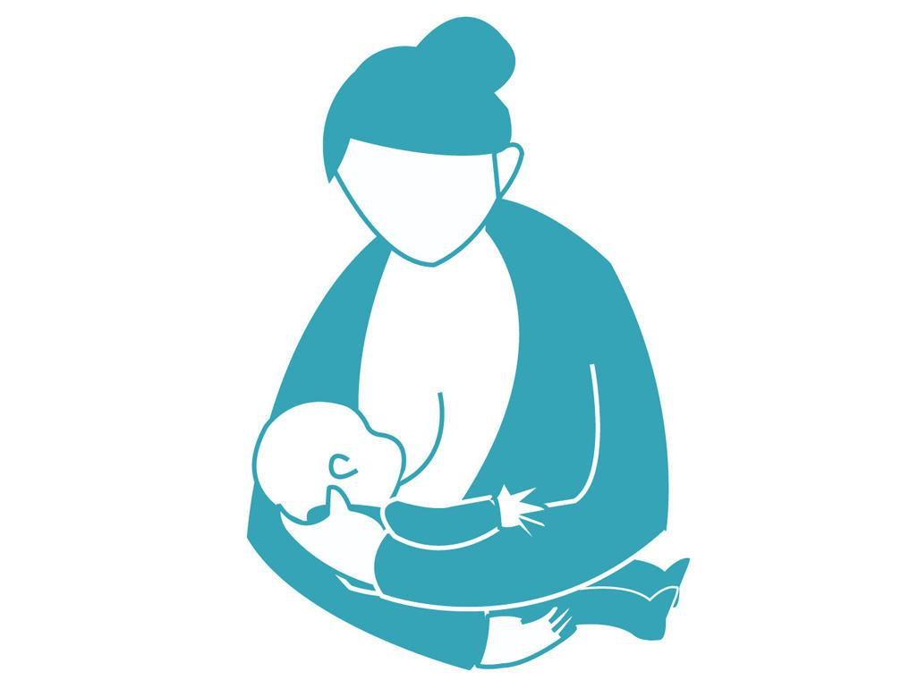
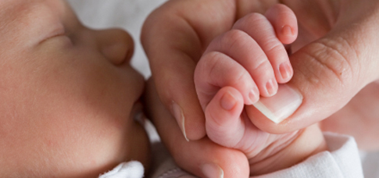
Feeding and parental care
During pregnancy the size of mammary glands increases.
The stored milk is released after parturition.
Milk secretion begins usually within 24 hrs under the influence of prolactin.

Slide 30
Advantages of breastfeeding over bottle-feeding
Antibodies
Balanced in nutrients
No risk of allergic reaction
No additives or preservatives.
Builds a bond between mothers & baby.
No cost involved.
Doesn’t’ need any preparation.
No contamination.

Slide 31
What happens when the egg is not fertilized?

Slide 32
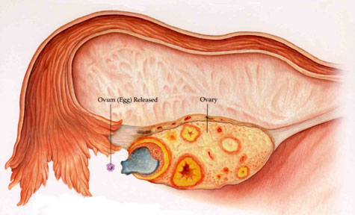
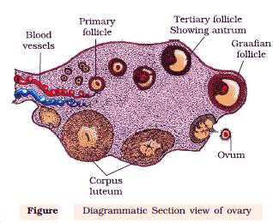
Structure of ovary
Ovulation release of the egg cell from the ovary
Where did the egg cell come from?
The egg cells develop inside the ovary.

Slide 33
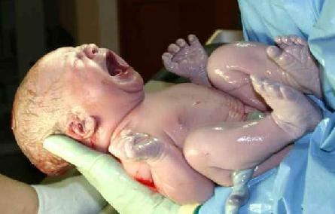
At what age does the development of egg start in the female body?
1-2 Million ( Birth)
6-7 Million immature eggs.(5-6 months)
Appx 4 ,00,000
(Puberty)

Slide 34
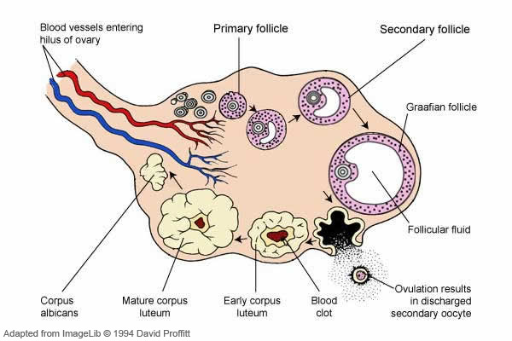
Structure of ovary
Potential eggs surrounded by cells - follicle
Potential eggs
AT PUBERTY
The follicle bursts after 2 weeks – ovulation.
The follicle left behind forms a yellow body- corpus luteum

Slide 35
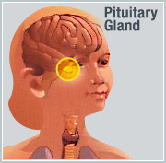
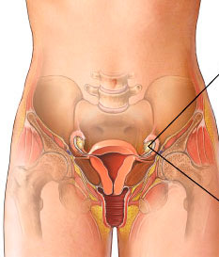
Menstrual cycle
The series of events that occur in cyclic manner at every 28-32 days and involve the maturation of female gamete with change in structure and function of entire female reproductive system.
Follicle stimulating hormone (FSH)
Luteinizing hormone (LH)
Oestrogen
Progesterone
The end or stopping of the cycle at 44-55years is called menopause
OVARY
The beginning of the cycle between 10-15 years is called menarche

Slide 36
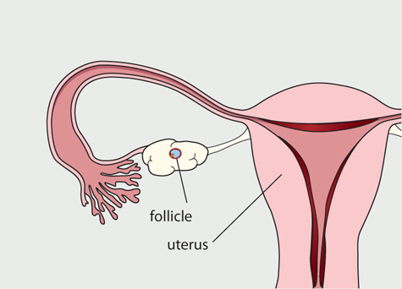
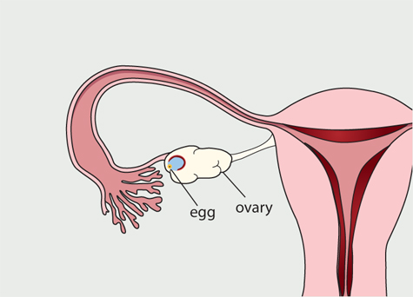
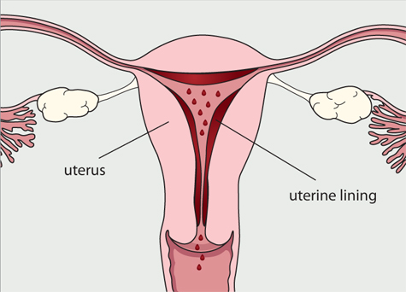
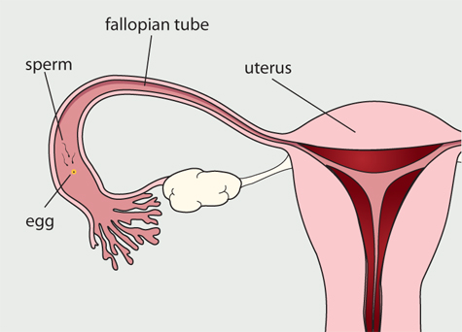
Menstrual cycle and Menstruation
FSH starts the cycle by stimulating a follicle to develop.
Oestrogen leads to the thickening of the uterine wall.
The egg cell develops inside Follicle cells release oestrogen.
Oestrogen now stimulates the production of LH from the pituitary
Oestrogen also acts on the pituitary to stop more secretion of FSH
If fertilization does not take place
LH acts on the ovary to release the egg and form the corpus luteum. (yellow body)
Corpus luteum (yellow body) produces progesterone
Progesterone thickens the uterine lining further and prevents its break down
Uterine lining breaksdown resulting in menstruation.
If fertilization takes place it results in pregnancy.

Slide 37
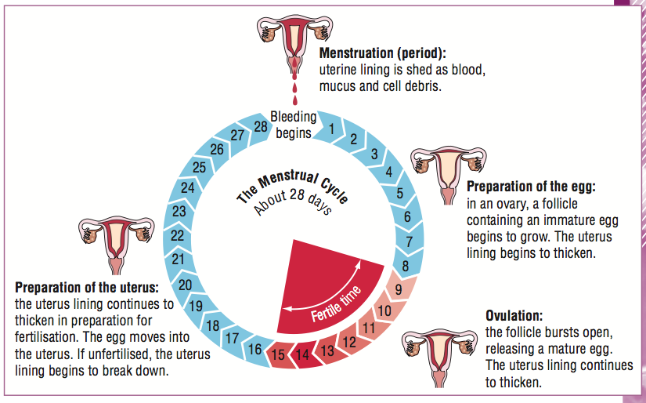
Menstrual cycle and Menstruation

Slide 38
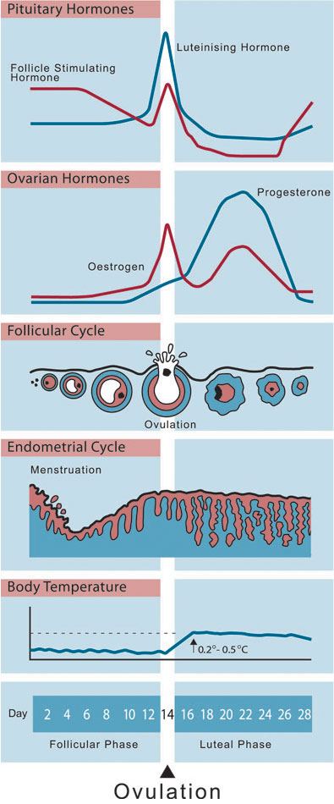
Changes during menstrual cycle
Changes in uterine lining.
Changes inside ovary
Changes in ovarian hormones
Changes in pituitary hormones.
Changes in temperature

Slide 39
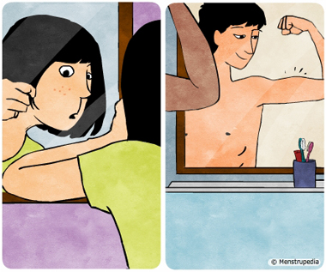
Sex hormones and Puberty
The time when the testis start to make sperms and the follicles start to develop in the females is called puberty.
At this time the pituitary releases hormones to stimulate the testis and the ovaries.
This results in the production of sex hormones by the ovary and the testis that leads to development of secondary sexual characteristics.
http://inteleducationresources.intel.co.uk/content/keystage3/biology/pc/learningsteps/puberty/launch.html

Slide 40
Puberty in boys
Testis produces testosterone that leads to-
The growth of male sex organs :Penis becomes larger:
Testes start to produce sperm
Body become more muscular
Hair starts to grow on chest, face, under arms and in pubic area.
The deepening of the voice.

Slide 41
Puberty in girls
Ovaries start making oestrogen that leads to-
The growth of female sex organs: Uterus and vagina become larger.
Ovaries start to release eggs and menstruation begin.
Widening of hips.
Hair develops under arms and in pubic area.
Breasts grows and nipple enlarge.

Slide 42
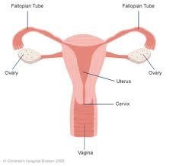
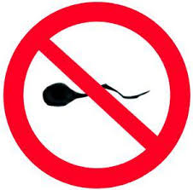
Birth control methods
Measures used to prevent pregnancy.
Stop the egg from being made
Stop the fertilized egg from implanting and developing in the uterus.
Stop sperms from reaching the egg

Slide 43
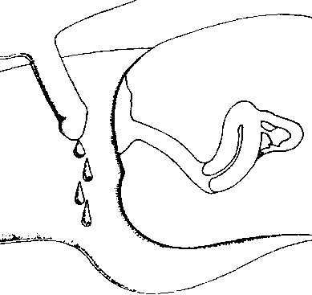
Birth control method: A. Natural methods
1. Withdrawal | Penis is withdrawn before ejaculation | Very unreliable (Some semen released before ejaculation)

Slide 44
Birth control method : A. Natural methods
2. Abstinence | No sexual intercourse | Best way of avoiding pregnancy

Slide 45
Birth control method : A. Natural methods
3. Rhythm method | Keeping records of the ovulation dates | Ovulation time can vary, not always reliable

Slide 46
Birth control method : Artificial method: chemical
1. Contraceptive pill | Contains estrogen & progesterone or progesterone only | Doctors need to decide. Reliable if taken regularly.
2. Spermicide | Kill sperms in vagina | Should only be used with a condom.

Slide 47
Birth control method : Artificial method: Mechanical
1. Condom | Rubber sheath placed over the penis to stop sperm entering the vagina | Prevent STD. Reliable if used with spermicide.

Slide 48
Birth control method : Artificial method: Mechanical
2. Femidom | Thin plastic sheath placed inside the vagina | Prevent STD

Slide 49
Birth control method : Artificial method: Mechanical
3. Diaphragm | Dome shaped rubber barrier that fits in the vagina at the cervix. | Needs to be correct size. Reliable if used with spermicide.

Slide 50
Birth control method : Artificial method: Mechanical
4. IUD | A plastic coated copper coil is surgically inserted into the wall of the uterus | Reliable. Prevents implantation

Slide 51
Birth control method : Artificial method: Surgical
Vasectomy
Tubectomy
Sperm ducts are tied or cut so no sperm can release out.
Not normally reversible,
Extremely reliable.
Oviducts are tied or cut, so no eggs can pass down them.
Not normally reversible,
Extremely reliable.
Notes:
http://en.hesperian.org/hhg/A_Health_Handbook_for_Women_with_Disabilities:Barrier_methods_of_family_planning

Slide 52
Reproductive health: STD
Gonorrhoea : By bacteria Neisseria gonorrhoeae
AIDS : By virus HIV

Slide 53
GONORRHOEA
Sign & symptoms | Effects | Treatment
Male Sores on penis Discharge of pus from penis Pain when urinating | Damage to urinary & reproductive organs. Sterility Blindness in a baby born to a mother with the disease | Antibiotics
Female: Discharge of pus from vagina, but not always obvious

Slide 54
HIV
Methods of transmission | Ways of preventing its spread
Unprotected sexual intercourse with an infected person. Drugs use involving sharing a infected needle. Transfusion of unscreened blood. Infected mother to foetus Feeding a baby with milk from an infected mother. Use of unsterilized surgical instruments. | Use of a condom for sexual intercourse. Abstinence from sexual intercourse. Use of sterilised needle for drug injections. Screening of blood used for transfusions. Feeding a baby with bottled milk Use of sterilised surgical instruments.
http://www.youtube.com/watch?v=DdEreogZbtQ

Slide 55
How HIV affects the immune system……?
The HIV attacks some types of lymphocytes(WBC).

Slide 56
How can a person get HIV…….?
HIV can be found in the blood, semen (cum), pre-seminal fluid (pre-cum) or vaginal fluid of a person infected with the virus.
In women, the lining of the vagina can sometimes tear and possibly allow HIV to enter the body. HIV can also be directly absorbed through the mucous membranes that line the vagina and cervix.
In men, HIV can enter the body through the urethra (the opening at the tip of the penis) or through small cuts or open sores on the penis.
http://www.cdc.gov/hiv/resources/qa/transmission.htm

Slide 57
TWINS

