Slide 1
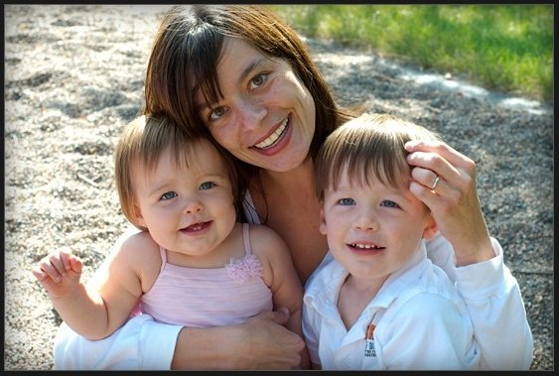
INHERITANCE
Chromosome, genes and DNA

Slide 2
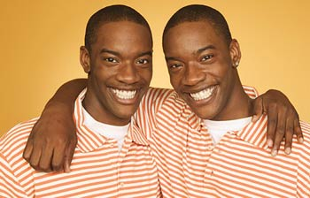
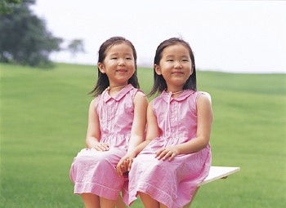
Observe the following

Slide 3
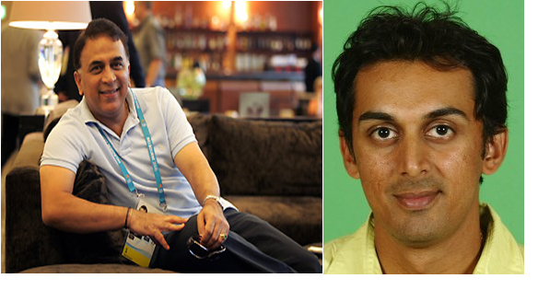
CHARACTERS
Hair : Curly
Eye colour
Capabilities…?
Physical appearance….?
But how do these characteristics transfer from parents to their offspring?

Slide 4
Genetics
The branch of science that deals with the study of heredity and variation.
HEREDITY:
The transfer of characters in living beings from parent to offspring generation after generation is called HEREDITY
VARIATION:
The difference among individuals of a species is called VARIATION.
But, how can we understand the process of inheritance …..?

Slide 5
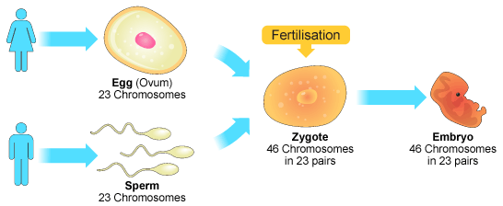
Method of inheritance
To understand the process of inheritance, we need to know the process of sexual reproduction.????????????

Slide 6
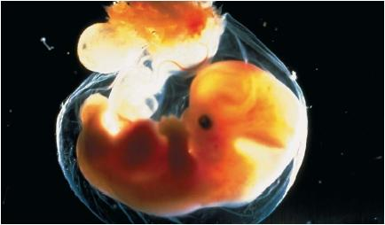
Method of inheritance
We start our life from one cell structure called zygote.
It mean all the instructions for the different characters (colour, hair pattern, height ) are present in zygote.

Slide 7
Method of inheritance
In what form are these instructions present in zygote…?
How these instructions decide the different characteristics ….?
How these instructions transfer from zygote to different cells of embryo?

Slide 8
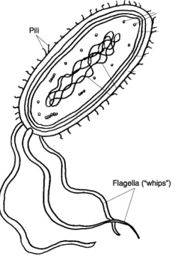
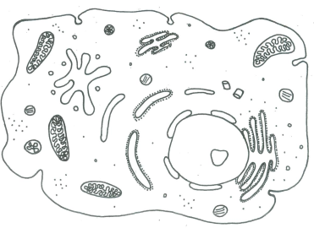
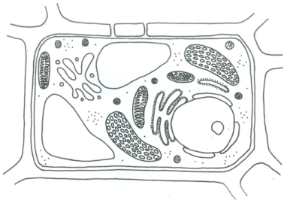
Locate the genetic material (instructions) in cell

Slide 9
1. In what form are these instructions present in zygote…?
Chromosomes
Do all living beings contains chromosomes?
What is the location of chromosomes inside the living organisms?
Do all organisms have similar number of chromosomes?
Do all cells of an organism contain same number of chromosome?
What does a chromosomes contain?
How can we observe the chromosomes under microscope?

Slide 10
Nucleus of eukaryotic cell
Replication
CHROMATIN
CHROMOSOME
Non dividing cell
WHEN THE CELL BEGINS TO DIVIDE

Slide 11
Nucleus of eukaryotic cell
CHROMATIDS
CENTROMERE

Slide 12
How many chromatids and chromosome in the following cell…?

Slide 13
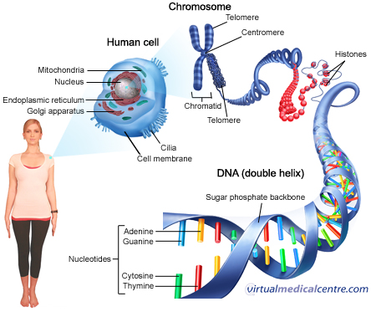

Slide 14
Chromatin: In a non-dividing cell, DNA is packed with proteins to form loosely arranged strands are known as chromatin
Chromosome: When cell division begin the DNA strands duplicate , condense and pack more tightly, giving rise to a thick rode shaped visible structure called chromosome.

Slide 15
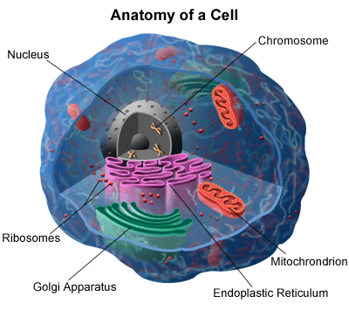
Chromosomes:
Journey into human DNA
Cromatin _chromosome_DNA

Slide 16
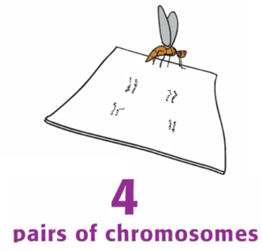
No. of Chromosomes: Do all organisms have similar number of chromosomes?

Slide 17
No. of Chromosomes: Do all organisms have similar number of chromosomes?
Number vary from species to species.
There is a fixed number of chromosomes in each species..
The number of chromosomes in a species is the same in all of its body cells.(except gametes)
The chromosomes are always in pairs.

Slide 18
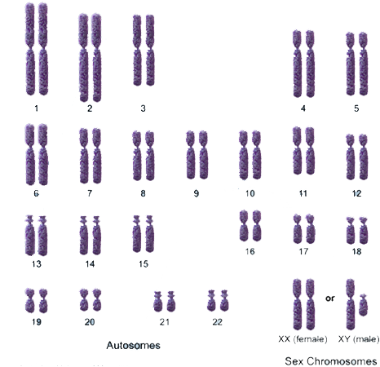
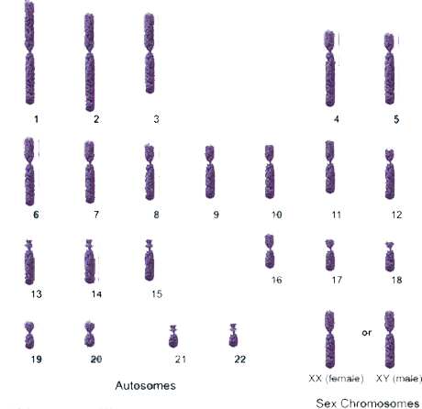
No. of Chromosomes
HAVING A SINGLE SET OF PAIRED CHROMOSOMES
HAVING A SINGLE SET OF UNPAIRED CHROMOSOMES
HAPLOID
DIPLOID
All body cells (Somatic cells)
In gametes (Sperm and egg)

Slide 19
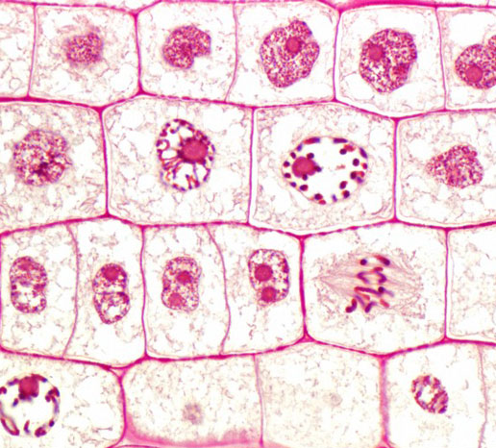
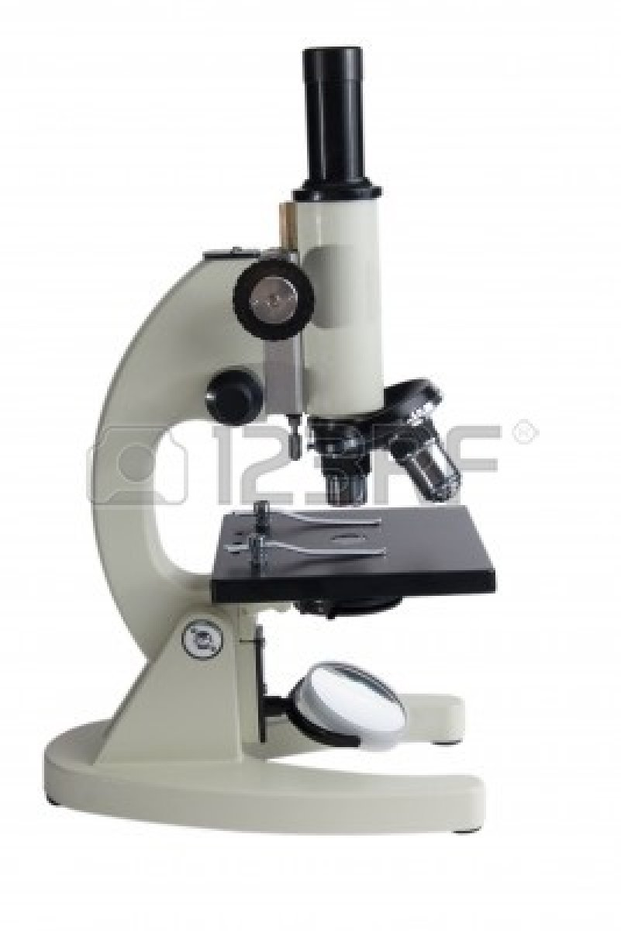
Chromosomes (Under light microscope)

Slide 20
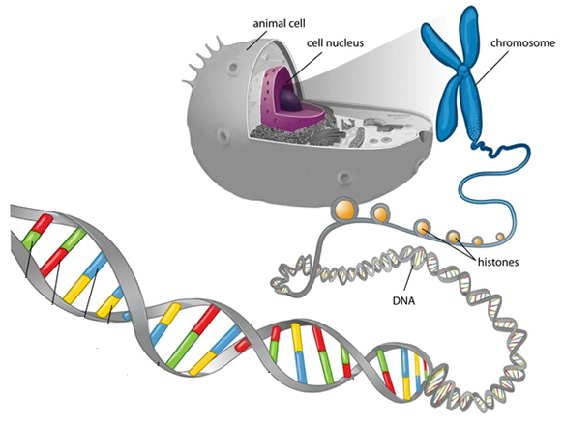
Chromosomes and DNA: Deoxyribonucleic acid
If we could unravel a chromosome, it would be form an extremely long thread.
This thread is made up of a long chain molecule called DNA .
The DNA is wound around molecules of protein.

Slide 21
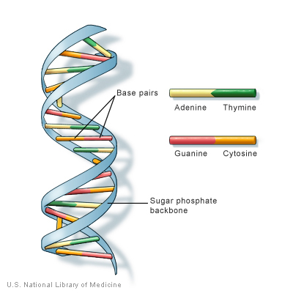
DNA Structure : A polymer of nucleotides
A molecule of DNA is made up of millions of tiny subunits called Nucleotides.
Each nucleotide consists of:
Phosphoric acid group
Pentose sugar
Nitrogenous base

Slide 22
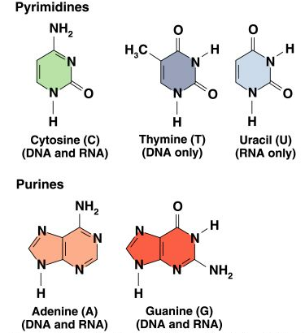
Components of a nucleotide

Slide 23
Nucleotides
Phosphate
Nitrogenous
Base
Pentose
Sugar

Slide 24
Types of Nucleotides
A
T
Adenine
Thymine
C
G
Cytosine
Guanine

Slide 25
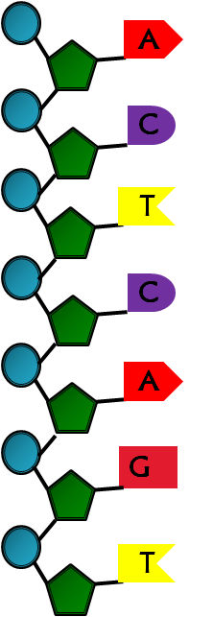
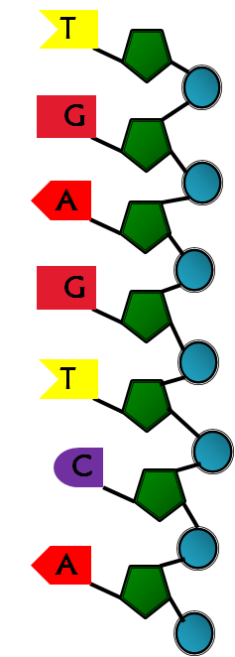
Structure

Slide 26
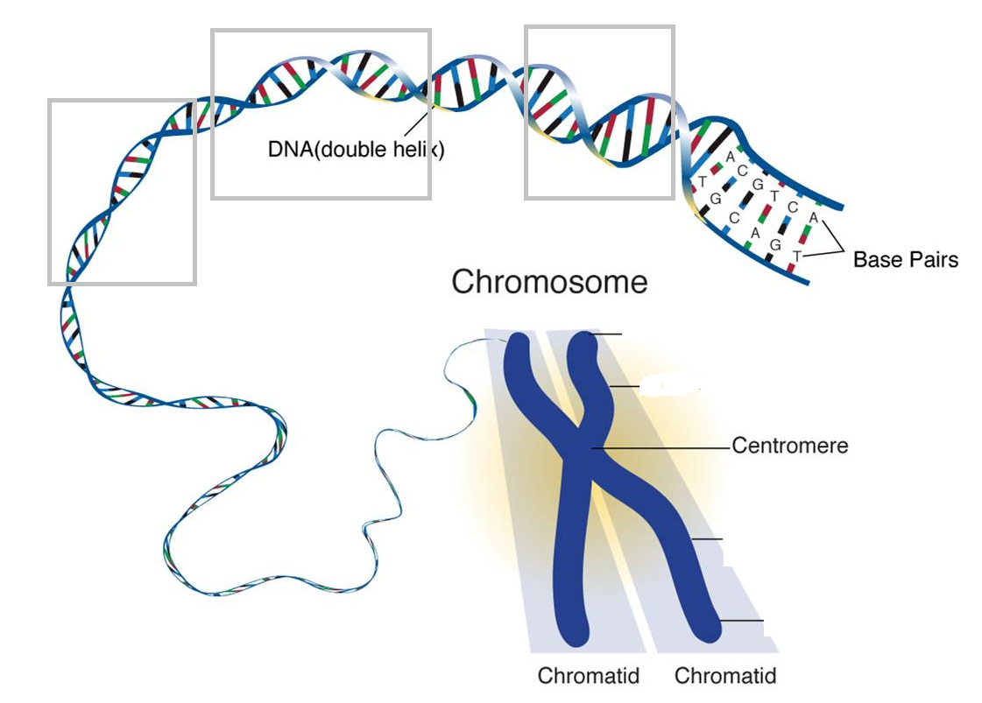
Chromosomes ,DNA and genes
Gene: Gene are segments of DNA on chromosomes that contains instruction for building proteins.

Slide 27
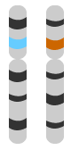
Genes (An unit of inheritance)
How many genes are there on a chromosomes…..?
Each chromosome has many genes along its length although the actual number depends on its length.
2. Are gene visible through light microscope during cell division. …? (Y/N)

Slide 28
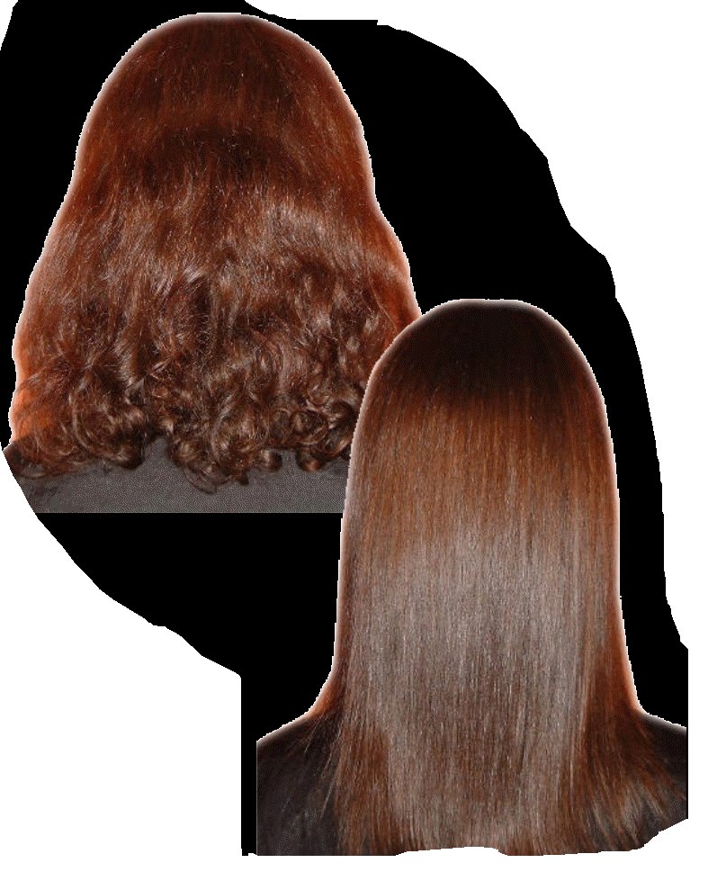
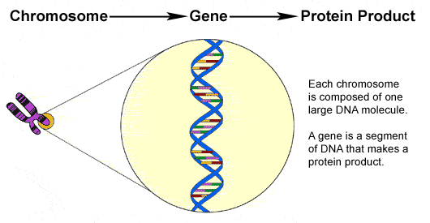
Genes: How do genes influence the body features…?
Each gene is a unit of inheritance .
It contains code that the cell interprets as an instruction to make a protein molecule.

Slide 29
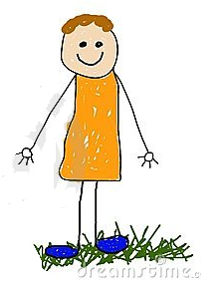
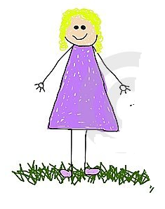
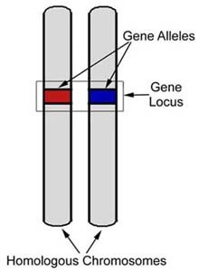
Gene and alleles
Alternative forms of a particular gene.

