Slide 1
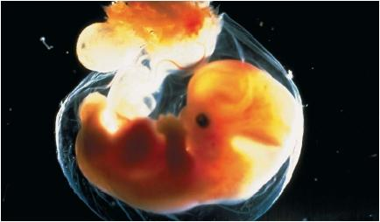
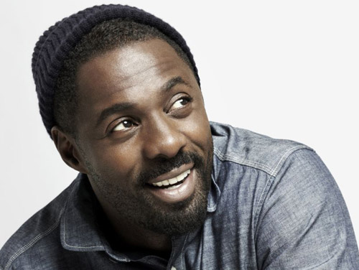
Method of inheritance
In what form are these instructions present in zygote…?
How these instructions decide the different characteristics ….?
How these instructions transfer from zygote to different cells of embryo?

Slide 2
CELL DIVISION

Slide 3
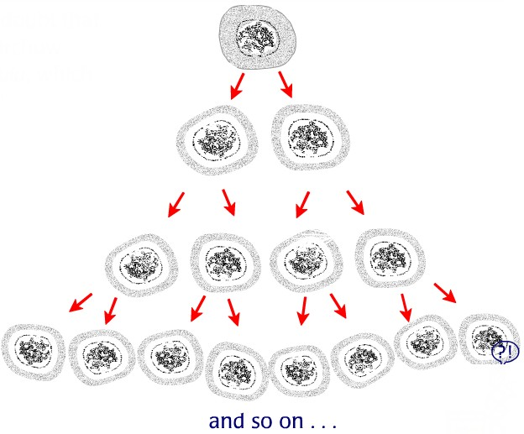
What do you mean the term cell division…?
Cell division is a method by which new cells arise from pre-existing cells.
There are two ways in which cells divide.
Mitosis
Meiosis

Slide 4
Cell cycle
Main events of cell cycle:
1.Non-dividing phase
2. Dividing phase
Nucleus divides
Cytoplasm divides

Slide 5
1. Mitosis (equational division)
1. What is mitosis? (equational division):-
A type of cell division in which a mother cell divides into two daughter cells and daughter cells have same number of chromosomes as present in the parent cell.
2. Which cells undergo mitosis?
All body cells (somatic) except the cells which produce male and female gametes.
3. Mechanism :
A) Division of nucleus
B) Division of cytoplasm

Slide 6
Asexual reproduction
Eg.:- Amoeba
Identify the process

Slide 7
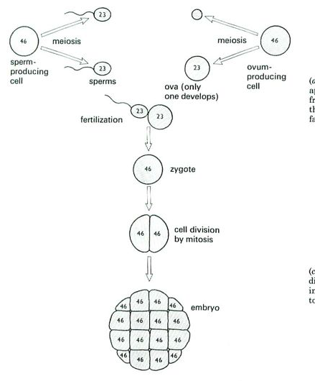
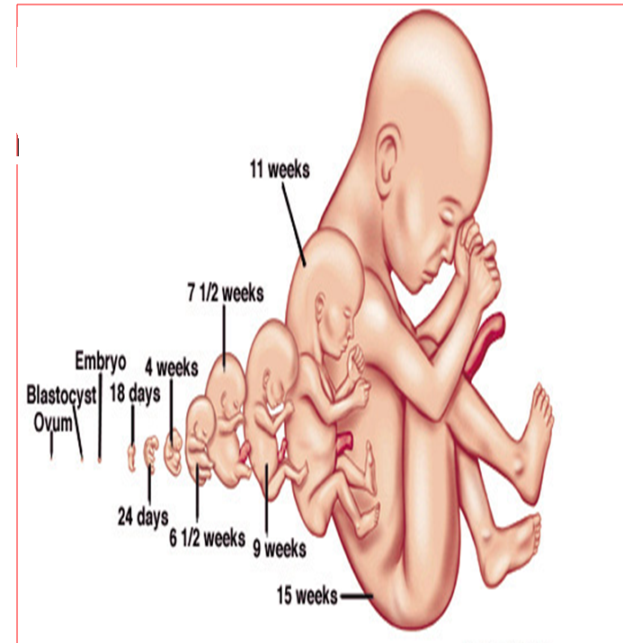
GROWTH IN ANIMALS

Slide 8
GROWTH IN PLANTS
Cells divide by mitosis
Cells divide by mitosis

Slide 9
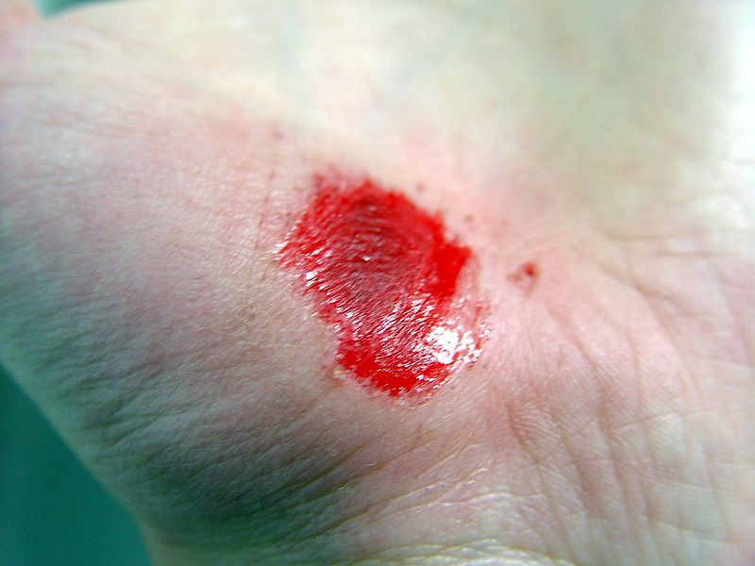
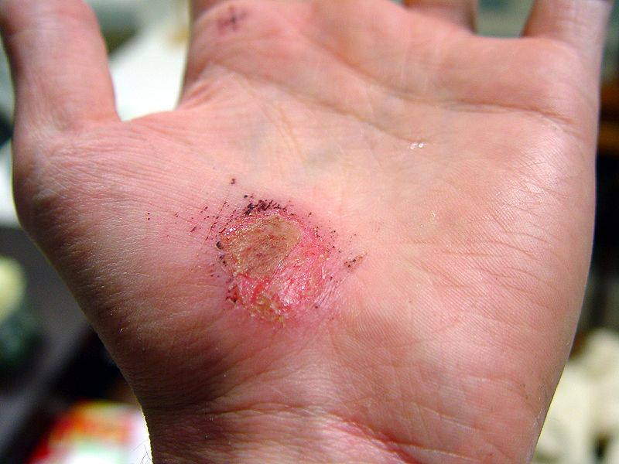
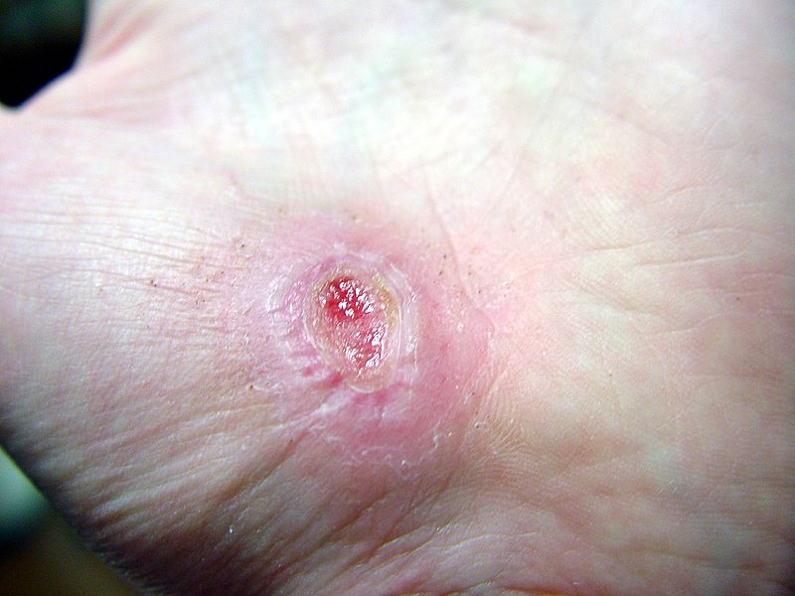
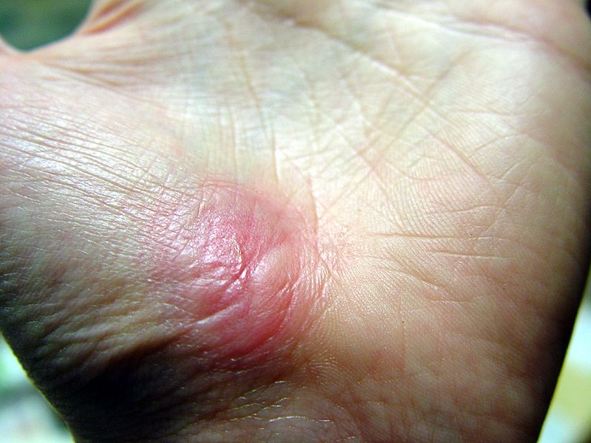
Repair of wounds

Slide 10
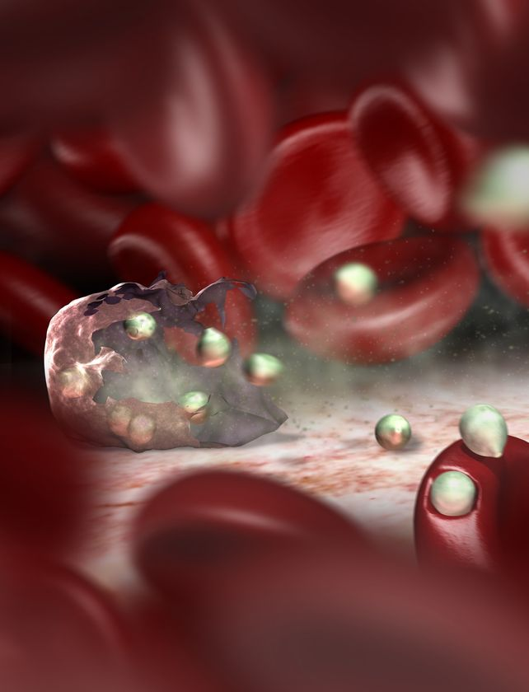
Replacement of cells that wear out and die
After
120 days
RBC
DEAD RBC
Every minute about 3 billion cells in our body die.

Slide 11
Significance: a) Asexual reproduction : In plant and fungi b)Growth (increase in the size ) c) Repair: to repair the injured tissues and c) Replacement: to replace the dead cells …….?
Mitosis

Slide 12
Watch the video List the events that are shown in the animation

Slide 13
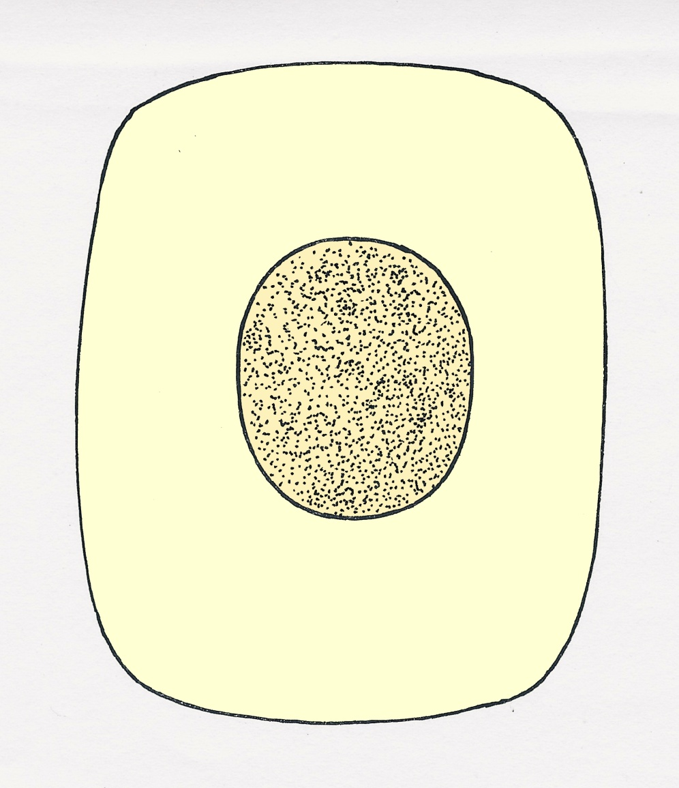
MECHANISM OF MITOSIS
nuclear
membrane
cytoplasm
In a cell which is not about to divide, the structures in the nucleus are not distinct

Slide 14
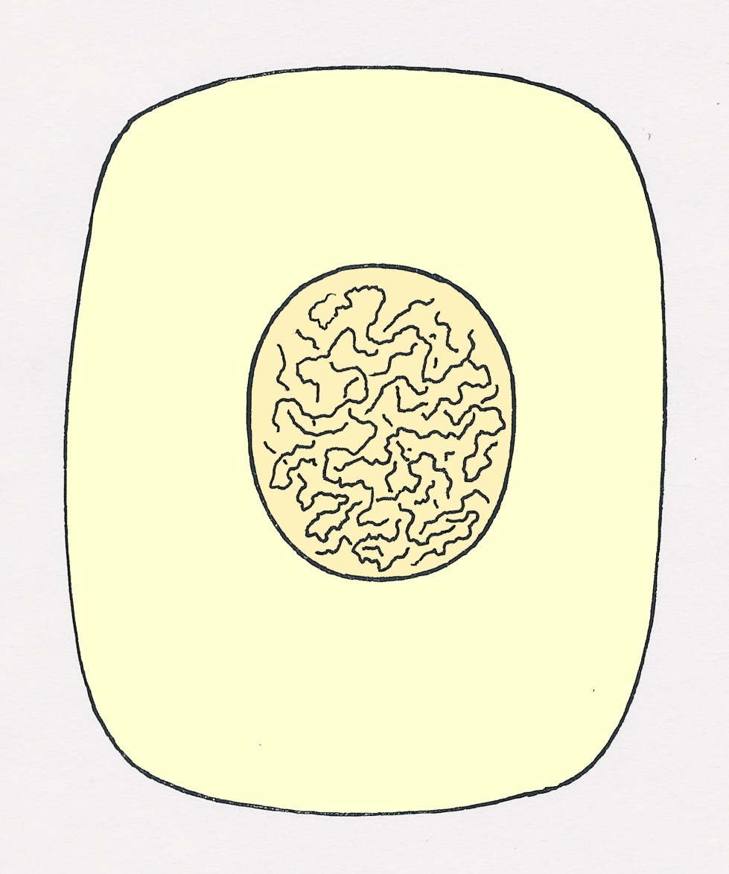
Just before cell division, thread-like
structures appear in the nucleus

Slide 15
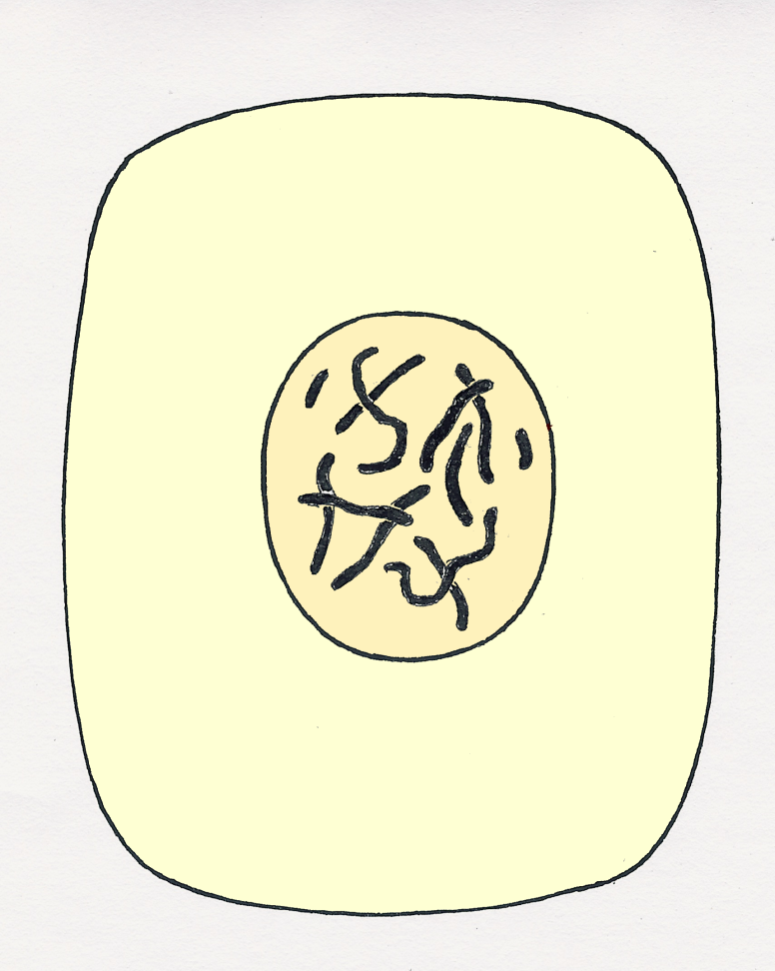
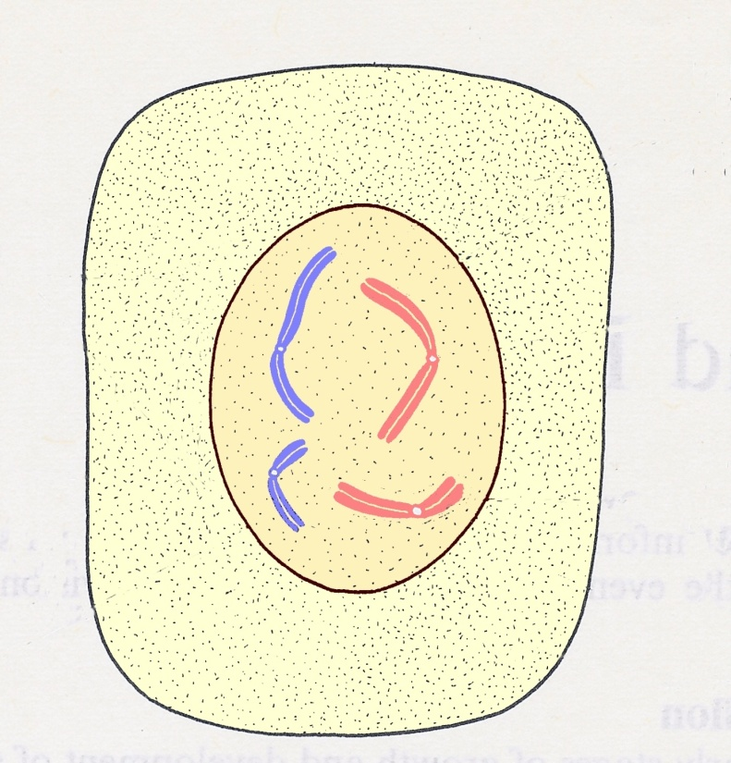
Due to continue shortening and thickening of chromosomes they become visible under microscope
Each chromosome has replicated to form chromatids

Slide 16
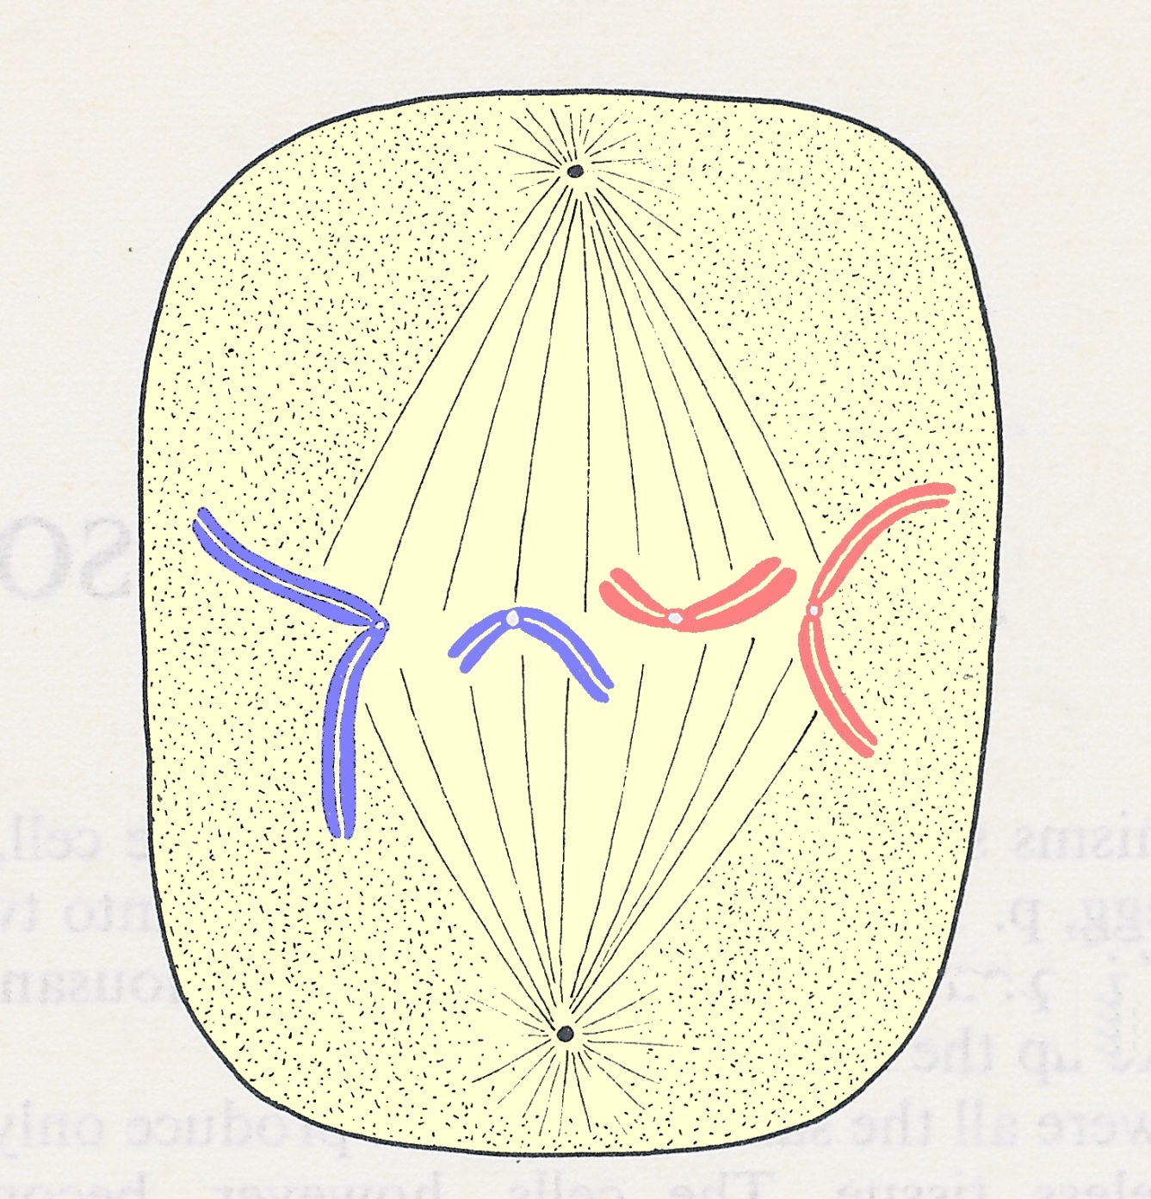
The nuclear membrane
disappears
Fibres appear in the
cytoplasm and form a
spindle
The chromosomes move
to the ‘equator’ of the
spindle

Slide 17
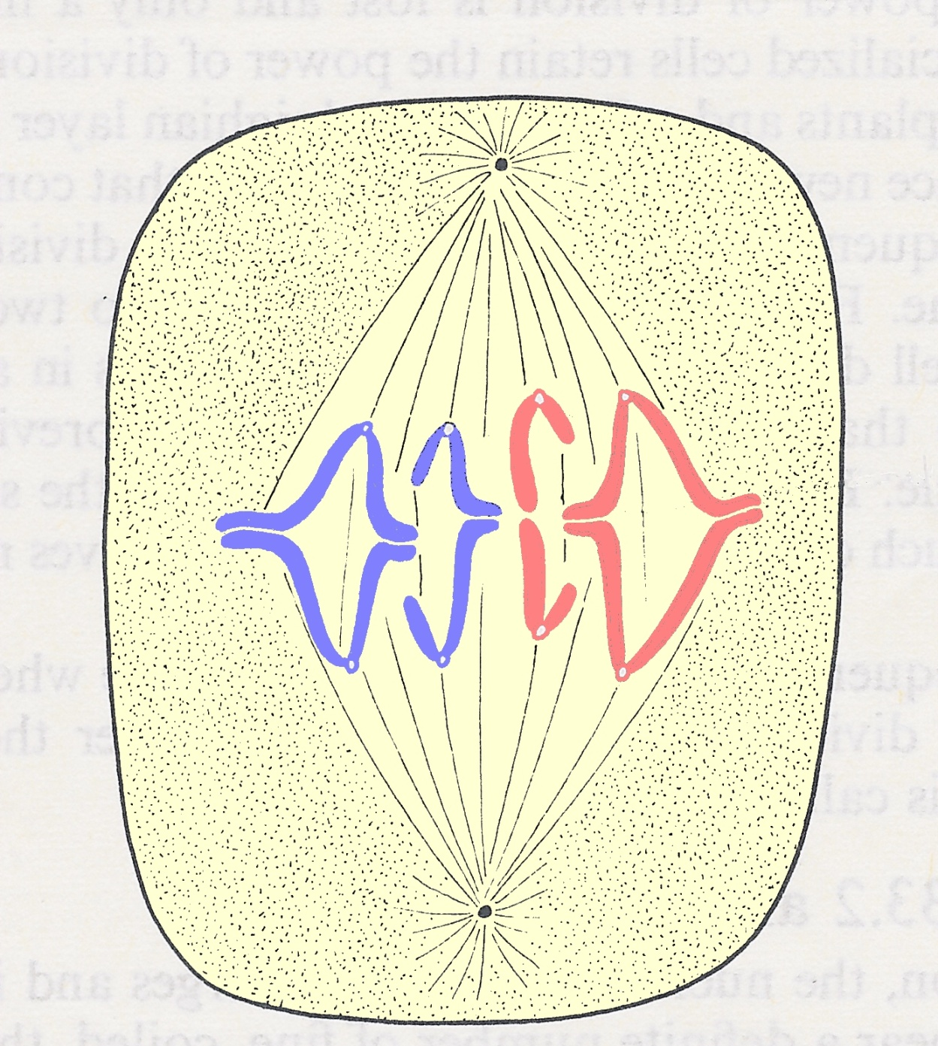
The spindle fibres
shorten and appear
to pull the chromatids
apart by their centromeres
Notes:
Although the shortening of the spindle fibres and the corresponding movement of the chromosomes are clearly associated, it should not be assumed that the fibres are physically tugging the chromosomes apart.

Slide 18
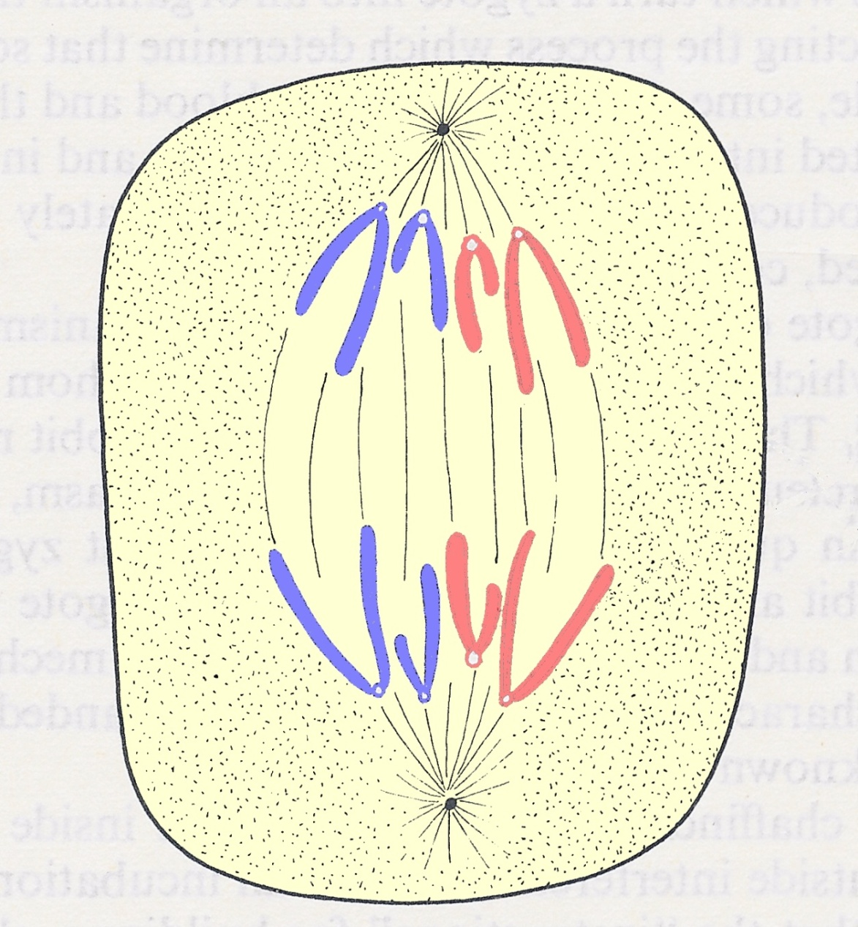
The spindle fibres
shorten and appear
to pull the chromatids
apart by their centromeres
The chromatids are now
chromosomes.
The chromosomes
migrate to opposite ends
of the cell as the spindle
fibres shorten

Slide 19
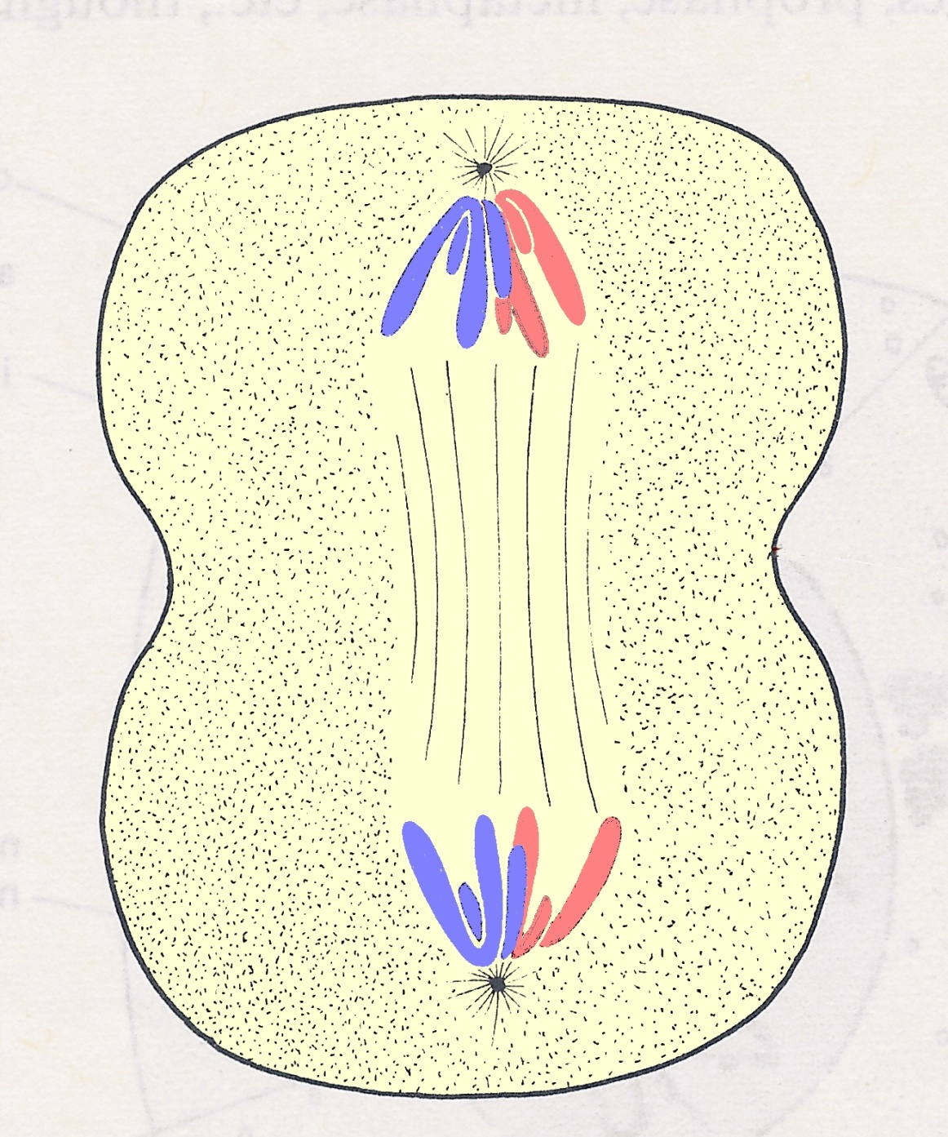
The cytoplasm begins to divide

Slide 20
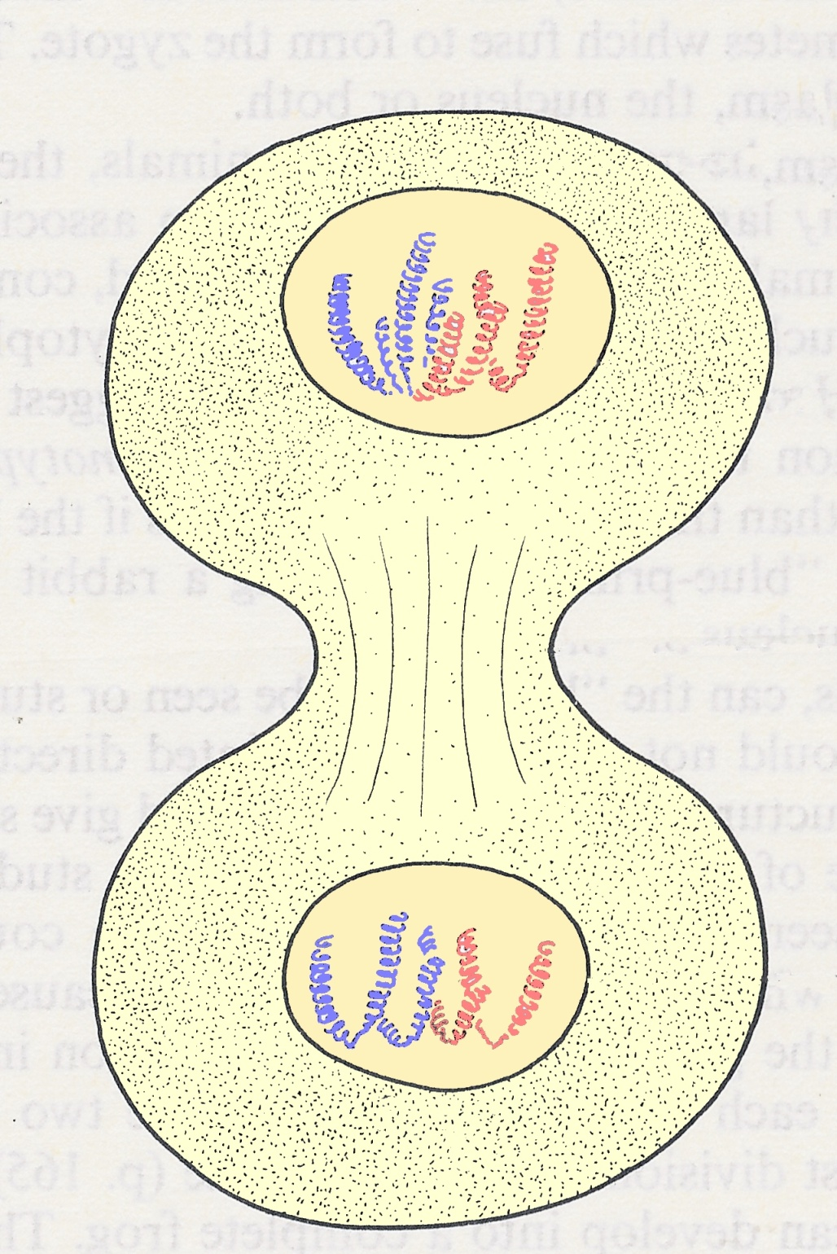
The nuclear membrane
forms again
The cell constricts
The chromosomes
become less distinct

Slide 21
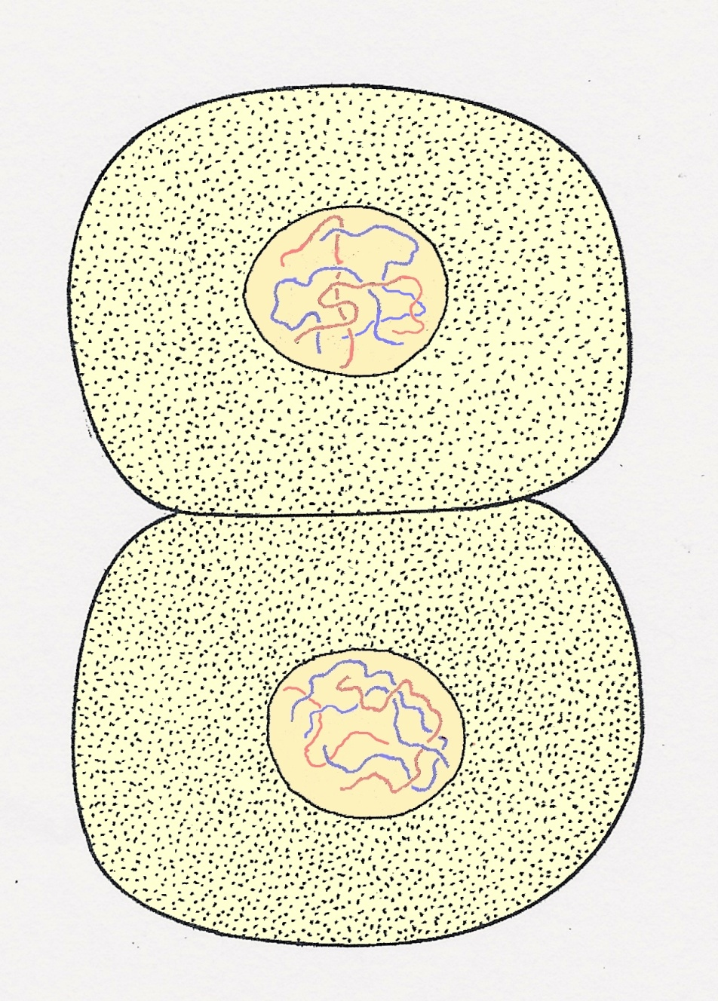
Two cells formed
The chromosomes revert to
their elongated thin shape
and eventually cannot be
seen
Each cell now has a full set
of chromosomes identical to
the parent cell

Slide 22
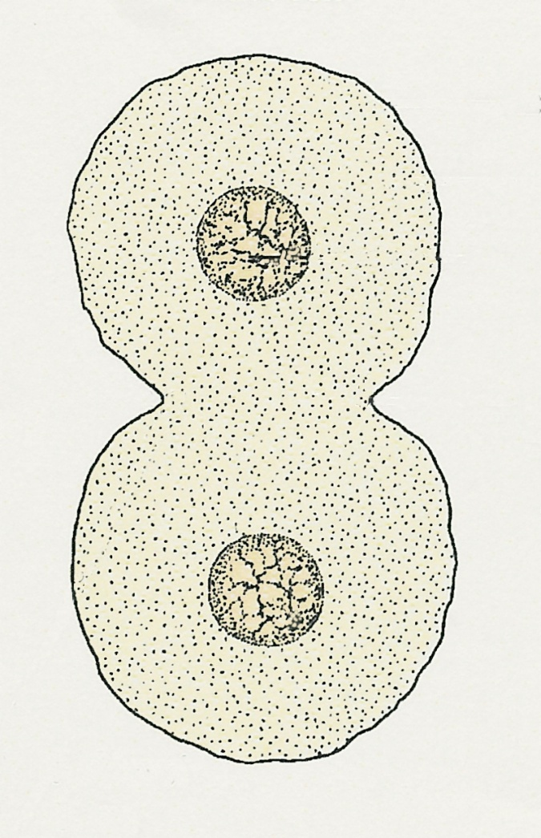
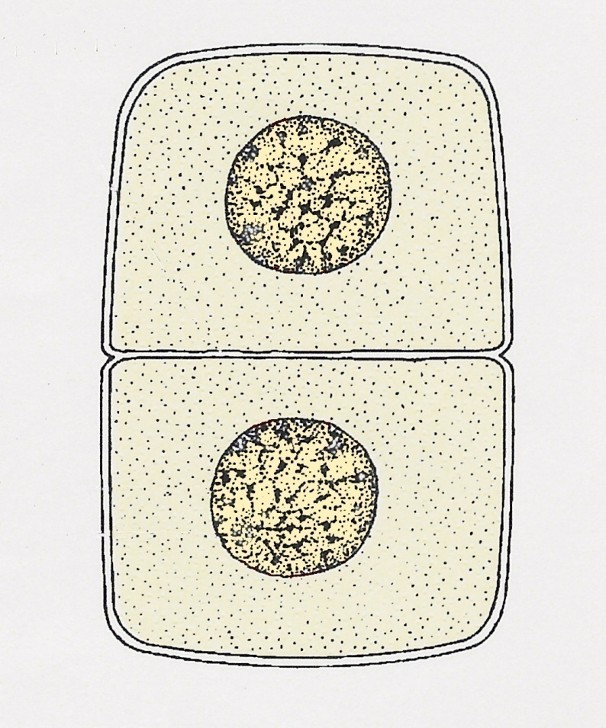
Plant and animal cells
Plant cells divide by
building a new cell wall
Animal cells divide by
a constriction of their
cytoplasm

Slide 23
Mitosis (Summary)
Produces 2 daughter cells
Chromosome number remain same in daughter cells.
Daughter cells are genetically identical to each other
Daughter cells are genetically identical to parent cell
Occurs in one stage.

Slide 24
Do you see a problem with this?

Slide 25
1. Meiosis (Reductional division)
1. What is meiosis? (Reductional division):-
A type of cell division in which a mother cell divides into four daughter cells and the number of chromosomes reduce to half in daughter cells.
2. Which cells undergo meiosis?
Germ cells present in reproductive organs produce male and female gametes by meiosis.
In humans: In Ovaries and testes
In plants: In anthers and ovules
3. Mechanism : Complete in two stages.
A) Meiosis I
B) Meiosis II

Slide 26
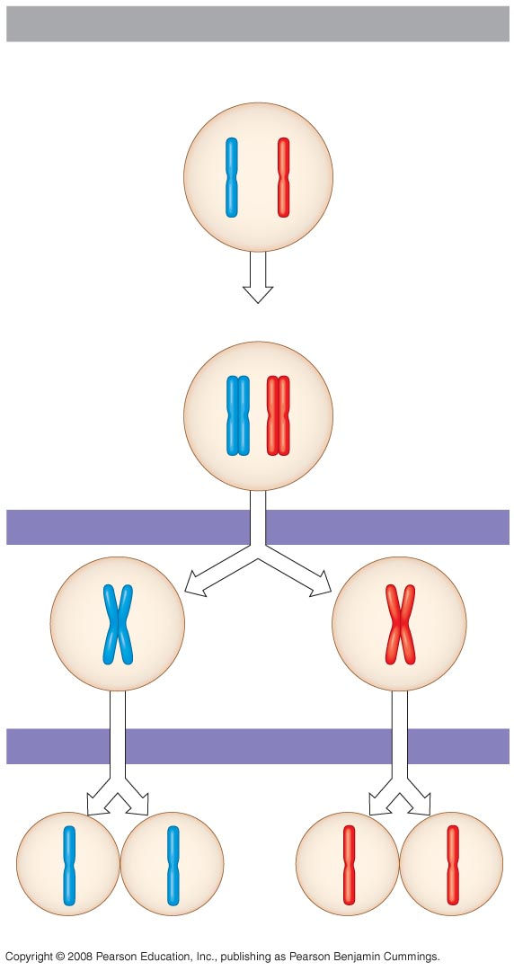
Produces 4 daughter cells
Daughter cells are haploid
Daughter cells are genetically different to each other
Daughter cells are genetically different to parent cell
Occurs in two stages.
Interphase
Homologous pair of chromosomes
in diploid parent cell
Chromosomes
replicate
Homologous pair of replicated chromosomes
Sister
chromatids
Diploid cell with
replicated
chromosomes
Meiosis I
1
Homologous
chromosomes
separate
Haploid cells with
replicated chromosomes
Meiosis II
2
Sister chromatids
separate
Haploid cells with unreplicated chromosomes

Slide 28
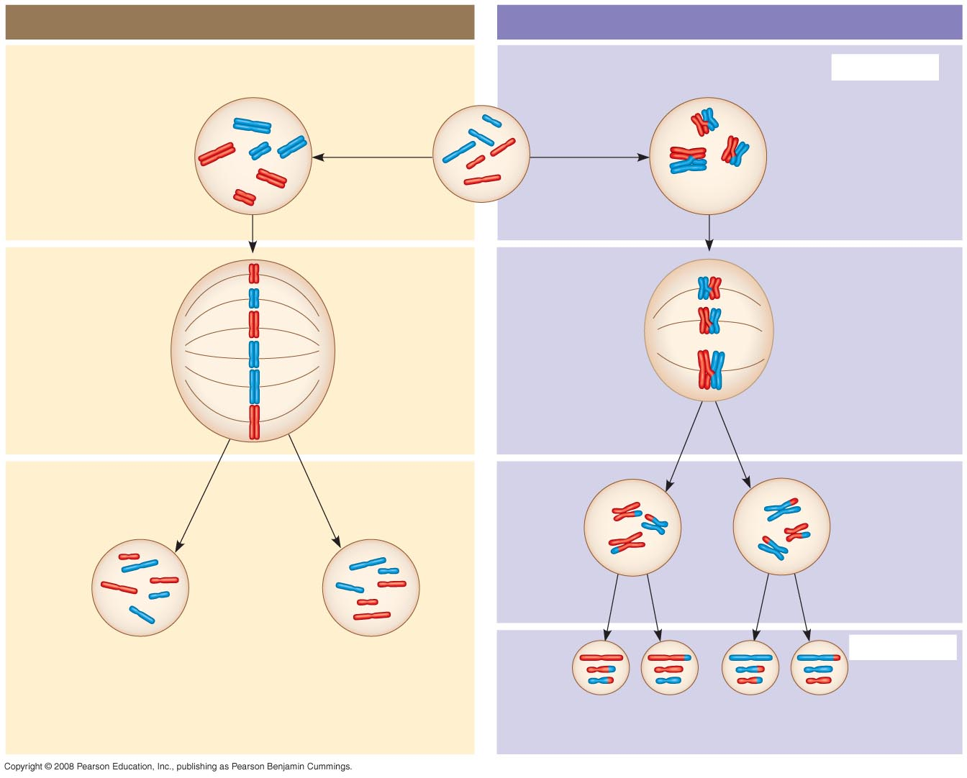
MITOSIS
MEIOSIS
MEIOSIS I
Parent cell
Chromosome
replication
Chromosome
replication
Replicated chromosome
Homologous
chromosome
pair
2n = 6
Daughter
cells of
meiosis I
Haploid
n = 3
MEIOSIS II
2n
2n
Daughter cells
of mitosis
n
n
n
n
Daughter cells of meiosis II
Notes:
Figure 13.9 A comparison of mitosis and meiosis in diploid cells

Slide 30
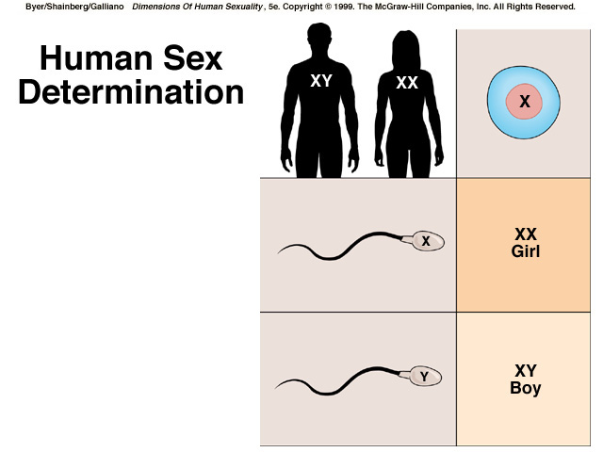
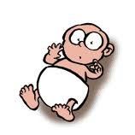
SEX DETERMINATION IN HUMANS

