Slide 1
GENETICS: TERMS

Slide 2
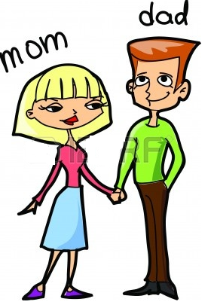
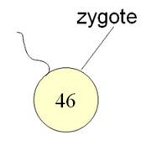
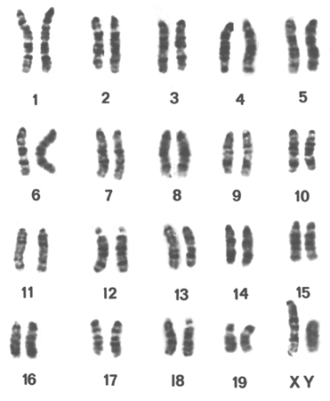

Slide 3
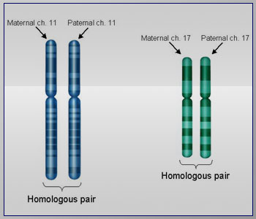
Homologous Chromosomes :
A pair of chromosome in which the member chromosome are similar in shape and size.

Slide 4
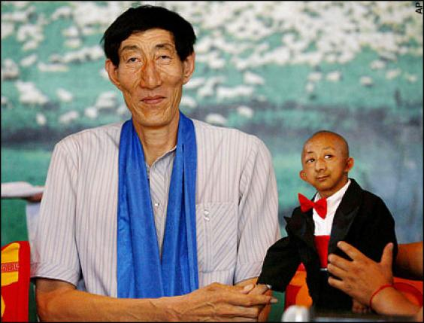
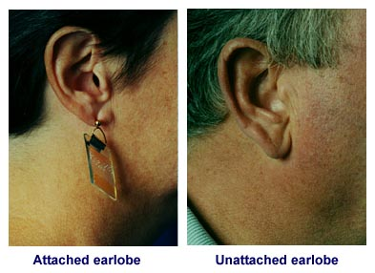
Character and trait
A structure, function, or attribute determined by a gene or group of genes is known as character.
Examples: Height, Flower colour, Eye colour, Ear lobes
A trait is a distinct variant of a character of an organism.

Slide 5
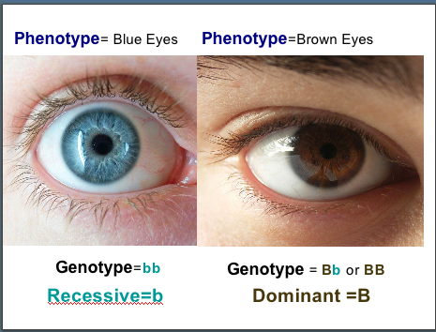
Phenotypes and genotypes
Phenotype
The characteristics visible in an organism.
the external appearance of an organism for a particular character.
Genotype
The genetic make- up of an organisms for a particular gene.

Slide 6
Genotype and phenotype
Homologous chromosome
GENOTYPE: THE GENETIC
MAKEUP
Height is the character and can be – tall or short (traits)
HEIGHT
HEIGHT
PHENOTYPE: THE PHYSICAL
APPEARANCE

Slide 7
How are genotypes written?
An organism's genotype is its pairing of alleles for a specific gene.
Genotypes, unlike phenotypes, can be homozygous (AA) or heterozygous (Aa).
If an organism is heterozygous for a gene, or possesses one of each allele, then the dominant trait is expressed.
A recessive allele is only expressed if an organism is homozygous for that trait, or posses two recessive alleles. (aa)

Slide 10
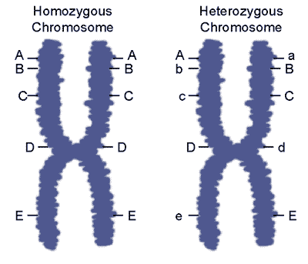
Homozygous and Heterozygous
When an organism has a pair of identical alleles controlling the same character, they are said to be homozygous for that characteristic (PP, pp)
When an organism has two different alleles for a character (Pp) they are said to be heterozygous for that characteristic.

Slide 11
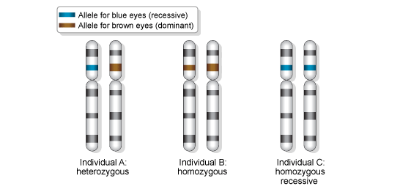
Notes:
http://www.abpischools.org.uk/res/coResourceImport/modules/genome/fullscreenflash19f9.cfm?flash=en-flash/eyecolour.swf&title=Eye+colour&version=6

Slide 12
Pure and hybrid
Eye colour
BB : Pure
Bb : Hybrid
bb: Pure

Slide 13
Dominant and recessive allele
Dominant allele : A gene that always shows the phenotype of an organism whether the organism is heterozygous or homozygous. (TT, Tt)
Recessive allele : A gene that only has effect on the phenotype when the organism is homozygous. (tt)

Slide 14
Assessment…?

Slide 15
Use the information for SpongeBob’s traits to write the phenotype (physical appearance) for each item.

Slide 16
Use the information in the chart in #1 to write the genotype (or genotypes) for each trait below.

Slide 17
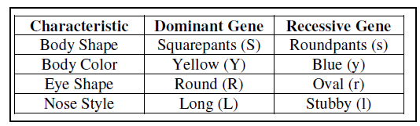
Determine the genotypes for each using the information in the chart in #1.
Heterozygous round eyes -_____
Homozygous long nose - ______
Purebred squarepants - ______
Hybrid yellow body - ______

