Slide 1
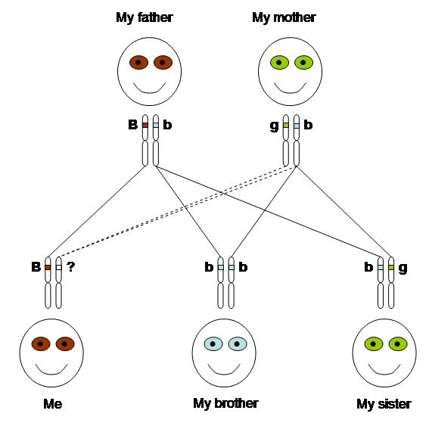
Inheritance pattern
What eye colour would be possible in me, my brother and my sister………?
Explanation………….?

Slide 2
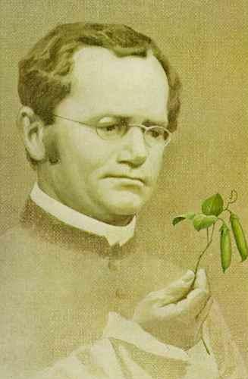
Who explained first about inheritance pattern….?
In the mid-1800s, the rules underlying patterns of inheritance were uncovered in a series of experiments performed by an Austrian monk named Gregor Mendel.

Slide 3
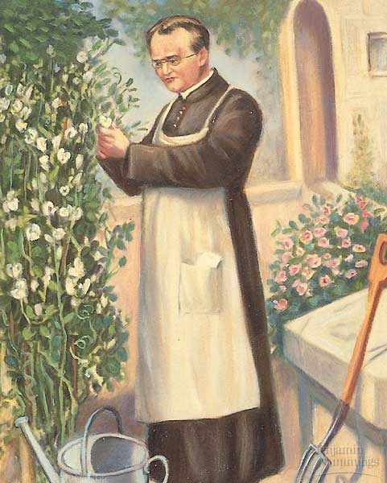

Which plant was selected by Mendel for genetics experiments……?

Slide 4
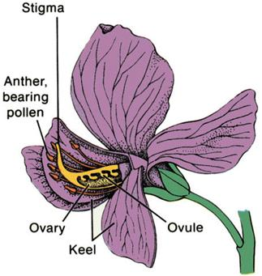
Why pea flower….?
Bisexual flower
Short life cycle
More offspring
Different contrasting features

Slide 5
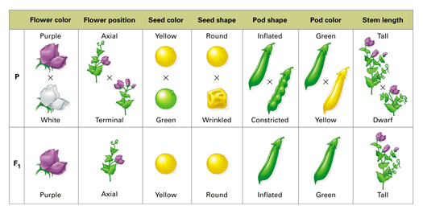
Mendel studies seven characteristics in the garden pea

Slide 6
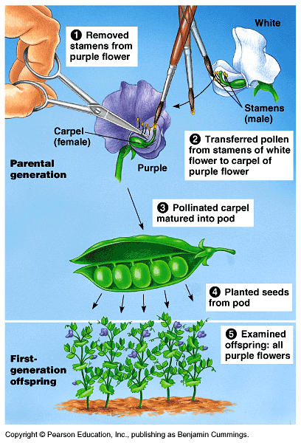
Method of experiment : Cross experiment

Slide 7
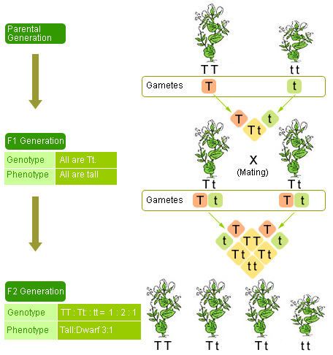
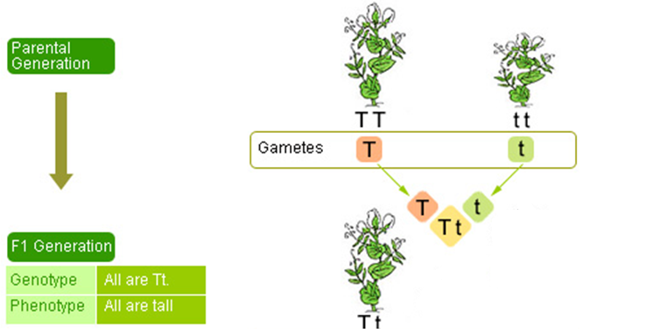

Slide 8
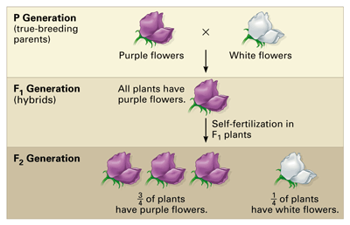
Monohybrid cross
For each monohybrid cross, Mendel cross-fertilized true-breeding plants that were different in just one character—in this case, flower color. He then allowed the hybrids (the F1 generation) to self-fertilize.

Slide 9
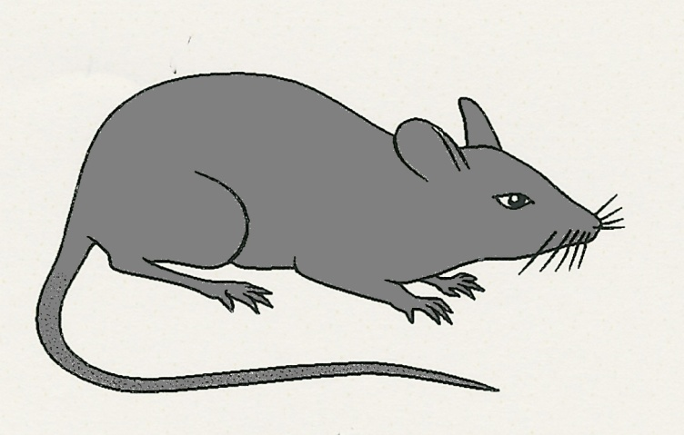
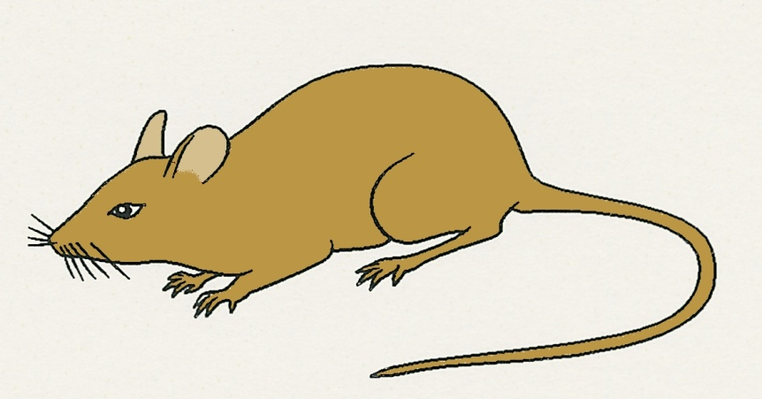
Example:2
Coat colour in mice

Slide 10
Symbols
4
The genes are represented by letters
The gene for black fur is given the letter B
The gene for brown fur is given the letter b
BB
bb
The genes must have the same letter but the
dominant gene is always in capitals

Slide 11
Alleles
5
The genes of a corresponding pair are called
alleles
This means alternative forms of the same gene
B and b are alleles of the gene for coat colour
B is the dominant allele
b is the recessive allele

Slide 12
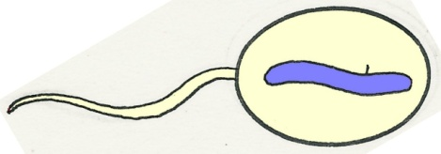

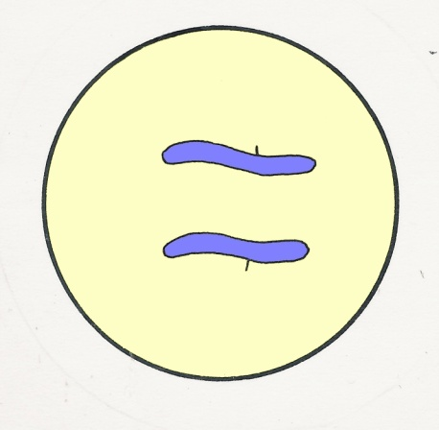
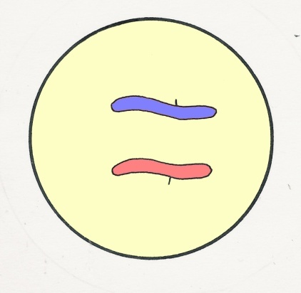
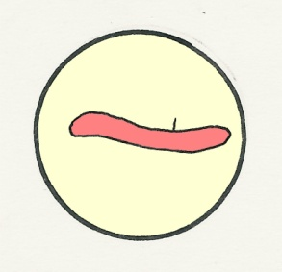
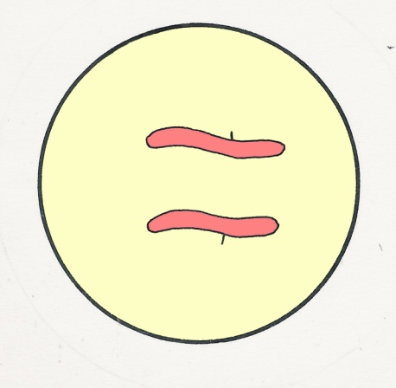

B
All offspring will
be black (Bb)
B
B
meiosis
B
fertilization
sperm mother cell
B
ovum mother cell
b
b
b
zygote
meiosis
b
b

Slide 13
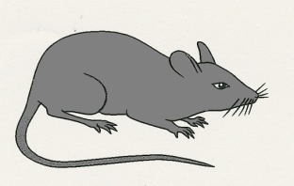
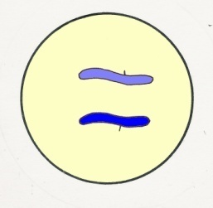


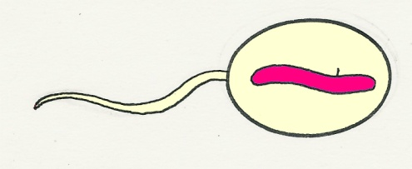

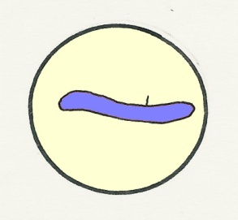
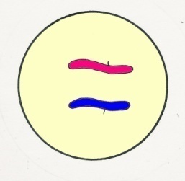

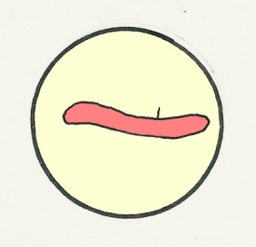
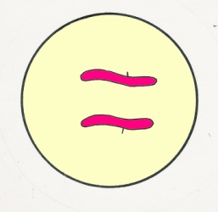

F₂
9
Fertilization
Possible combinations
sperms
B
B
B
B
BB
b
b
B
sperm mother cell
b
meiosis
Bb
ovum mother cell
b
B
B
B
Bb
b
b
b
b
ova
bb
zygotes

Slide 14
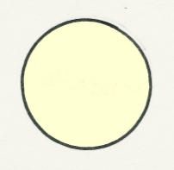
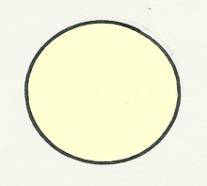
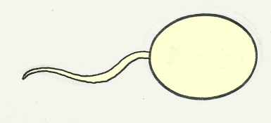
Punnett square
10
A neater way of working out the possible combinations
is to use a Punnett Square*
Draw a grid
Enter the alleles in the gametes
Enter the possible combinations
B
b
female gametes
B
male
gametes
BB
Bb
b
These are the
F₂ generation
Bb
bb
Notes:
* After Dr. R.C. Punnett, Professor of Genetics in Cambridge in the first half of the 20th century.

Slide 15
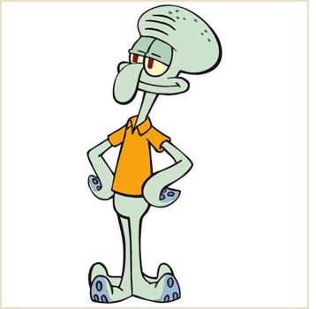
Problem:1
Everyone in Squidward’s family has light blue skin, which is the dominant trait for body color in his hometown of Squid Valley.
His family brags that they are a “purebred” line. He recently married a nice girl who has light green skin, which is a recessive trait.
Create a Punnett square to show the possibilities that would result if Squidward and his new bride had children.
Use B to represent the dominant gene and b to represent the recessive gene.

Slide 16
Solve the following
A. List the possible genotypes and phenotypes for their children.
B. What are the chances of a child with light blue skin? ____%
C. What are the chances of a child with light green skin? ____%
D. Would Squidward’s children still be considered purebreds? Explain!

Slide 17
Test cross
A test cross is used to identify the genotype of an individual showing a dominant characteristic by crossing it with a homozygous recessive individual.
BB or Bb?

Slide 18
The Monohybrid Cross
BB or Bb?

Slide 19
The Monohybrid Cross
X
X
BB
bb
Bb
bb
b
b
b
b
B
Bb
Bb
B
Bb
Bb
B
Bb
Bb
b
bb
bb
Ratio = Black : White
1 : 1
All offspring: black

Slide 20
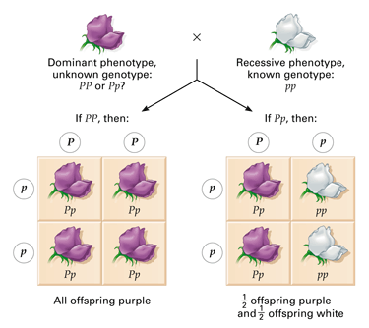
Testcross
A testcross is designed to reveal whether an organism that displays the dominant phenotype is homozygous or heterozygous.

Slide 21
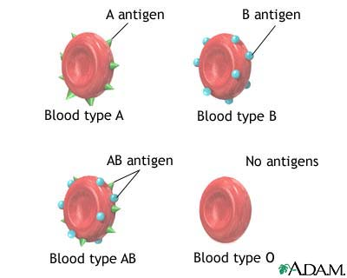
Co-dominance
Co-dominance is a pattern of inheritance where both alleles are expressed equally.

Slide 22
ABO blood groups
The I^{A} allele produces group A
The I^{B} allele produces group B
The I^{O} allele produces group O
I^{O} is recessive to I^{A} and I^{B}
 | Phenotype (blood group) | Genotype
 | Phenotype (blood group) | Genotype
 | A | I^{A}I^{A} or I^{A}Iº
 | B | I^{B}I^{B} or I^{B}I^{O}
 | AB | I^{A}I^{B}
 | o | I^{O}I^{O}
The alleles I^{A} and I^{B} are equally dominant (co-dominant)

Slide 23
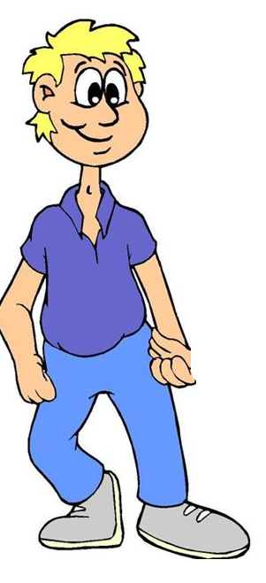
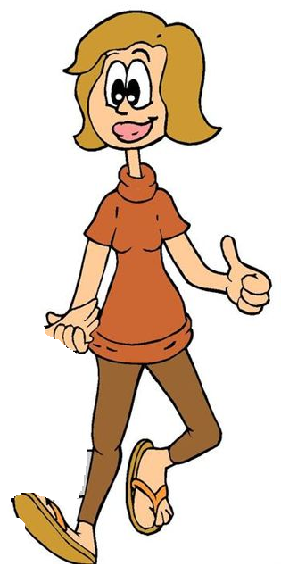





Use a genetic diagram to work out the possible blood groups of the offspring where the father is heterozygous for blood group A and mother is blood group O.

Slide 24
Family trees (pedigree)
24
It is sometimes possible to work out the genotypes of parents and
to track the inheritance of an allele by studying family trees
= normal female
= affected female
= normal male
= affected male
Parents have normal phenotypes
but produce
an affected child
For this to happen, both parents must have heterozygous
genotypes (Nn) for the characteristic

Slide 25
25
 | A | A
A | AA | AA
a | Aa | Aa
 | A | A
a | Aa | Aa
a | Aa | Aa
AA
If one of the parents is homozygous
for a dominant allele, all the children
will be affected
If one parent is heterozygous for a
dominant allele and the other is
homozygous recessive, there is
a chance that half their children will
be affected
Aa
aa
Aa
Aa
If both parents are heterozygous for
a recessive allele, there is a chance
that one in four of their children
will be affected

Slide 26
26
grandparents
marriage
marriage
parents
children
cystic fibrosis
What can you deduce about the genotypes of the grandparents from
this family tree?

Slide 27
27
Cystic fibrosis is caused by a recessive gene
An affected person must therefore have the genotype nn
Since neither of the grandparents is affected, they must be either
NN or Nn genotypes
If they were both NN, none of their children or grandchildren could
be affected
If one was Nn and the other NN, then there is a chance that
50% of their children could be carriers Nn
If one of the carriers marries another carrier, there is a
1 in 4 chance of their having an affected child
The genotypes of the grand parents must be either both Nn or one
NN and the other Nn

Slide 28
Question 1
29
Which of the following are heterozygous genotypes?
(a) Aa
(b) bb
(c) nn
(d) Bb

Slide 29
Question 2
30
Which of these genes are alleles?
A
B
C
chromosomes
A
b
c
(a) A and A
(b) A and B
(c) B and C
(d) B and b

Slide 30
Question 3
31
Which of the following processes separates
homologous chromosomes ?
(a) mitosis
(b) cell division
(c) meiosis
(d) fertilization

Slide 31
Question 4
32
Which of the following terms correctly describes
the genotype bb ?
(a) homozygous dominant
(b) heterozygous dominant
(c) homozygous recessive
(d) heterozygous recessive

Slide 32
Question 5
33
What is the likely ratio of affected children born to parents
both of whom are heterozygous for cystic fibrosis ?
1 affected: 3 normal
(b) 3 affected: 1 normal
(c) 2 affected: 2 normal
(d) all affected

Slide 33
Question 6
34
Which of the following phenotypes corresponds to the
Genotype I^{A}I^{O} ?
Blood group A
(b) Blood group B
(c) Blood group O
(d) Blood group AB

Slide 34
Question 7
35
What is the expected ratio of offspring from
a black rabbit Bb and a white rabbit bb ?
(a) 3 black: 1 white
(b) 1 black: 3 white
(c) 50% white; 50% black
(d) all black

Slide 35
Question 8
36
Which of these Punnett squares correctly represents
a cross between two heterozygous individuals ?
(a)
A
a
(b)
A
a
A
AA
aa
A
AA
Aa
a
AA
aa
a
Aa
aa
(c)
(d)
A
a
a
a
A
AA
Aa
A
Aa
Aa
a
Aa
Aa
a
aa
aa

Slide 36
Question 9
37
A married couple has a family of 6 boys.
What are the chances that the next child will be a girl ?
(a) 6:1
(b) 1:6
(c) 3:1
(d) 1:1

Slide 37
Question 10
38
Which of the following is a ‘carrier’ genotype for a disease
caused by a recessive gene ?
(a) nn
(b) NN
(c) Nn

Slide 38
Question 11
39
If normal parents have a child with cystic fibrosis
(a) one of them must be heterozygous
(b) both of them must be heterozygous
one of them must be homozygous
(d) both of them must be homozygous

Slide 39
Answer
40
Correct

Slide 40
Answer
41
Incorrect

