Slide 1
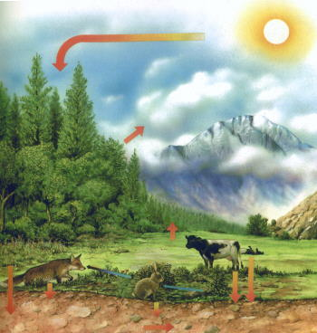
Unit_ IV : Ecology & environment

Slide 2

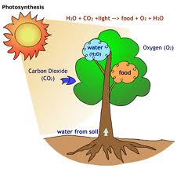


For different activities , we need energy.
The source of energy is food.
We get food from plants or animals.
But, What about plants…….?
Sun is the principal source of energy input to biological systems
So what is the principal source of energy…….?

Slide 3
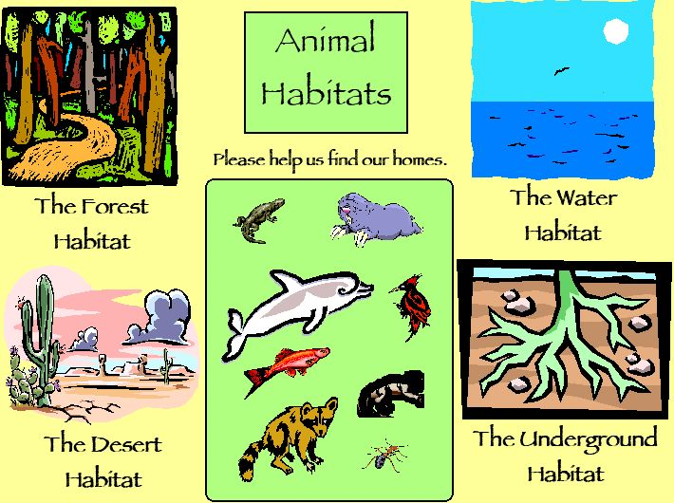
Habitat
Habitat is a place where an organism lives.

Slide 4
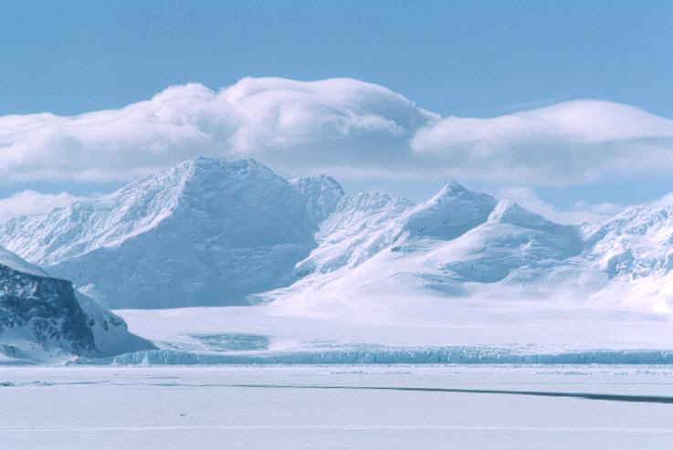
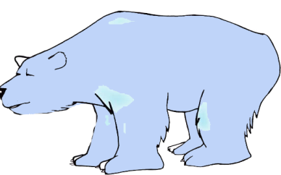
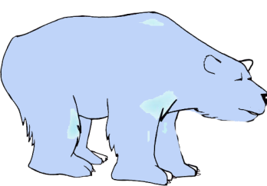

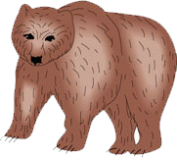
Species
Species—a group of organisms which can interbreed and produce fertile offspring.

Slide 5
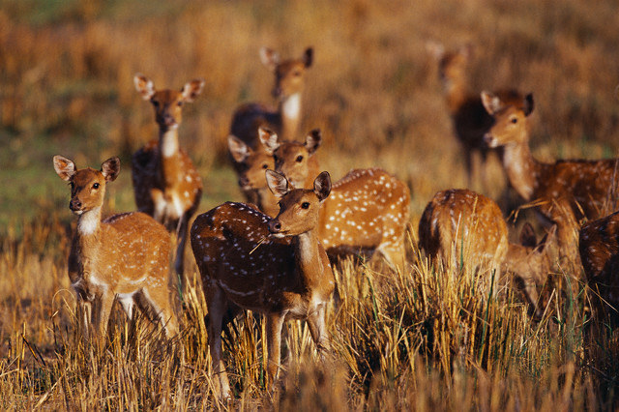
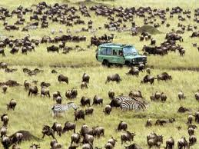
Population
A group of organisms of the same species living in the same area at the same time.

Slide 6
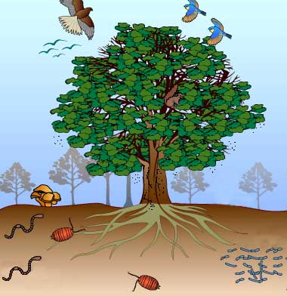
Community
All the populations of all the species in an area.

Slide 7
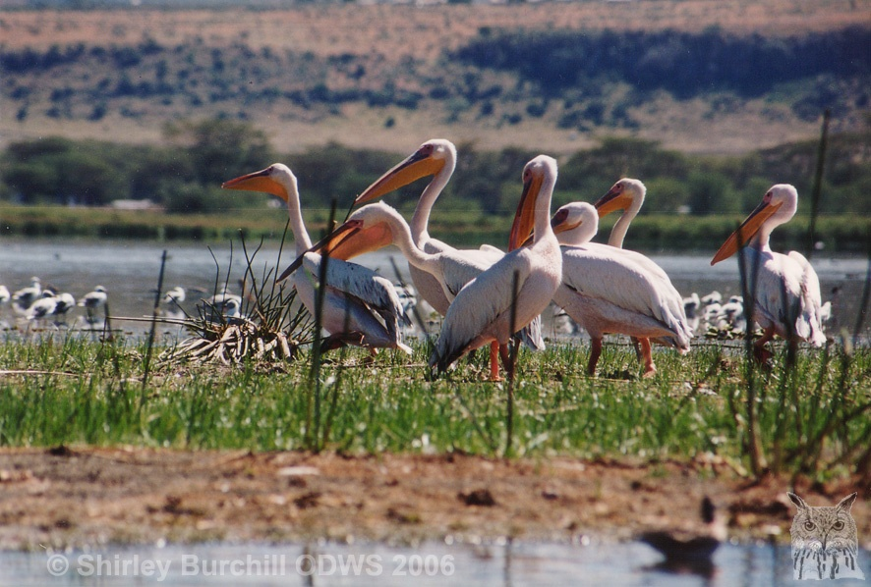
Ecosystem (A natural functional unit of ecology )
Community of organisms interacting with each other and their surroundings in a particular area.
Example :-
a pond,
a lake,
A tree
An aquarium
a forest etc.

Slide 8
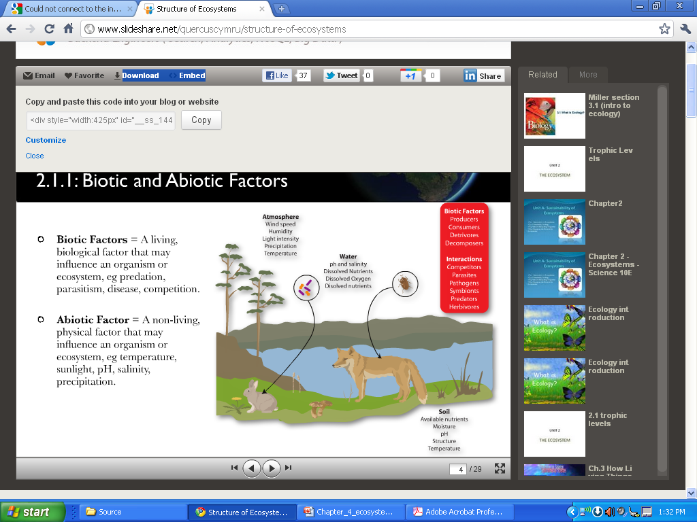
Ecosystem : Components

Slide 9
Apply a term ……..?
The whole lake
All the frogs in the lake
The flow of water through the lake
All the plants and animals present
The mud of the lake
The temperature variations in the lake
Ecosystem
Population
Abiotic factor
Community
Habitat
Abiotic factor

Slide 10
Ecosystem :b) Biotic Components
Producers
Consumers
a) primary consumers
b) Secondary consumers
c) Tertiary consumers
d) Quaternary consumers
c) Decomposers

Slide 11
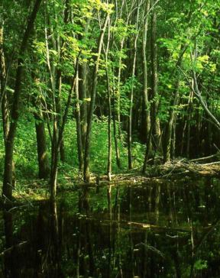
Producers (Autotrophs)
An organism that makes its own organic nutrients, usually using energy from sunlight, through photosynthesis.
Importance of Producers- make energy available for all other members of the community.

Slide 12
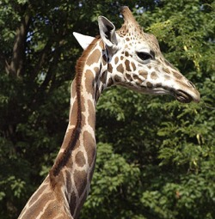
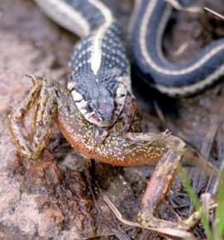
Consumer (Heterotrophs)
An organism that gets its energy by feeding on other organisms
Herbivore : An animal that gets its energy
by eating plants
Carnivore :An animal that gets its energy by
eating other animals.

Slide 13
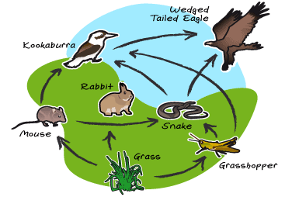
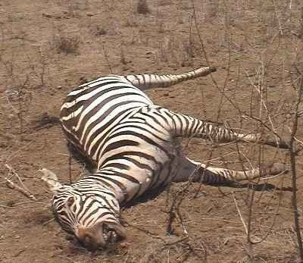
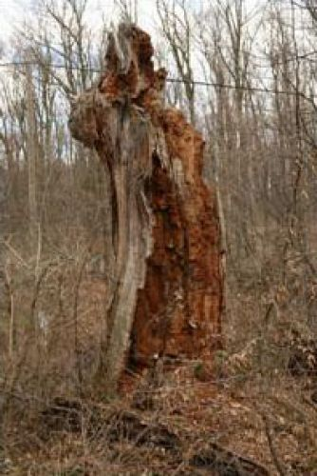
Decomposers
After death of plants and animals, where do they go?
Decomposer as an organism that gets its energy from dead or waste organic matter
Bacteria, fungi and moulds are the decomposers or reducers of the ecosystem.

Slide 14
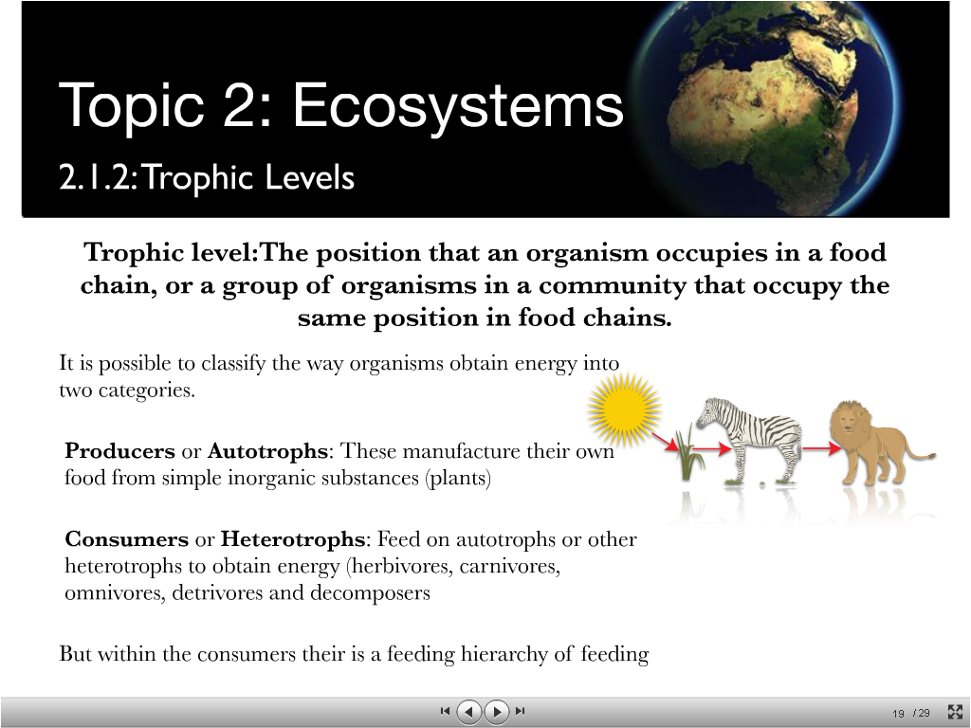
Trophic levels
the position of an organism in a food chain, food web or pyramid of biomass, numbers or energy

Slide 15
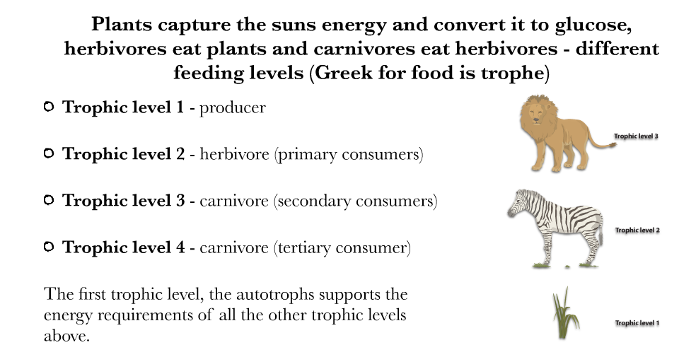
Trophic levels

Slide 16
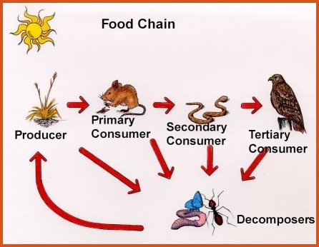
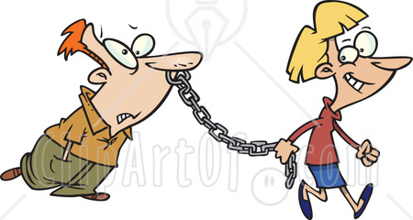
FOOD CHAIN
A food chain is a sequence of relationships between trophic levels where each member feeds on the previous one.
Remember: We do not include the sun in food chains, as it s not a food.

Slide 17
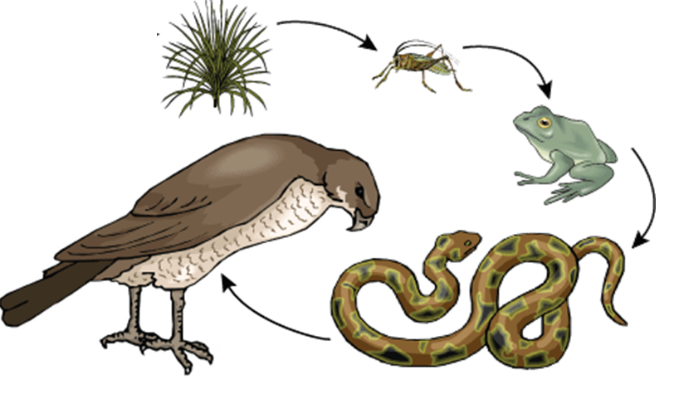
FOOD CHAIN

Slide 18
Food web
Food web can be defined as a network of a number of food chains existing in an ecosystem.

Slide 19
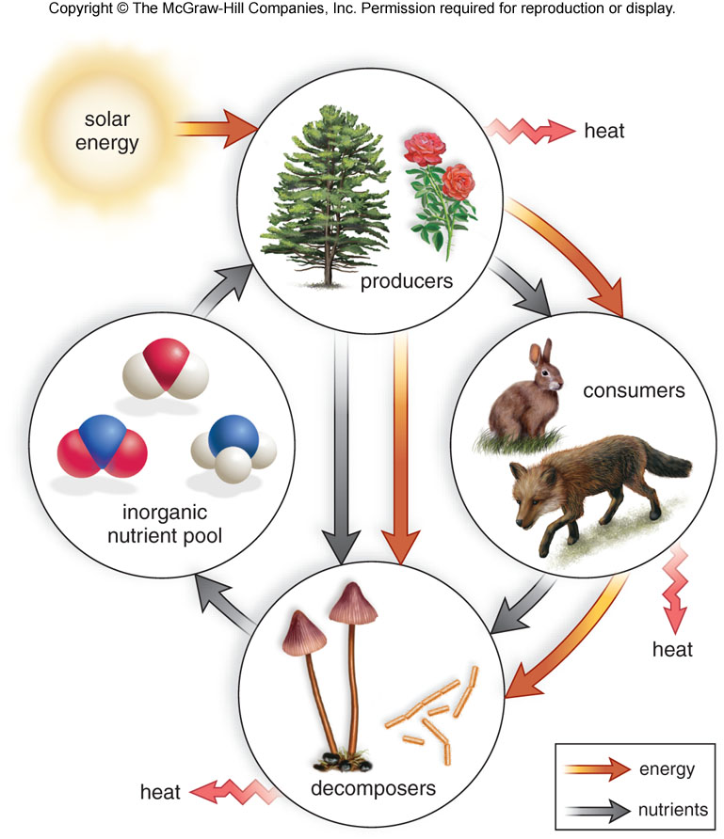
Energy flow and nutrient cycling
Non-cyclic nature of energy flow
Mineral cycling

Slide 20
Energy flows through ecosystems
sun
secondary
consumers
(carnivores)
loss of
energy
primary consumers
(herbivores)
loss of
energy
producers (plants)

Slide 21
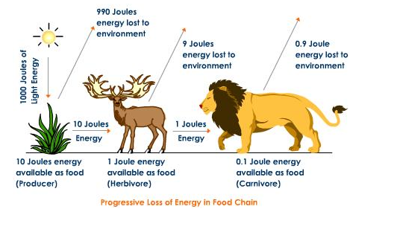
Energy loss in ecosystem

Slide 22
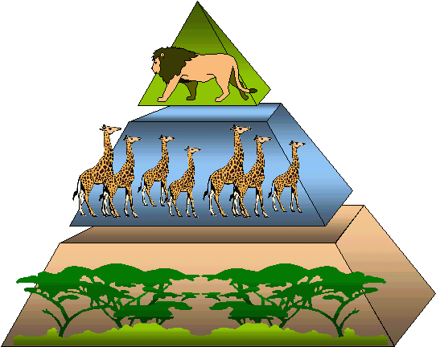
Ecological Pyramids
Food chains and food webs show feeding relationships in a community, but they do not show how many living organisms are involved.
“It is a representation of an ecological parameter present in various trophic levels of a food chain“.
Like,- Energy flow, number of individuals etc.
Here the producers are at the base and consumers at the top.
On the basis of the parameters used, ecological
pyramids are of three types.
Pyramid of Numbers
Pyramid of Biomass
Pyramid of Energy

Slide 23
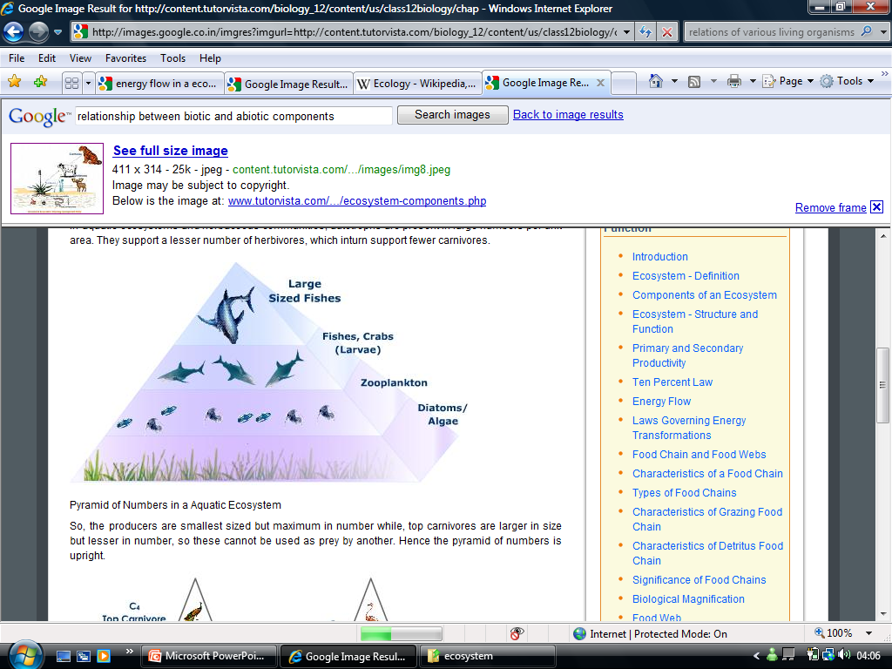
1)Pyramid of Numbers
The graphic representation of number of individuals per unit area of various trophic levels.
For eg-
  About 100 algae ---
  8 zooplanktons—
  3 fishes and crabs-----
  one large fish.

Slide 24
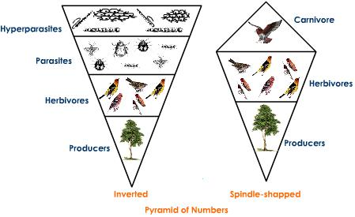
Pyramid of numbers
Producers are at the first level, herbivores at second and carnivores at third.
There are fewer herbivores than producers.
There are fewer carnivores than herbivores.

Slide 25
Pyramid of numbers
Drawback:
Does not take into account the size of organisms.
Buzzard
Parasites
Blackbirds
Ladybirds
Greenfly
Catterpillars
Rose bush
Mahogony tree

Slide 26
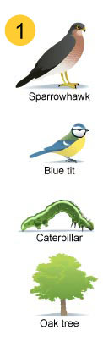
Sparrowhawk
Blue tits
Caterpillars
Oak tree

Slide 27
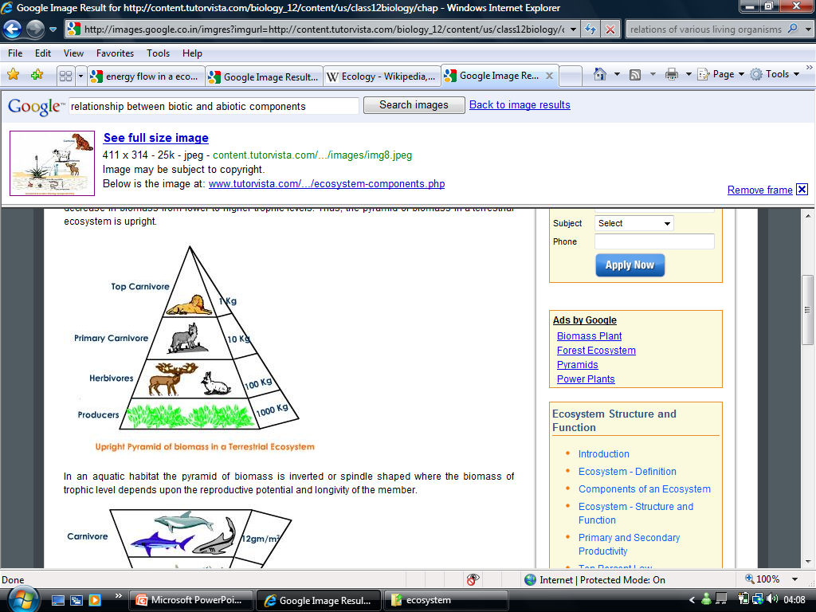
2. Pyramid of Biomass
The total amount of living or organic matter in an ecosystem at any time is called 'Biomass'.

Slide 28
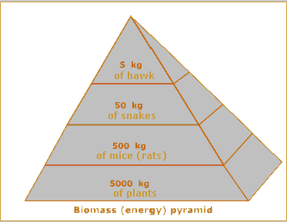
Pyramid of biomass
For construction-
  Samples of organisms at each trophic level is taken,
  Average mass is calculated
  Average mass is multiplied by the estimated number of organisms present in the community.

Slide 29
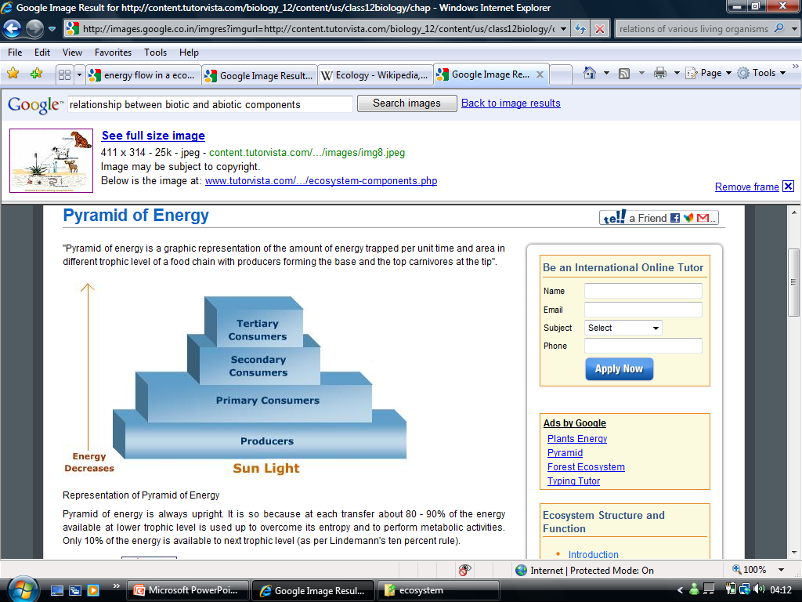
3. Pyramid of Energy
Graphic representation of the amount of energy trapped per unit time and area in different trophic level of a food chain.
The producers forming the base and the top carnivores at the tip.

Slide 30
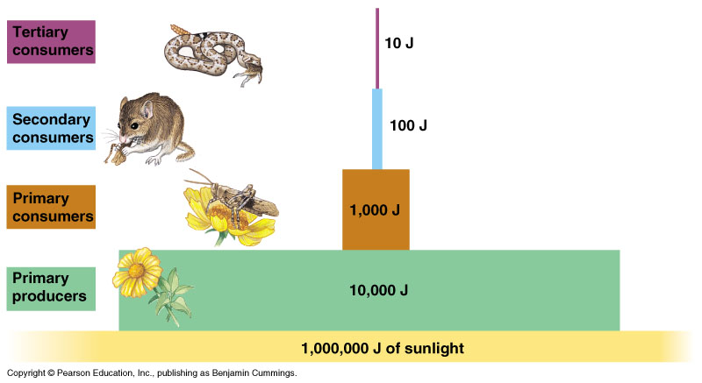
Ecological pyramid
sun
Loss of energy between levels of food chain
  can feed fewer animals in each level
  Fewr organisms at the top due to energy loss
1
100
100,000
1,000,000,000

Slide 31
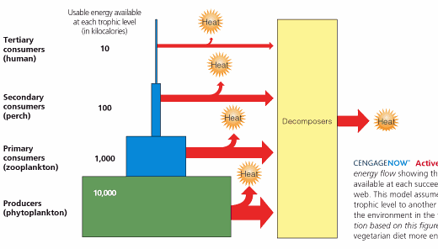
Explain why food chains usually have fewer than five trophic levels
it's probably because energy is lost in huge amounts as you go up the trophic levels, due to metabolism, heat loss, etc.
so if you had a 5th level consumer, they would have to eat less amounts of food to be able to survive.

Slide 32
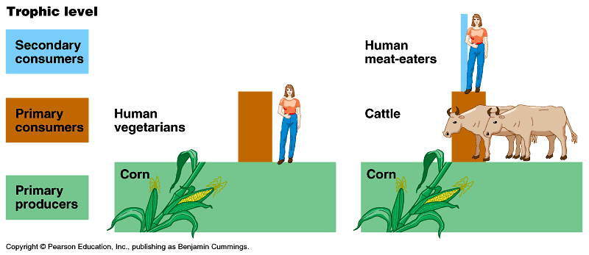
Humans in food chains
  how much energy does it take to feed a human?
    if we are meat eaters? Vegetarians?

Slide 33
Carbon Cycle…?
In what forms does carbon present in living organisms…..?
Carbohydrate, Protein, Fats, DNA etc.
What are the sources of carbon.
How do carbon enters into living organisms.
In what way does it come back to the sources again.

Slide 34
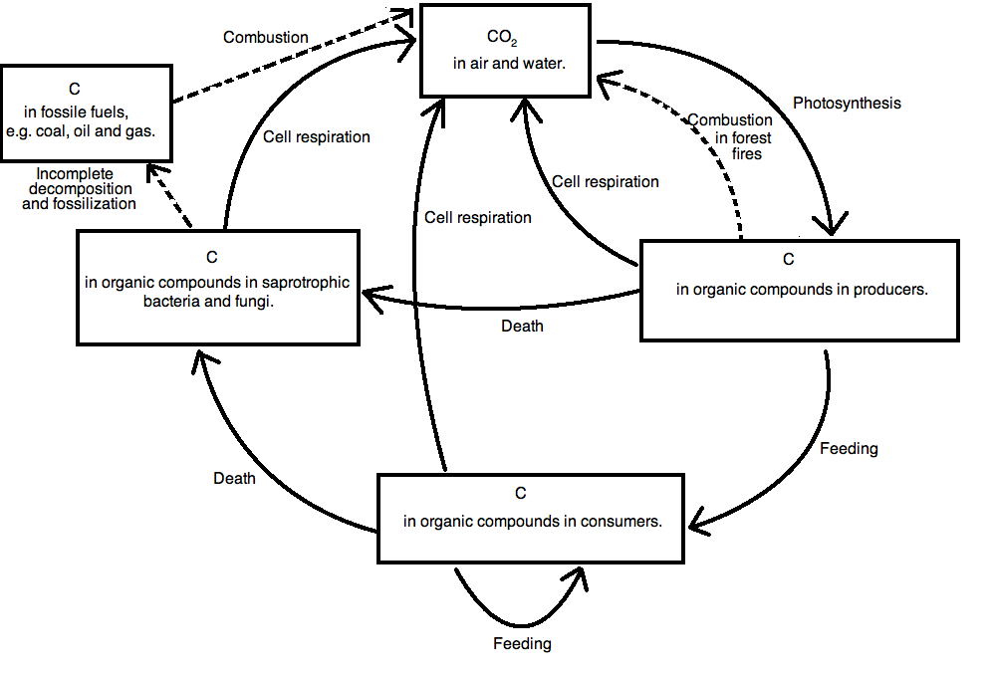
Copy the following figure
abiotic reservoir:
  CO₂ in atmosphere
enter food chain:
  photosynthesis = carbon fixation in Calvin cycle
Recycle:
decomposition
return to abiotic:
  respiration
  Combustion of fossil fuels

Slide 35
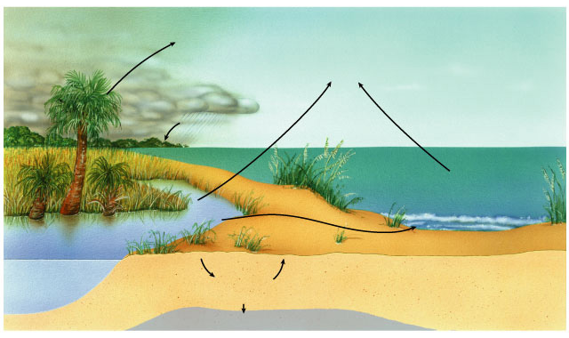
Water cycles
abiotic reservoir:
  surface & atmospheric water
enter food chain:
  precipitation & plant uptake
recycle:
  transpiration
return to abiotic:
  evaporation & runoff
Solar energy
Transpiration
Water vapor
Evaporation
Precipitation
Oceans
Runoff
Lakes
Percolation in soil
Aquifer
Groundwater

Slide 36
Nitrogen Cycle…?
In what forms does nitrogen present in living organisms…..?
Amino acids, Protein, Chlorophyll, DNA etc.
What are the sources of nitrogen.
How do nitrogen enters into living organisms.
In what way does it come back to the sources again.

Slide 37
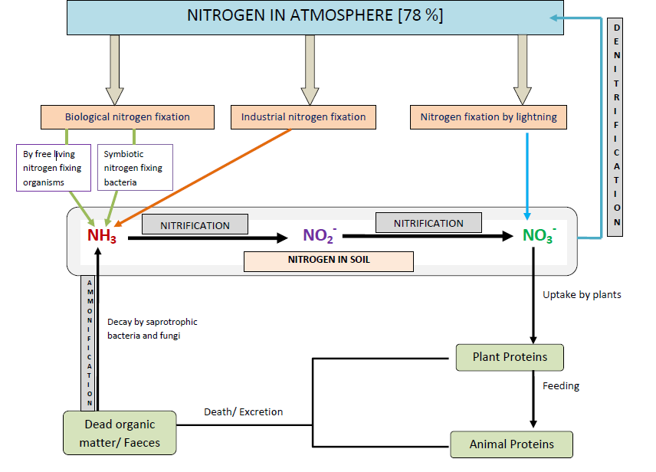
abiotic reservoir:
  N in atmosphere
enter food chain:
  nitrogen fixation by soil & aquatic bacteria
recycle:
  decomposing & nitrifying bacteria
return to abiotic:
  denitrifying bacteria

Slide 38
Remember the following
Nitrogen fixation
Ammonification
Nitrification
Denitrification

Slide 39
Discuss the effects of the combustion of fossil fuels and the cutting down of forests on the oxygen and carbon dioxide concentrations in the atmosphere
Photosynthesis
Carbon dioxide + Water
Glucose + Oxygen
Respiration, combustion
Processes that change the equilibrium :
  Cutting down forest (Deforestation)
  Combustion of fossil fuel (Coal, oil and gas)
  Increasing numbers of animals (respiration)
An increase in CO2 levels: global warming.
  Melts polar caps, causing flooding of low lying land
  Change weather conditions in some countries.
  Cause the extinction of some species (higher temperatures)

