Slide 1
Unit-5

Slide 2
4. Population size : objectives
Core
Define population as a group of organisms of one species, living in the same area at the same time.
State the factors affecting the rate of population growth for a population of an organism (limited to food supply, predation and disease), and describe their importance .Identify the lag, exponential (log), stationary and death phases in the sigmoid population growth curve for a population growing in an environment with limited resources
Describe the increase in human population size and its social implications
Interpret graphs and diagrams of human population growth.
Supplement
Explain the factors that lead to the lag phase, exponential (log) phase and stationary phase in the sigmoid curve of population growth making reference, where appropriate, to the role of limiting factor

Slide 3
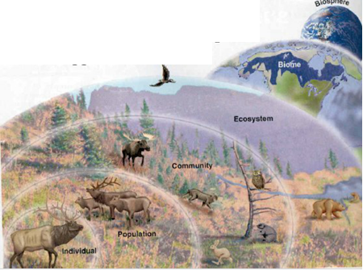
Define the term population…?
Population as a group of organisms of one species, living in the same area at the same time.
All the individuals in a populations may interbreed and produce fertile offspring.

Slide 4
Define the term population…?
Some species individuals are very widely distributed and it is difficult to divide them into separate populations.
These are divided into separate populations due to reproductive barrier such as rivers and mountains.

Slide 5
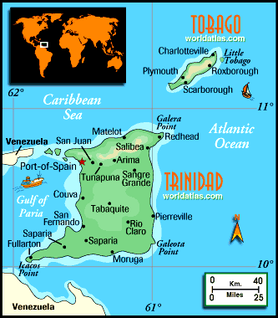
Populations: Creole wrasse Habitat: Coral reef Place: Reefs around Tobago in the Caribbean

Slide 6
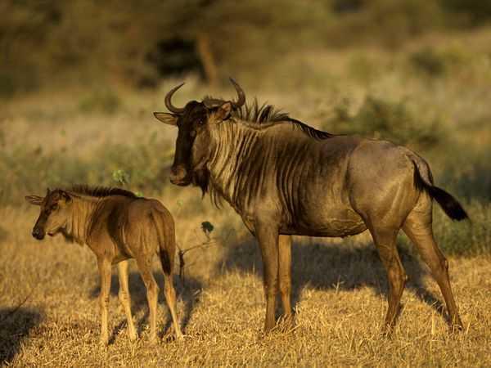
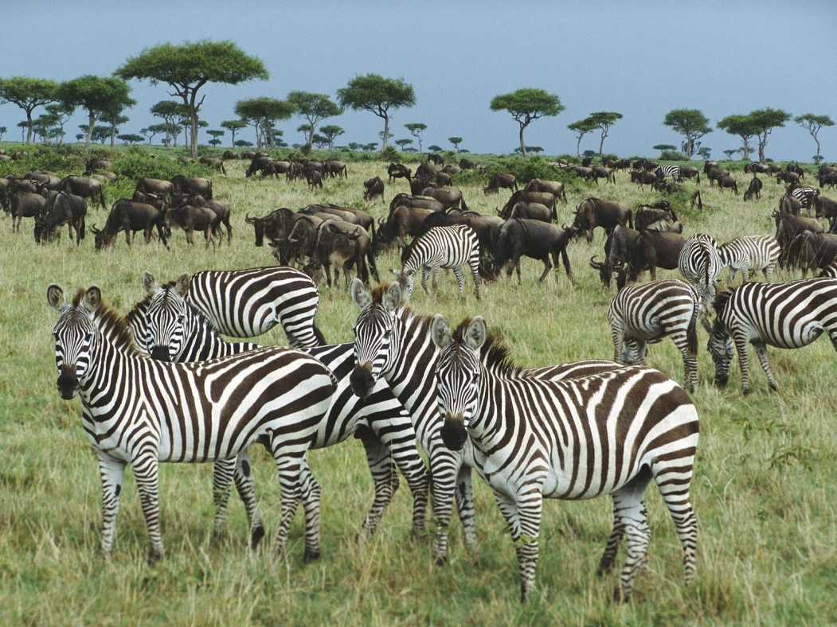
Populations: Wildebeest And Zebras Habitat: Grassland Place: East Africa (Game park)

Slide 7
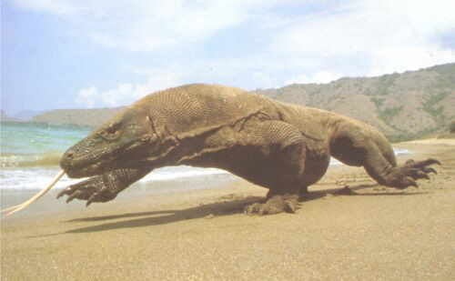
Populations: komodo dragon Habitat: Dry grassland and forest Place: Komodo island in Indonesia

Slide 8
Populations: Nepenthes rajah( Carnivorous plant) Habitat: Mountain forest Place: Mount Kinabalu in Malaysia

Slide 9
Population size

Slide 10
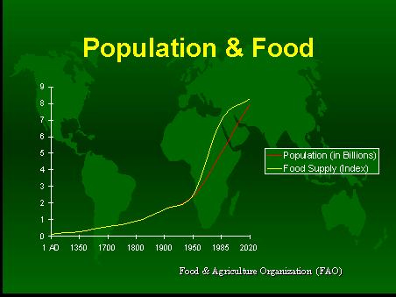
Factors that affect the rate of population growth are….?
Food supply:
Ample food will enable organisms to breed more successfully to produce more offspring.
Shortage of food can result in death or emigration reducing the population.

Slide 11
Factors that affect the rate of population growth are….?
Predation:
Heavy predation of a population will drop the number of organisms eaten.
As predator numbers increase, prey numbers drop and as predators numbers drop, prey numbers rise.

Slide 12
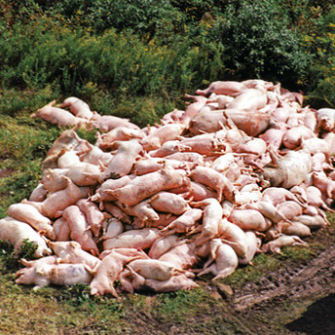
Factors that affect the rate of population growth are….?
Diseases:
Epidemics can reduce population sizes very rapidly.

Slide 13
Population growth ……?
What will happen if a population grows in the presence of any limiting factor/s.
What will happen if a population grows in the absence of limiting factors.

Slide 14
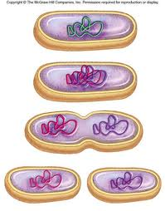
Bacterial growth
What effect will you find on population growth if there is any limiting factor/s exist.

Slide 15
Identify the lag, exponential (log), stationary and death phases in the sigmoid population growth curve for a population growing in an environment with limited resources.
Lag phase:
new population takes time to settle and mature before breeding season.
Log phase:
No limiting factors will allow rapid breeding that result into significant increase in population.
Stationary phase:
Limiting factor such as shortage of food, reproduction rate down, more death.

Slide 16
b) What will happen if a population grow in the absence of limiting factors.
Is this pattern match with human population growth……..?

Slide 17
Describe the increase in human population size
http://www.ined.fr/en/everything_about_population/animations/world_population/
Find out the nature of curve and reasons of it…?

Slide 18
Describe the increase in human population size
Improvement in food supply
Development of medicine to control diseases.
Infant mortality has decreased
Increased life expectancy

Slide 19
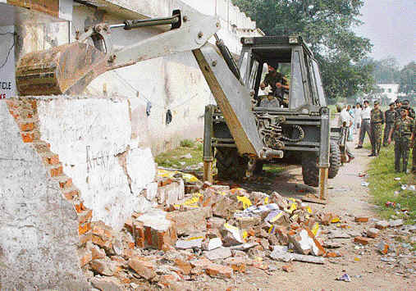
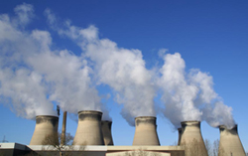
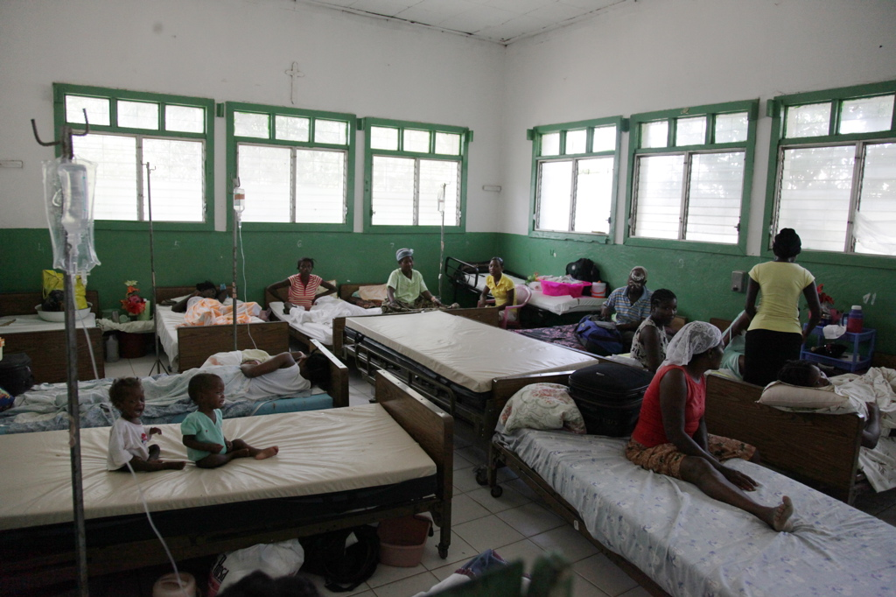
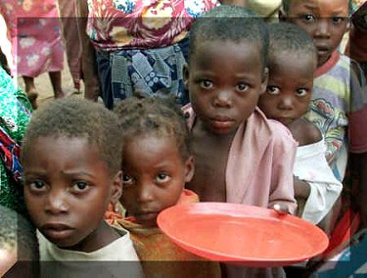
Human population size and its social implications
Increasing demands for basic resources like
Food
Water
Space
Medical care
Fossil fuels
Greater pressure on environment leads to pollution.

Slide 20
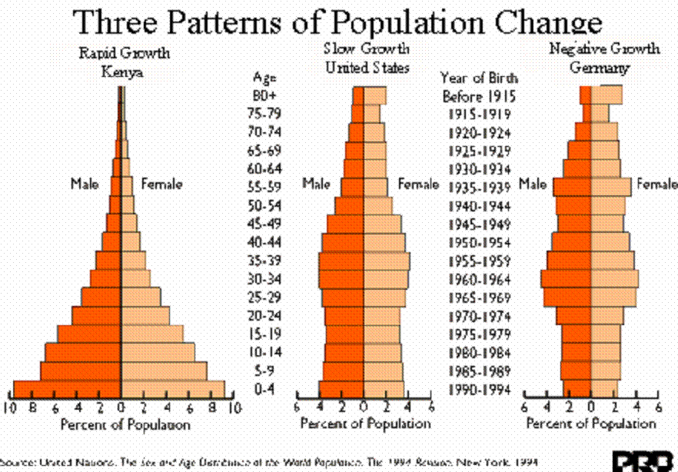
Interpret graphs and diagrams of human population growth.
http://www.ined.fr/en/everything_about_population/animations/age_pyramid/

Slide 21
Checks on population increase
Competition:
Predation:
Diseases:
Famine
War
Epidemics
Flood
Tsunami
Earthquakes

