Slide 1
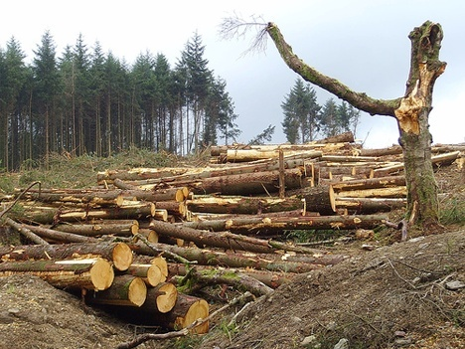
5. Human influences on the ecosystem

Slide 2
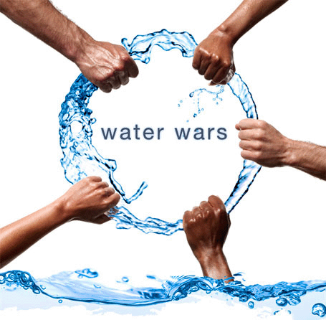
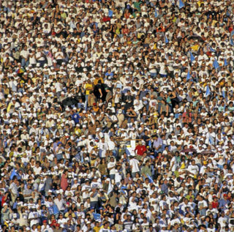
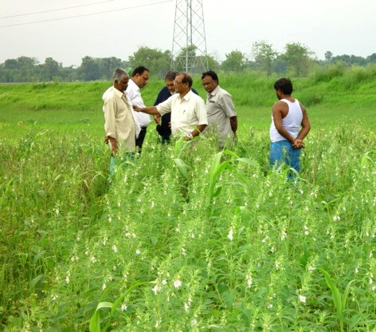
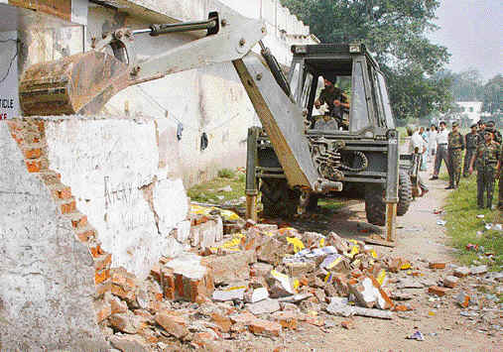
Social implication of increase in the world population
Population explosion
Resources affected on planet …..?

Slide 3
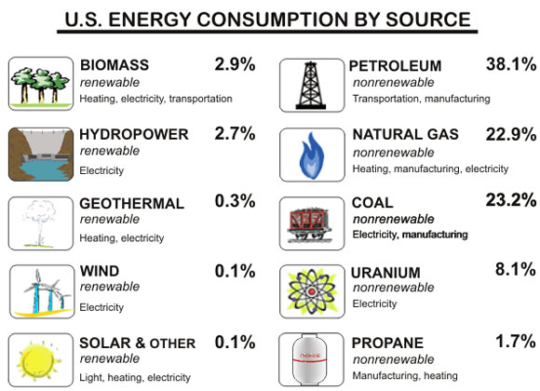
Renewable and non renewable resources
Renewable resources:
Non- renewable resources:

Slide 4
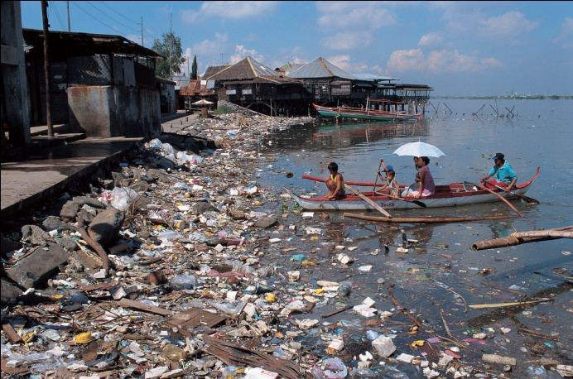
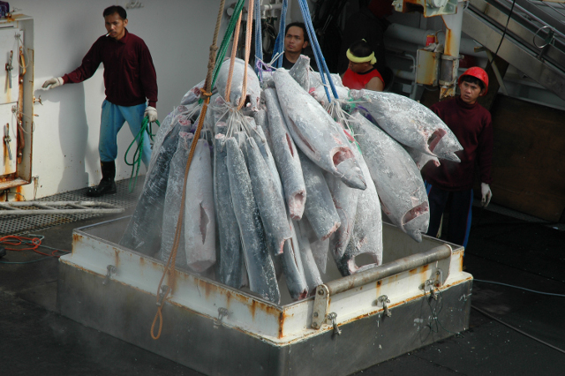
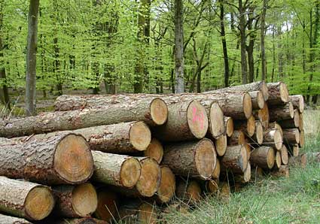
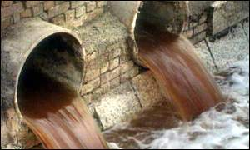
Outline the effects of humans activities on ecosystem (tropical rain forests, oceans and important rivers)
The oceans have been overfished, reducing fish stocks considerably.
Toxic waste has been dumped into the oceans.
Rivers are used to disposal of waste.
Forests are felled for timber and for growing crops.

Slide 5
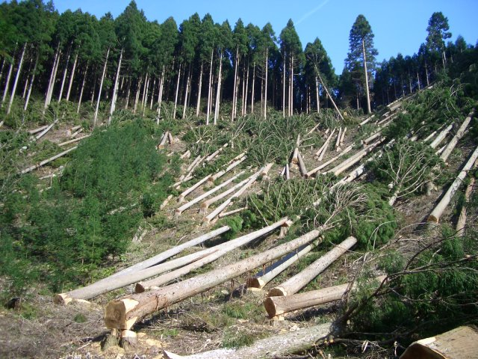
DEFORESTATION
What do you mean by deforestation…?
Removal of large forest area.
What are the reasons of deforestation…?
For timber requirement
Paper for different purposes.
Land for farms, cattle ranches
Land for road, town and factories
Firewood and charcoal as fuels

Slide 6
List the undesirable effects of deforestation
Soil erosion in tropical rain forest.
Local weather pattern change
Flooding
Destruction of rainforest means the loss of many habitats and the extinction of species.
Carbon dioxide build up.
Leaching of nutrients can lead to eutrophication.
Less CO2 is absorbed from atmosphere, increasing the green house effect.
Less transpiration can lead to reduced rainfall.

Slide 7
5.2 Pollution
Core
Describe the undesirable effects of pollution to include:
water pollution by sewage and chemical waste
air pollution by sulfur dioxide
air pollution by greenhouse gases (carbon dioxide and methane) contributing to global warming
pollution due to pesticides and herbicides
pollution due to nuclear fall-out
Supplement
Discuss the effects of non-biodegradable plastics in the environment
Discuss the causes and effects on the environment of acid rain, and the measures that might be taken to reduce its incidence
Explain how increases in greenhouse gases (carbon dioxide and methane) are thought to cause global warming

Slide 8
Pollution
Pollution is the harm done to the environment by the release of substances produced by human activities.
Air pollution
Water pollution
Soil pollution
Nuclear fall out
Noise pollution

Slide 9
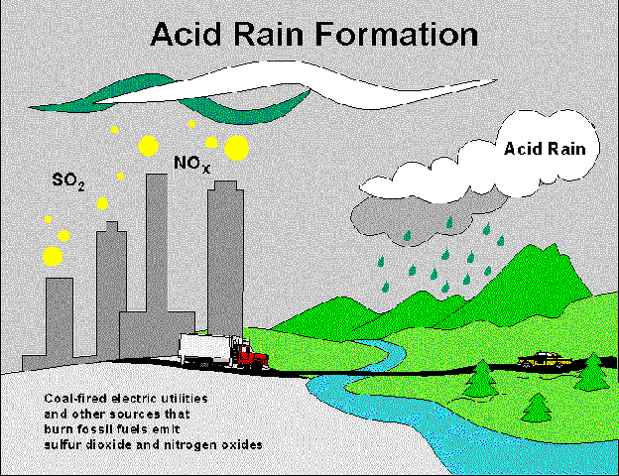
Air pollution by sulfur dioxide
Sulphur dioxide is released due to burning of coal and oil (Fossil fuel)

Slide 10
Air pollution by sulfur dioxide
Causes:
Combustion of fossil fuels
Effects:
Damage to plant leaves
Acidification of lakes.
Increased risk of asthma and bronchitis in human.
Corrosion of stone work on buildings.
Soluble plant nutrients can wash out.
In acidic medium aluminum compound becomes soluble, acidifies water body and become toxic to fishes etc.

Slide 11
Discuss the causes and effects on the environment of acid rain, and the measures that might be taken to reduce its incidence.
Main causes of acid rain:
Sulphur dioxide and nitrogen dioxide.
Sources
Burning of fossil fuel by power stations, factories.
Combustion of petrol in car engines (Large NO2, CO2, CO).
Effects : same as mentioned in previous slide
Ways of reduction:
Low sulfur fuel
Using scrubber in power station chimney- removes most of SO2.
Catalytic converter : can be use in car exhausts which convert oxides of nitrogen to harmless nitrogen.

Slide 12
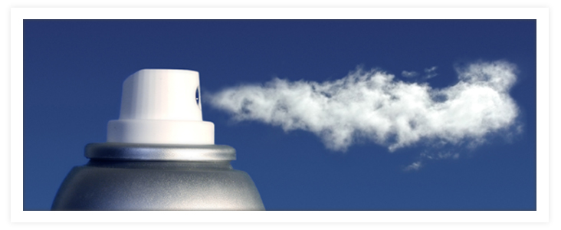
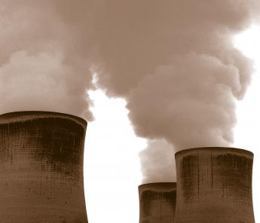
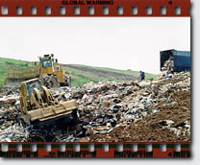
Air pollution by greenhouse gases (carbon dioxide and methane)
What do you mean by green house gases?
The gases which present in atmosphere act like a green house to keep in heat that radiated into space.
Green hose gases
Carbon dioxide
Water vapour
Methane
CFC (Man made air pollutants)

Slide 13
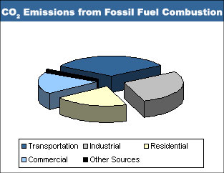
Air pollution by greenhouse gases : Carbon dioxide & Methane
Increasing in amount carbon dioxide:
Power station, factories, domestic heating and transport use fossil fuel release huge amount of carbon dioxide.
Deforestation
Decomposer microbes produce more carbon dioxide.

Slide 14
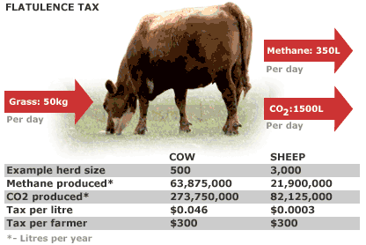
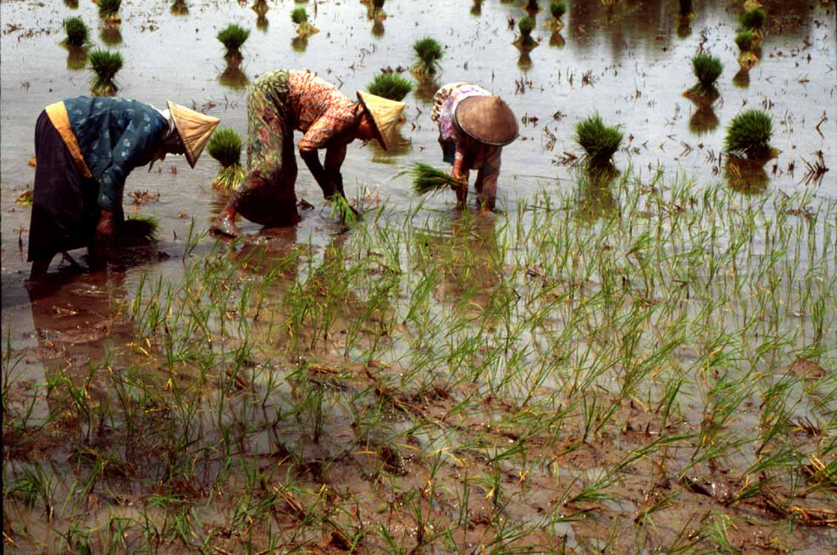
Air pollution by greenhouse gases : Carbon dioxide & Methane
Increasing in amount of methane
Expansion of rice cultivation
Cattle rearing
Rotting of materials in landfills
Extraction of oil and natural gas.
Wetlands and rice fields are two major sources of methane emissions to the atmosphere

Slide 15
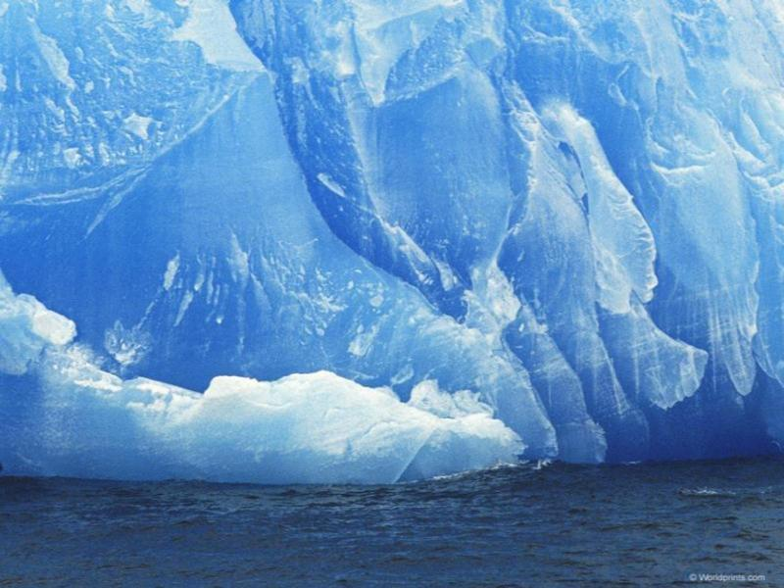
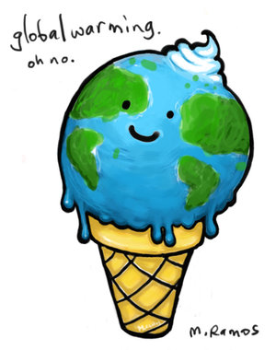
Green house effect
Without green house gases
With more green house gases

Slide 16
Air pollution by greenhouse gases (carbon dioxide and methane) contributing to global warming
What do you mean by global warming…?
Due to human activities there is an increase in concentration of green house gases, which causing enhanced greenhouse effect. This result into global warming.
What are the consequences of global warming?
Rise in sea level
Flooding of low lying areas
Changes in the world’s climate
Reduction in crop production in some areas.
What are the measurement of reduction?
Reduce carbon emission
Use of fossil fuel efficiently.
Change in the diet of cattle.

Slide 17
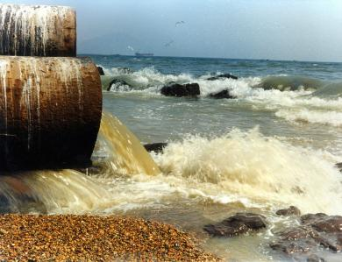
Water pollution
What do you mean by water pollution..?
Any undesirable change in the physical, chemical and biological property of water that make it unfit for human use.
Pollution of river and seas
Domestic and industrial pollutants are often discharged into rivers and into sea.
Rivers empty toxic waste into sea.

Slide 18
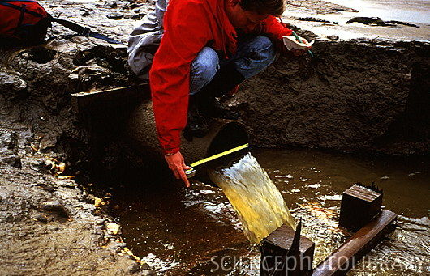
Water pollution by chemical waste
Fertilizers :increases microbes growth
Sewage : Increases microbes growth
Pesticides: concentrated in mollusks.
Radioactive chemicals: higher concentration
Toxic metals (Copper, Lead, Mercury)

Slide 19
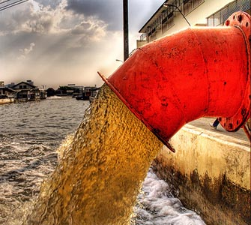
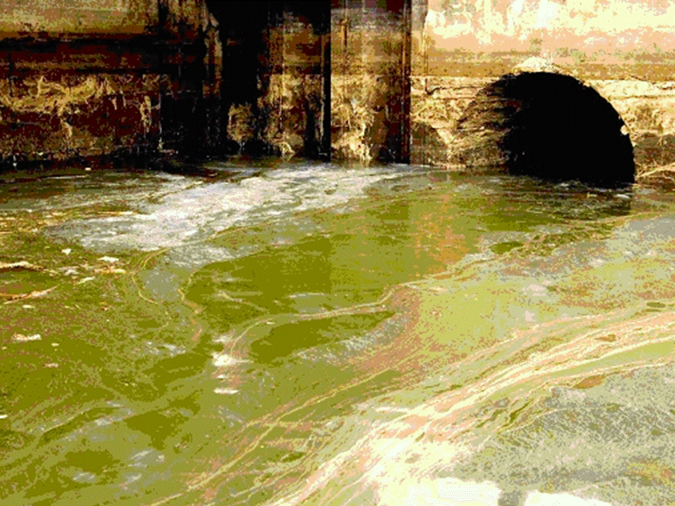
Water pollution by sewage
What is sewage..?
The waste water from domestic, commercial and industrial sources.
Undesirable effects
It encourages the growth of bacteria that feed on organic matter.
Microbes used up lot of oxygen.
Oxygen deficiency kills fishes and small invertebrates

Slide 20
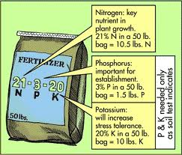
Describe the undesirable effects of overuse of fertilizers (to include eutrophication of lakes and rivers)

Slide 21
Describe the undesirable effects of overuse of fertilizers (to include eutrophication of lakes and rivers)

Slide 22
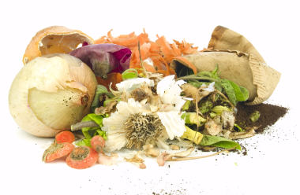
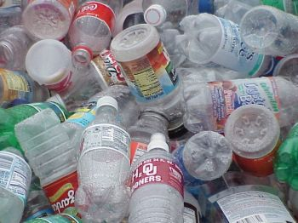
Difference between biodegradable and non biodegradable materials
Biodegradable materials :
The materials which can be broken down in the environment by decomposers.
Non- biodegradable materials:
The materials which can not be broken down in the environment by decomposers.

Slide 23
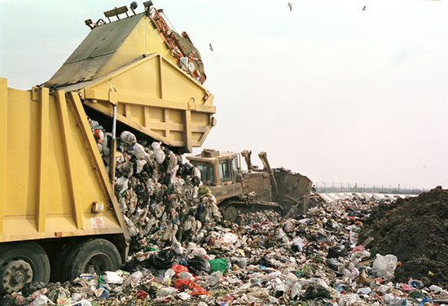
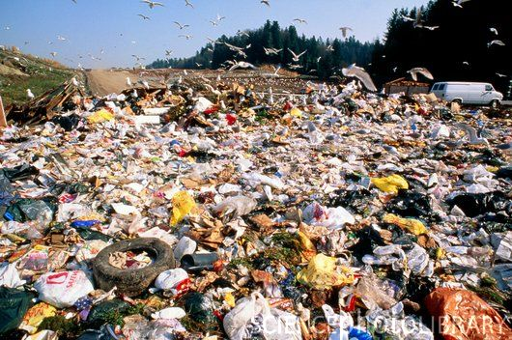
Discuss the effects of non-biodegradable plastics in the environment
Non biodegradable plastic:
Plastic that are non-biodegradable are not broken down by decomposers when dumped in landfill sites.
Sources: Packaging materials, containers, households etc.
Undesirable effects
It remain in the environment and take up lot of valuable space.
Produce toxic gases on burning
Can trap small animals (nylon net and fishing lines)

Slide 24
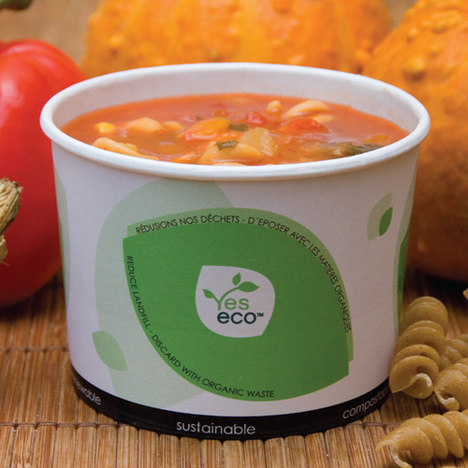
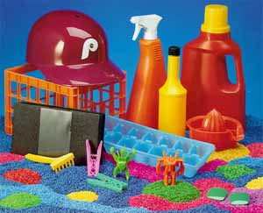
What are the measurement of reduction of non-biodegradable plastics
A) Use of biodegradable plastic:
Plastic are designed in a way that they can decompose very quickly.
starch incorporated into their structure which is digested by bacteria in soil.
B) Use of thermoplastic
- It can be recycle and remould into new shapes.
C) Burning plastic in incinerators
- It reduces the volume of waste.

Slide 25
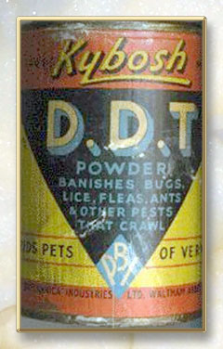
Pollution due to pesticides and herbicides
Insecticide:
Chemicals used to kills insect pests.
Example: DDT, DDD
DDT has been a very effective insecticide against mosquito that spread malaria.
DDT is very dangerous because it does not break down for a long time and remains in animals.

Slide 26
Pollution due to pesticides : Bioaccumulation

Slide 27
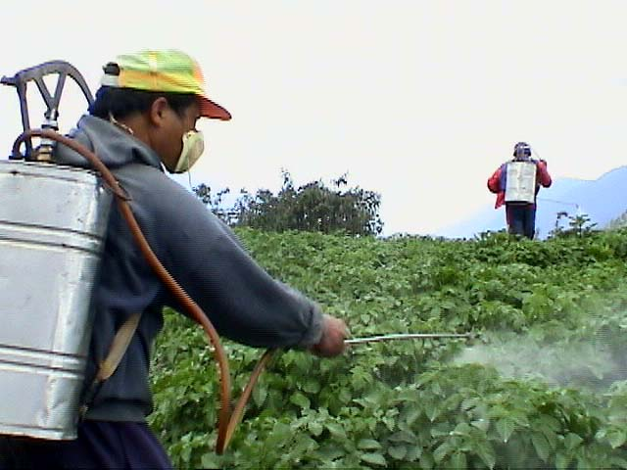
Pollution due to herbicides
Herbicides
Chemicals used to kill weeds in a crop.
May kill rare wild plant.
May be harmful for farmers.

Slide 28
Pollution due to nuclear fall-out
Fallout is the residual radioactive material propelled into the upper atmosphere following a nuclear blast.
Human produced radiation comes from testing and use of nuclear weapons and leakage from nuclear reactor.
Certain atoms are unstable and release alpha, beta particles and gamma rays.

Slide 29
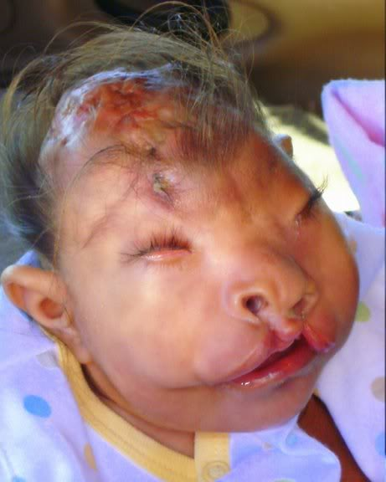
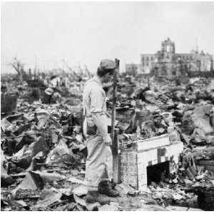
Pollution due to nuclear fall-out
Safe disposal of radioactive nuclear waste is a major problem and potential threat to environment.
Radiation infers: cell division and growth and cause mutation
1945

Slide 30
5.3 Conservation
Core
Describe the need for conservation of:
species and their habitats
natural resources (limited to water and nonrenewable materials including fossil fuels)
Supplement
Explain how limited and non-renewable resources can be recycled (including recycling of paper and treatment of sewage to make the water that it contains safe to return to the environment or for human use)

Slide 31
Needs of conservation of species : Reasons
Many species of plants and animals are in danger of extinction due to factors such as
- Habitat destruction
- Introduction of other species
- International trade and pollution
Loss of genetic variability.
Species may be a important in a food chain.

Slide 32
Needs of conservation of habitat : Reasons
Habitat and ecosystem provide us with services such as
Treating waste
Providing food and fuels
Areas for recreation
Provide us useful substances such as medicines.
Maintains balance of life on the planet ( nutrient cycle)

Slide 33
Methods of conservation of habitat
National parks
Marine park
Breeding programs
Botanical garden
Zoological garden
Reduction in habitat destruction
Using laws to protect the habitat
Encouraging sustainable management of ecosystem
Seed banks
Economic use of natural resources.

Slide 35
Sewage treatment and recycling
Sewage:
Sewage is made up of various materials like faeces, urine, domestic waste, industrial waste etc.
Sewage treatment: in three stages
Primary treatment
Secondary treatment
Tertiary treatment

Slide 36
Sewage treatment and recycling
Sewage treatment: in three stages
Primary treatment
Involves removing of large solids, like paper and twigs by means of filters or screens.
Suspended grit allowed to settle out by gravity in grit settling tank.

Slide 37
Sewage treatment and recycling
Sewage treatment: in three stages
b) Secondary treatment (involves microbes)
Activated sludge process : air is pumped through the sewage with a community of bacteria, fungi and protists.
Trickle filters: beds of gravel covered with microbes, as the liquid trickles down, the microbes breakdown the organic matter.

Slide 38
Sewage treatment and recycling
Sewage treatment in three stages:
C) Tertiary treatment (involves period of settling)
Liquid from the secondary process is passed to large tanks.
Organic matter is allowed to settle out by gravity in sludge-settling tank.
This sludge is used as fertilizer after digestion in a sludge digester.
Water leaving out is then treated with chlorine to make it safe.

Slide 39
Recycling our waste
Consequence of increasing population is production of waste.
Improper disposal can cause pollution, harming organisms.
Dumping wastes in landfills can deprive plants and animals of their habitat.
The solution to conserving useful materials is to recycle them.

Slide 40
Recycling our waste
Materials that can be recycled-
Glass, metals, paper and plastics.
How will this help?
Saves raw materials, large quantities need not be produced.
Paper is made from wood- hence is a limited resource.
If it is collected and recycled then less of paper pulp from trees is required.

Slide 41
Web- links
http://www.mhhe.com/biosci/pae/environmentalscience/enger8e/interexplor/chap15.htm

