Slide 1
REPRODUCTION IN LIVING ORGANISMS

Slide 2
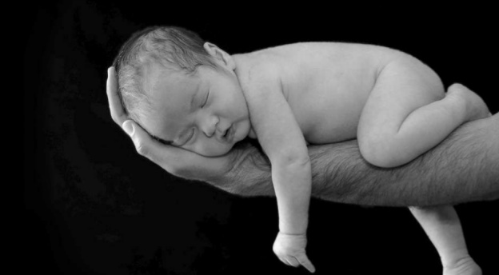
All living organisms show reproduction.
Reproduction: Reproduction is defined as a biological process that make more of the same kind of organisms- new individuals.

Slide 3
TYPES OF REPRODUCTION
ASEXUAL REPRODUCTION
SEXUAL REPRODUCTION
ASEXUAL REPRODUCTION
It involves one parent only.
The offspring are genetically identical to their parent
No specialized cells like gametes are produced.
Large number of organisms produced in a very short time.
Definition: Asexual reproduction can be defined as the process resulting in the production of genetically identical offspring from one parent

Slide 4
Asexual reproduction:
1_Asexual reproduction in bacteria

Slide 5
Asexual reproduction:
2_ Spore production in fungi
Hypha grows upwards.
Tip of hypha swells to form sporangium;
In sporangium nuclei divide (by mitosis); spores form;
Sporangium opens and spores are released .

Slide 6
Asexual reproduction:
3_ Tuber formation in potatoes
Stem grows underground;
Sucrose transported to stem from leaves;
Sucrose converted to starch;
Stem swells and form tuber.

Slide 7
Asexual reproduction: Advantages
The process is quick.
Only one parent is needed.
No gametes are needed.
All the good characteristics of the parent are passed on to the offspring.
When there is no dispersal (eg. potato tubers) offspring will grow in the same favourable environment as the parent.
Asexual reproduction: Disadvantages
There is little variations.
If the parents has no resistance to a particular disease, none of the offspring will have resistance.
Lack of dispersal can lead to competition for nutrients, water and light.

Slide 8
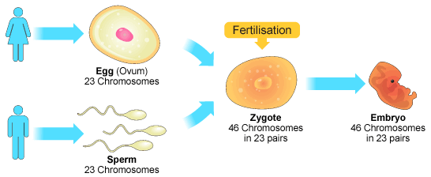
Sexual reproduction
Sexual reproduction is a process involving the fusion of haploid nuclei to form a diploid zygote and the production of genetically dissimilar offspring

Slide 9
Sexual reproduction: Advantages
Offspring shows variations.
New varieties can be developed.
Sexual reproduction: Disadvantages
Two parents needed.
Fertilization is random, so harmful variation can occur.
Very complex process compare to asexual reproduction.

Slide 10
Sexual reproduction in plants
Flowering plants carry out sexual reproduction by producing flowers.
The parts of the flower are arranged in a ring form attached to the end of a swollen stalk.

Slide 11
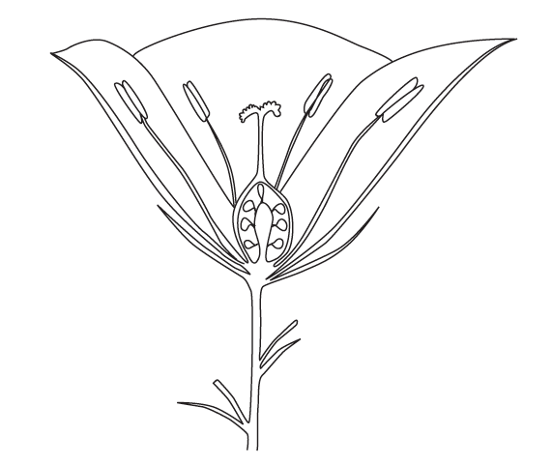
Flower structure and function
Pollen grain is made here
Stigma
Anther
Receive pollen grains
Stamen
Male sex organs
Filament
Style
Holds the anther
Links the stigma to the ovary
Carpel
Petal
Ovary
Female sex organs
Brightly coloured and scented structure
Has ovules that contain female gamete
Sepal
Green leaf-like structure that protect the flower in bud stage
The flowers vary in structure based on the pollination.

Slide 12
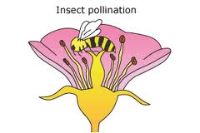
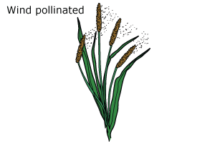
Pollination and it’s agents
Pollination is the transfer of pollen grains from the anther to a stigma of a plant of the same species.
Pollination may be carried out by insects or by the wind.

Slide 13
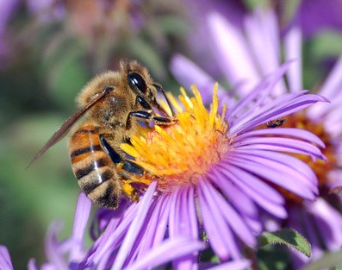
Insect pollinated flowers

Slide 14
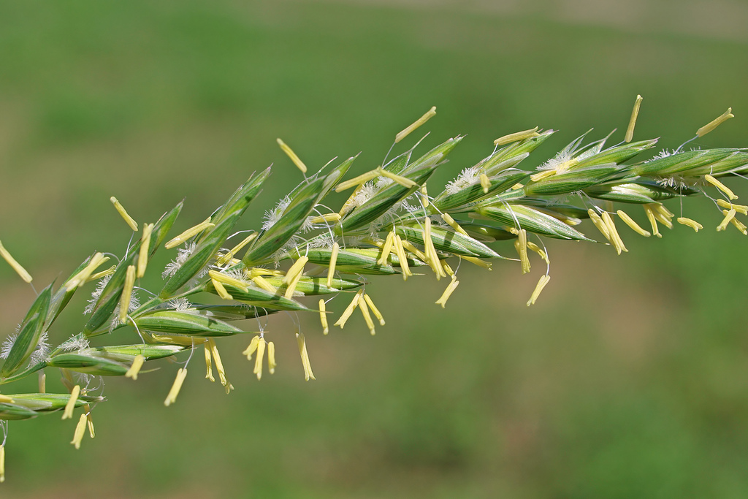
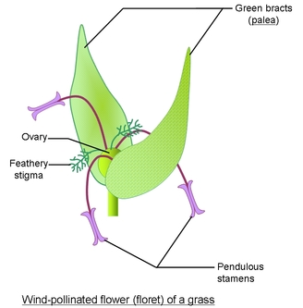
Wind pollinated flowers

Slide 15
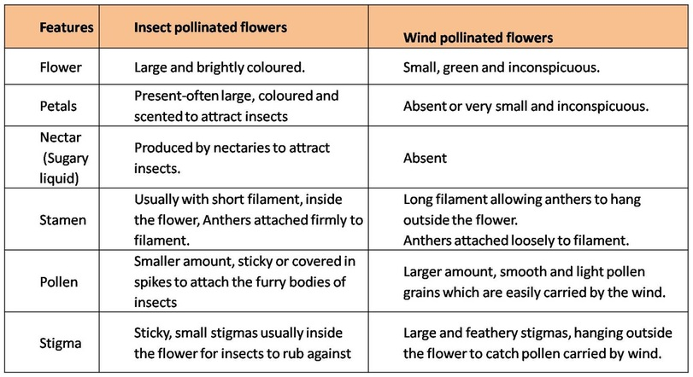
COMPARE THE DIFFERENT STRUCTURAL ADAPTATIONS OF INSECT-POLLINATED & WIND POLLINATED FLOWERS

Slide 16
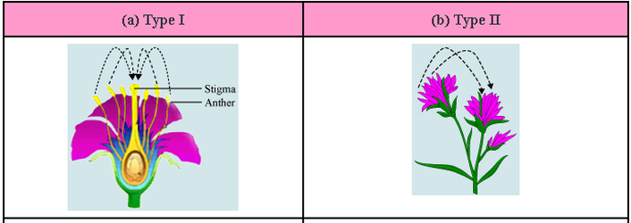
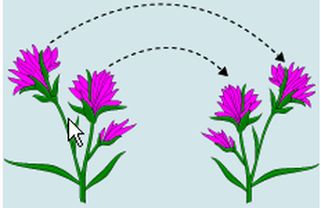
Pollination : Self pollination and cross pollination

Slide 17
Fertilisation :
stigma
style
carpel
ovary
ovule
The fusion of male gamete and female gamete (egg) inside the ovule is called fertilization.
Fertilization results in the formation of zygote

Slide 18
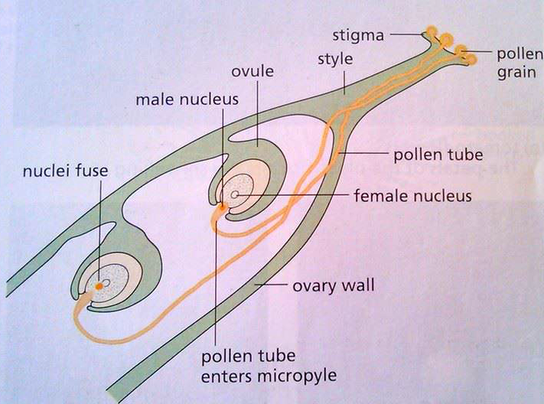

Slide 19
FERTILIZATION
After successfully landing on the stigma of flower of the same species, pollen start to germinate.
Pollen grains absorb sugary solution from the stigma.
Pollen germinates to produce a pollen tube.
The pollen tube grows down the style of the carpel.
Growing pollen tube carry male gametes (Sperm)
The pollen tube complete its growth by entering an opening in the ovule.
The male gamete moves from the tube to fuse with the egg (in ovule)

Slide 20
Describe the events that occur in flowering plants after fertilisation to form a seed.
Fusion of male gamete and female gamete forms zygote.
Zygote divides by mitosis and form embryo.
Embryo consist of radicle and plumule.
Food is stored in the form cotyledons.
The wall of the ovule forms the seed coat (Testa).
After fertilization ovule turns into seed.
Notes:
With the help of diagram .

Slide 21
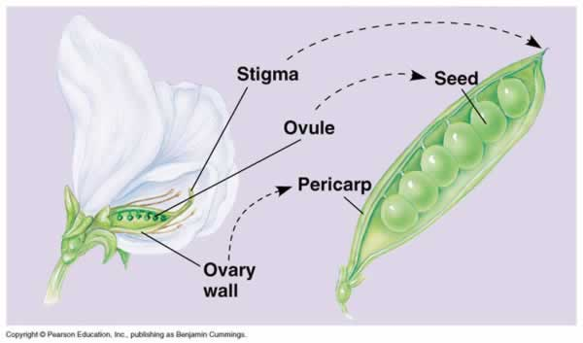
Formation of fruit
After fertilization the ovary wall develops into fruits.
Ovary wall may be fleshy (plum)or dry pod (pea)

Slide 22
FRUITS
SEED
PERICARP
(Around the carpel)

Slide 23
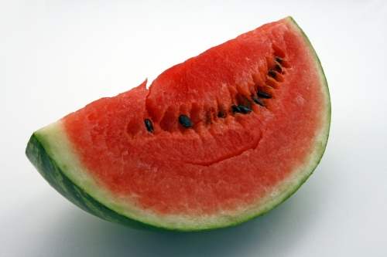
OVARY

Slide 24
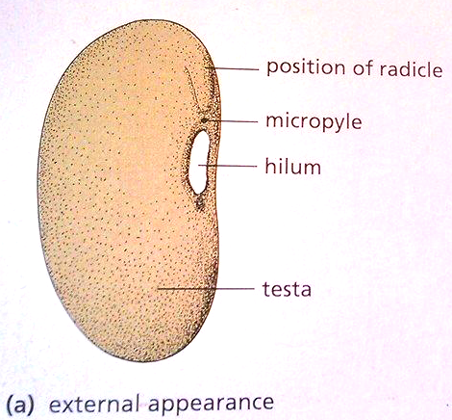
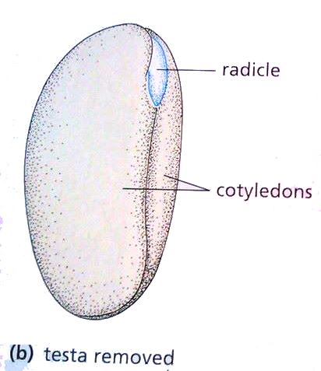
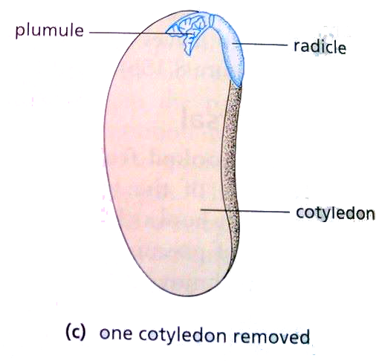
Structure of seed
Investigate and describe the structure of a non-endospermic seed in terms of the embryo (radicle, plumule and cotyledons) and testa, protected by the fruit

Slide 25
Seed coat
Plumule
Radicle
Micropyle
Cotyledon
Dicot seed: Longitudinal section

Slide 26
Seed and fruit dispersal
Seed dispersal is the scattering of the seeds all over the place to colonize the area away from the parent plant.
Seeds need to be dispersed away from the parent plant in order to reduce competition for
Space,
Light,
Nutrients
Water.

Slide 27
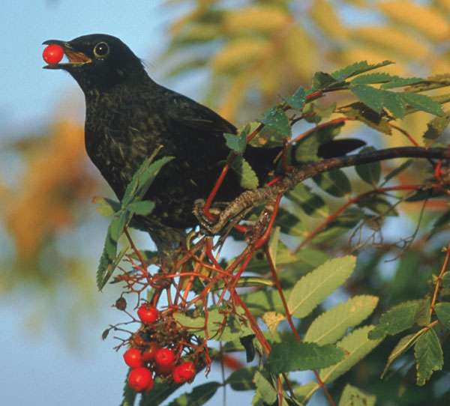
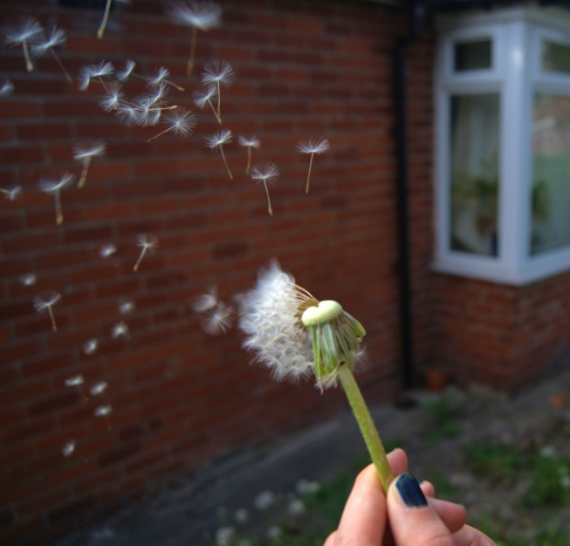
Methods of seed and fruit dispersal
Seeds can be dispersed by:
Wind
Animals
Water
Mechanical

Slide 28
Dispersal by wind
Light weight seeds.
May have a parachute
May have wings.
Examples:
Dandelion
Sycamore

Slide 29
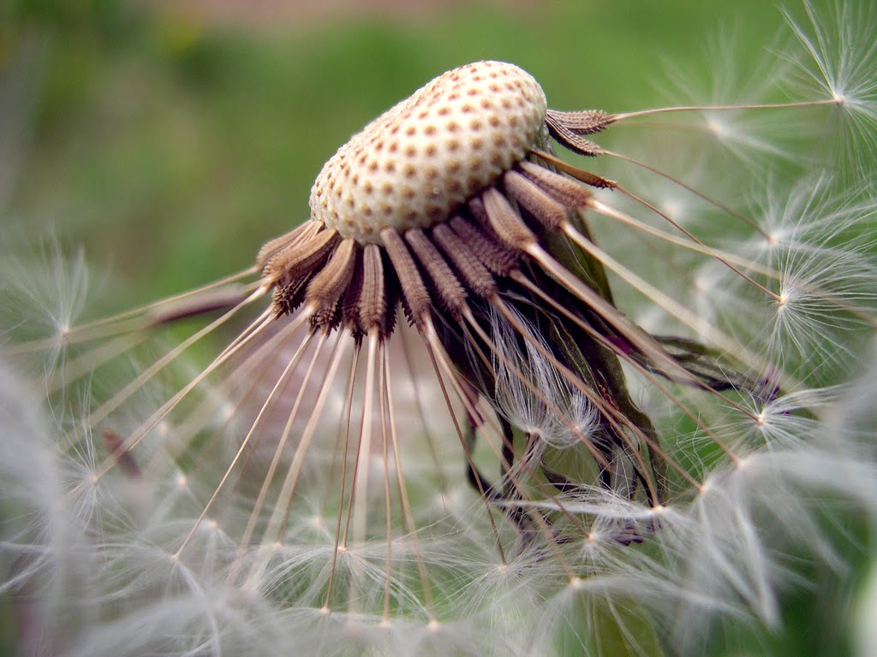
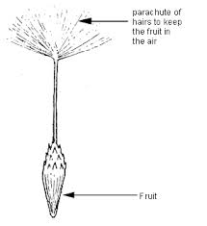
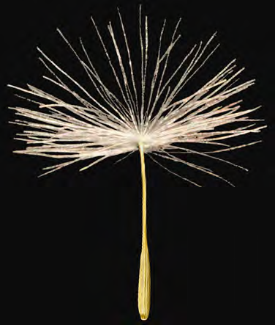
Wind dispersed fruits: Dandelion
The dandelion fruit has a group of fine hairs called a pappus.
It catches the wind and acts like a parachute.
The fruit counterbalance the pappus.

Slide 30
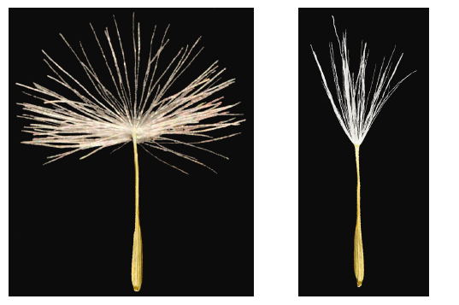

Slide 31
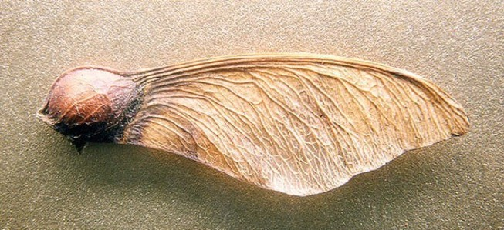
Wind dispersed fruits: Sycamore (Fig mulberry)
Wing formed from ovary wall
Fruit
The sycamore has a wing with a large surface area.
When the fruit drops off the tree it spins, slowing down its descent.
If caught by the wind the seed will be carried away from the parent plant.

Slide 32
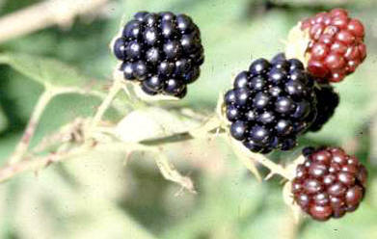
Dispersal by animals : Features
Succulent fruit (Fleshy and bright coloured fruits)
Hooked fruits
Examples:
Berry
Bur
Nuts

Slide 33
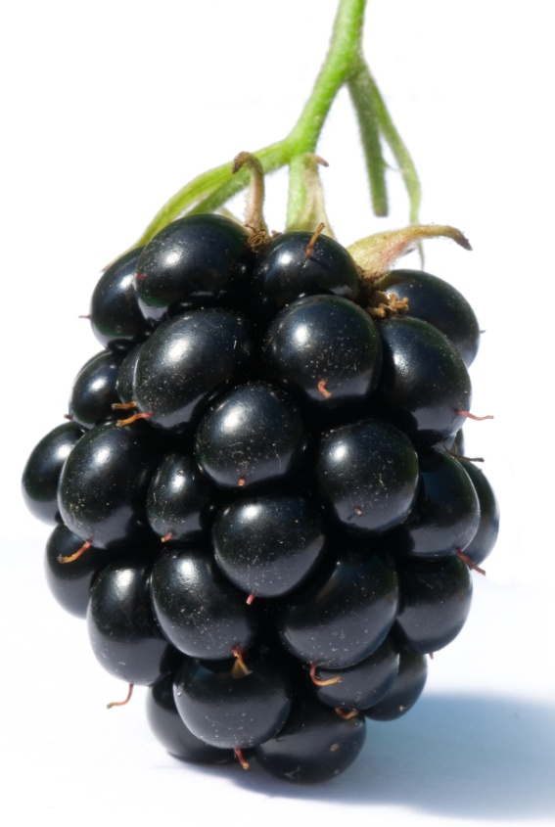
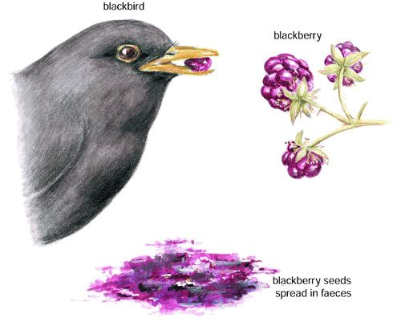
Animal dispersed fruits: succulent fruits
Fleshy fruits are brightly coloured to attract animals, such as birds, monkey and bats.
Tough seed coats protect the seeds from digestion by gut enzymes.
The seeds egested in the faeces, usually miles away from parent plant.

Slide 34
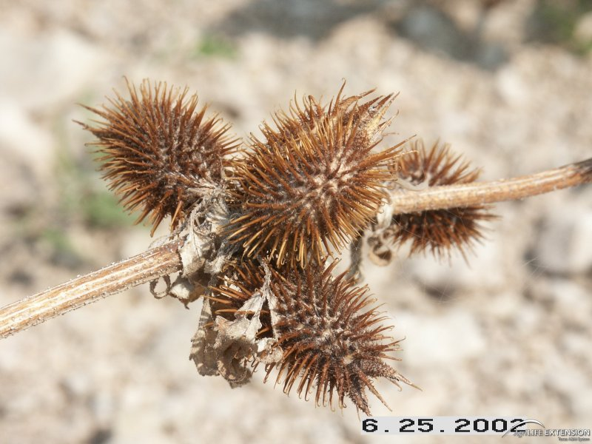
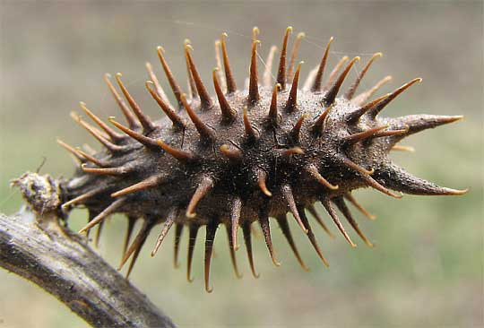
Animal dispersed fruits: Cocklebur
Fruits are covered with stiff, hooked spines, which catch onto animal fur or onto our clothes.
They can be carried a long distance before they drop off.

Slide 35
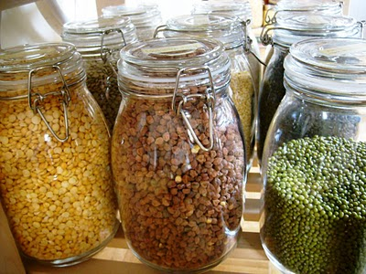
Seed dormancy: Seed dormancy is a condition of plant seeds that prevents germinating under optimal environmental conditions.
Are these seeds
Living/
dead or
dormant .....?

Slide 36
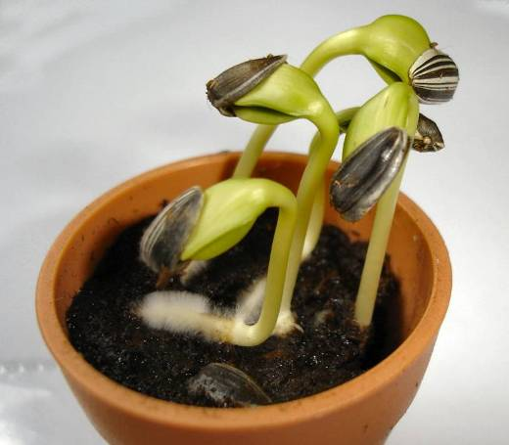
Seed germination
What is seed germination......?
What are the conditions required for the process of seed germination...?

Slide 37
The seed contains the embryo plant and cotyledons (starch stores)
Testa
Water enters the seed through the micropyle and activates enzymes.
The water also softens the testa to allow it to split.
Plumule
(embryo shoot)
Radicle
(embryo root)
Micropyle
Cotyledon

Slide 38
Enzymes are used in seed germination
Plumule
The enzymes break starch down into maltose and then glucose. The glucose is used in respiration to provide energy for growth
starch
amylase
secreted
embryo plant
absorbed
maltose
Radicle
This is the first part to grow out of the seed as it needs to absorb more water

Slide 39
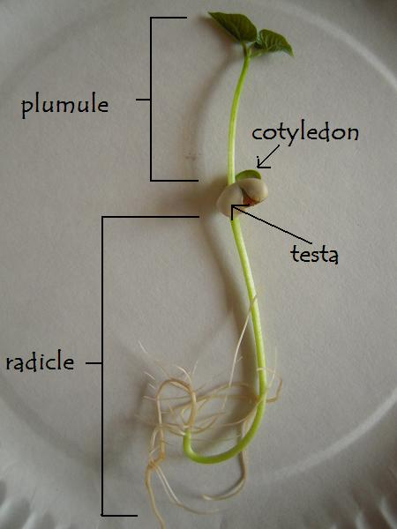
Seedling

Slide 40
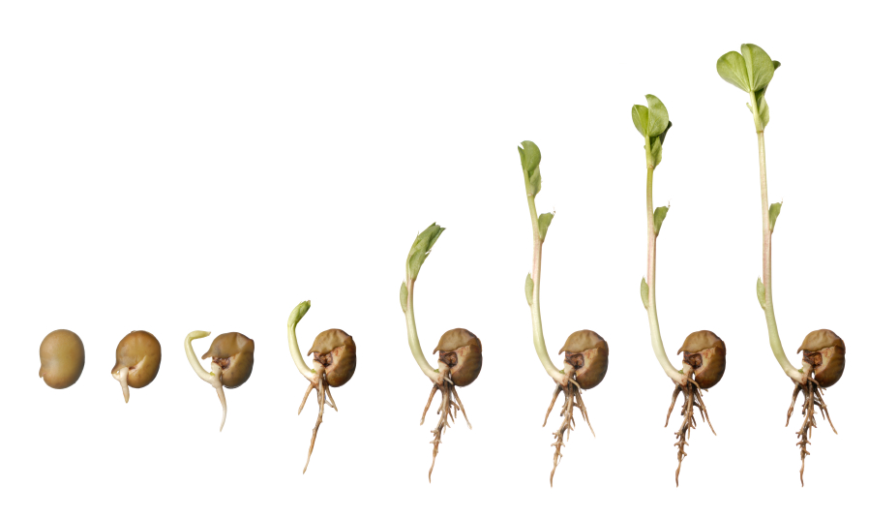
Whilst germinating the plant uses food stores in the cotyledon to provide energy for growth
light
The seedling can now photosynthesise and make its own food
germination
Plant growth and development
soil

Slide 41
Conditions required for germination Summarise the findings of the experiment shown below:
Pyrogallol (absorbs oxygen)
No light
Oxygen present
Oxygen present
Oxygen present
Oxygen present
No oxygen
moist
dry
moist
moist
moist
4ºC
A
Warm
B
Warm
C
Warm
D
Warm
E

Slide 42
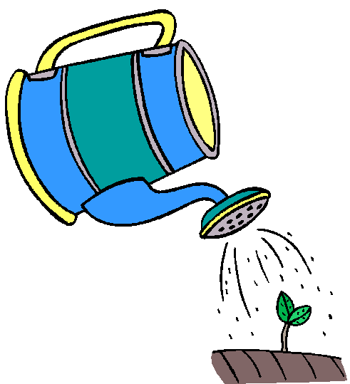
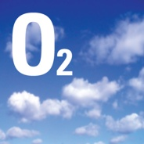
Conditions for seed germination
Water is needed for seed to swell. This swelling breaks the testas of some seeds.
Activate enzymes.
Transport of simple materials to the embryo
Oxygen is needed for aerobic respiration to provide the embryo with energy.
Suitable warm temperature is needed for efficient enzyme action.

Slide 43
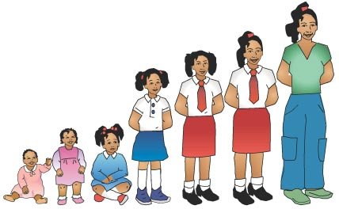
Growth
What do you mean by growth…?
Permanent increase in size and dry mass of an organism, by an increases in cell number or cell size or both.
What are the ways to measure the plant growth….?

Slide 44
Growth
What are the ways to measure the plant growth….?
Wet mass
Dry mass

Slide 45
Changes in dry mass of the germinating seed:
Seed loses weight as it uses up starch stores in the cotyledons as the seedling cannot photosynthesise yet
Dry mass/g
Weight increases as the seedling can photosynthesise and plant grows
Dry mass is the mass of solid matter with all water removed
Days

Slide 46
Development
Development………….?
As the plant and animal grow, the cells of an organism become specialized and the organism becomes more complex. This is termed development.

